Slide 1

Mission: To cultivate, enrich, and support undergraduate students at the University of Texas at Austin by providing resources to refine their artistic skills and producing theatre that is engaging, exhilarating, and daring.

Slide 2

Exit, Pursued by a Bear
By Lauren Gunderson
Directed by Addie Arnold

Slide 3
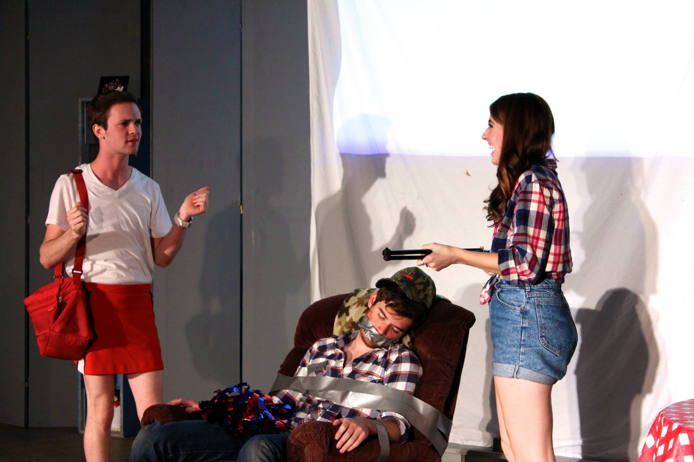

Slide 4
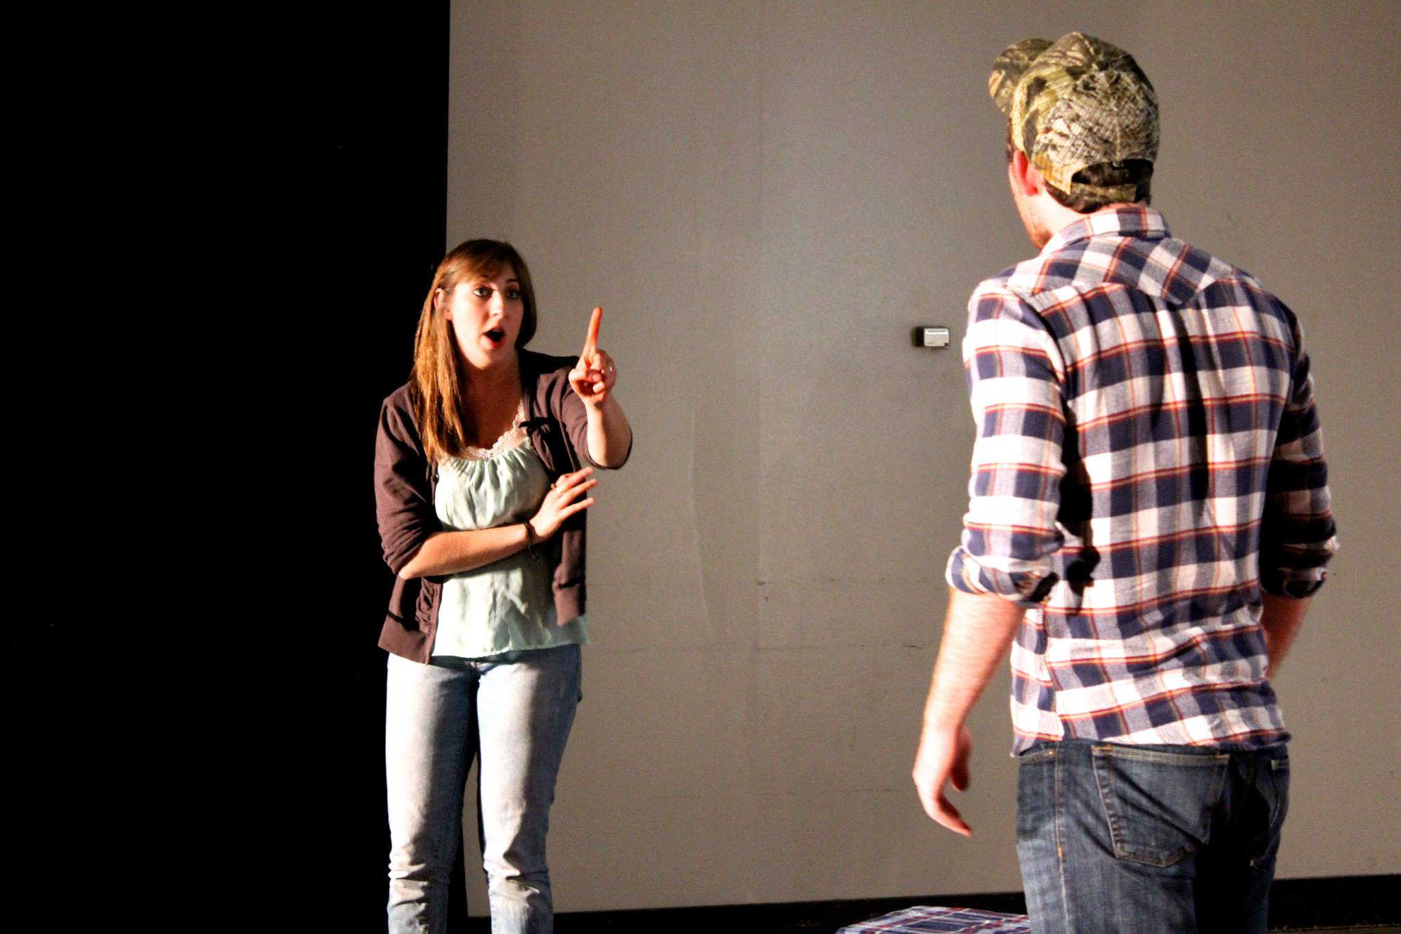

Slide 5
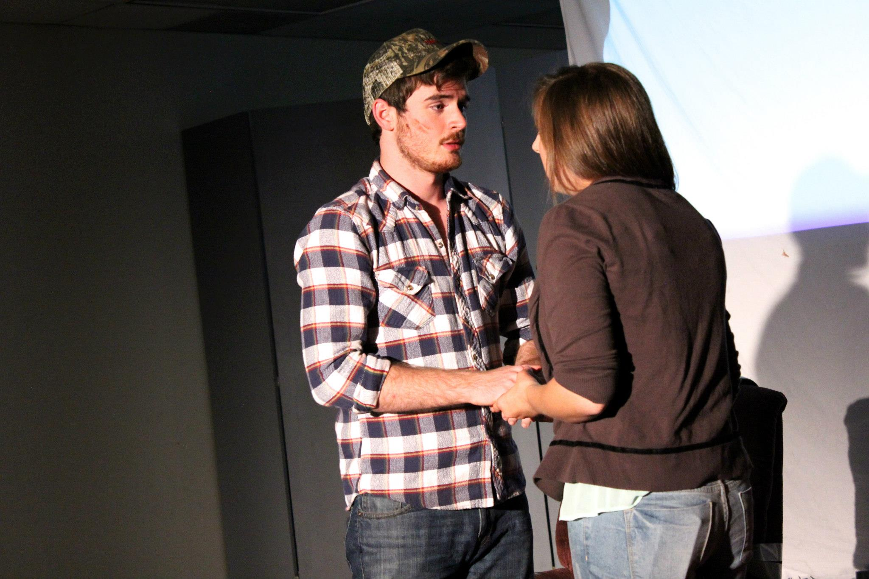

Slide 6
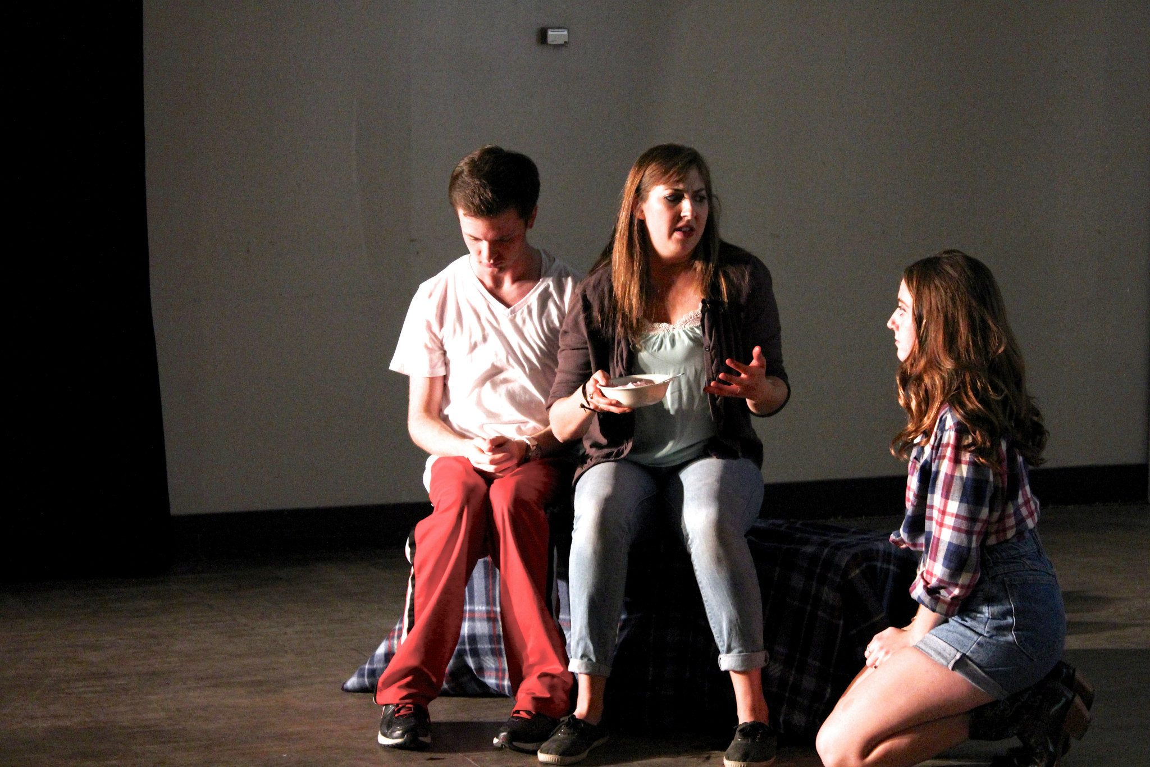

Slide 7
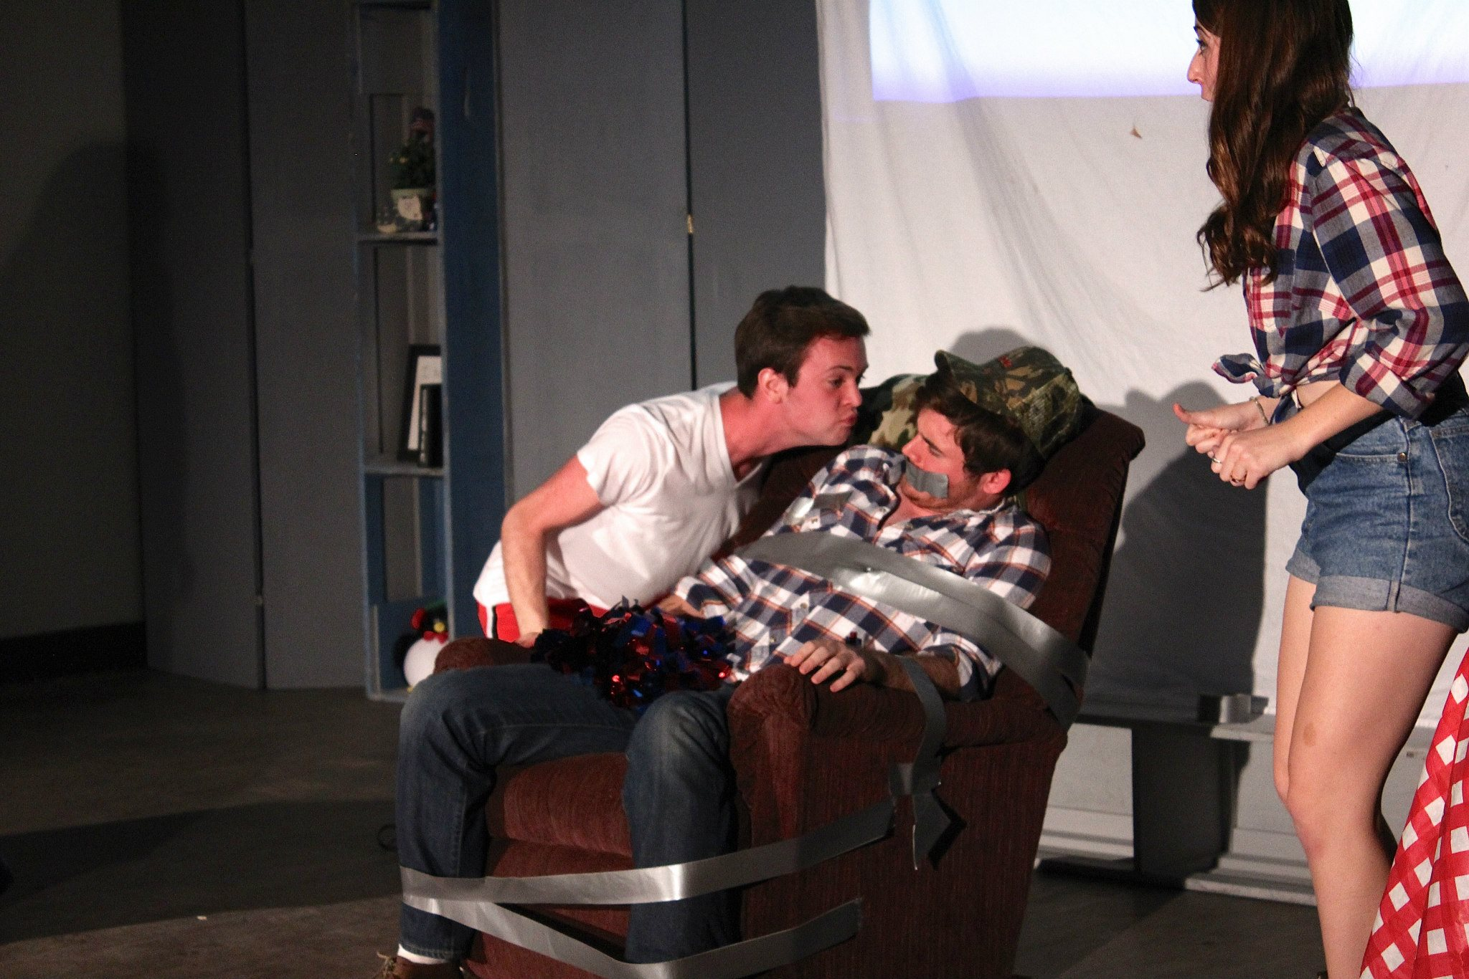

Slide 8
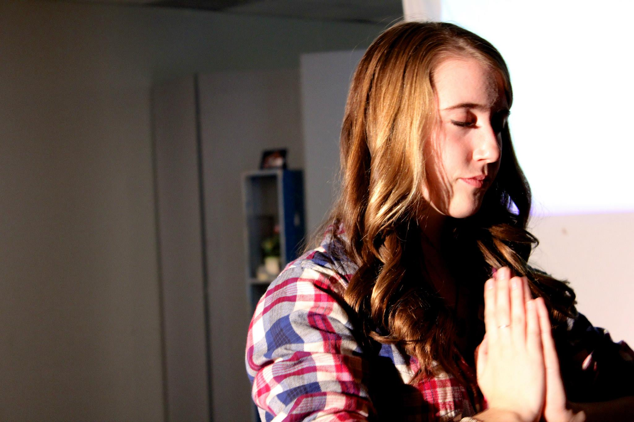

Slide 9
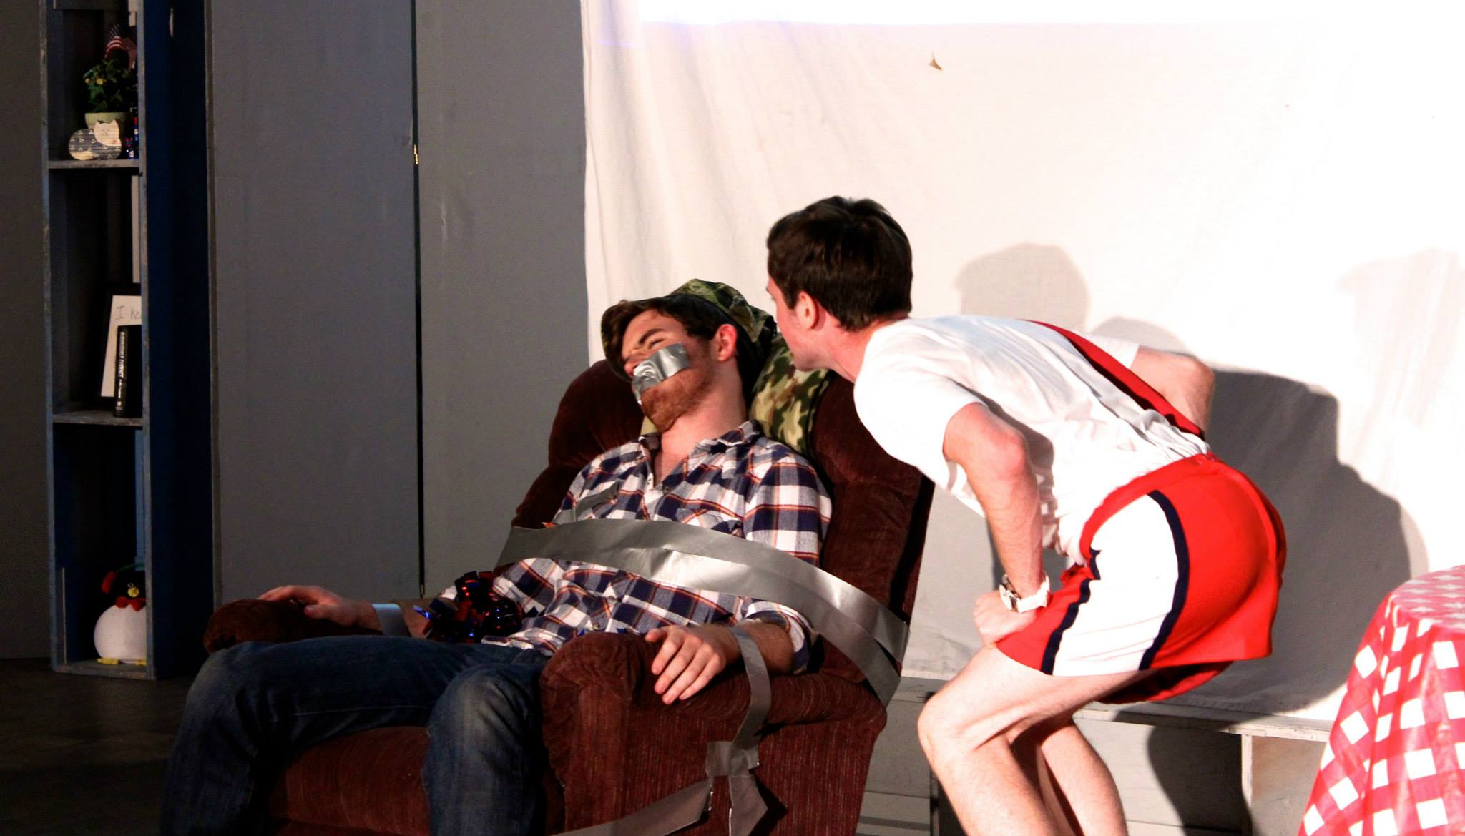

Slide 10
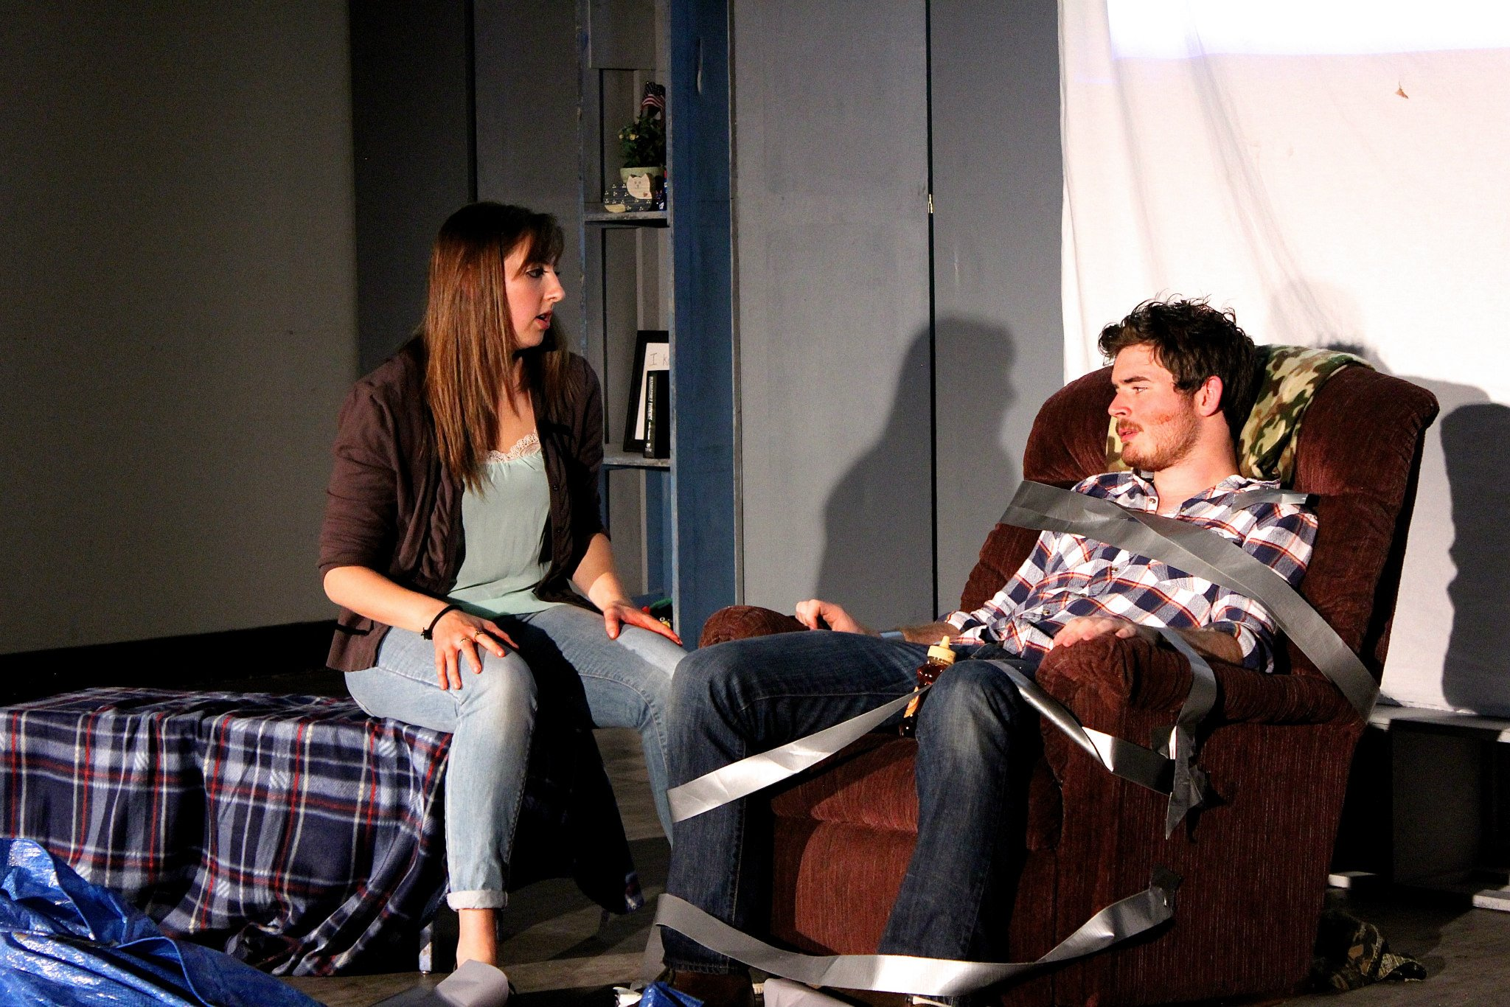

Slide 11
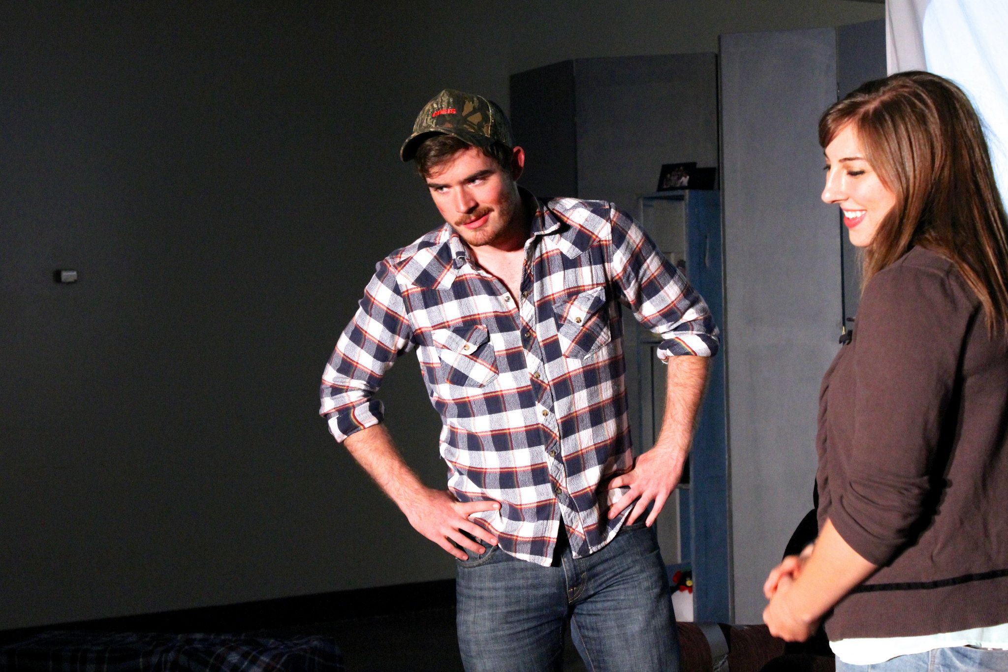

Slide 12
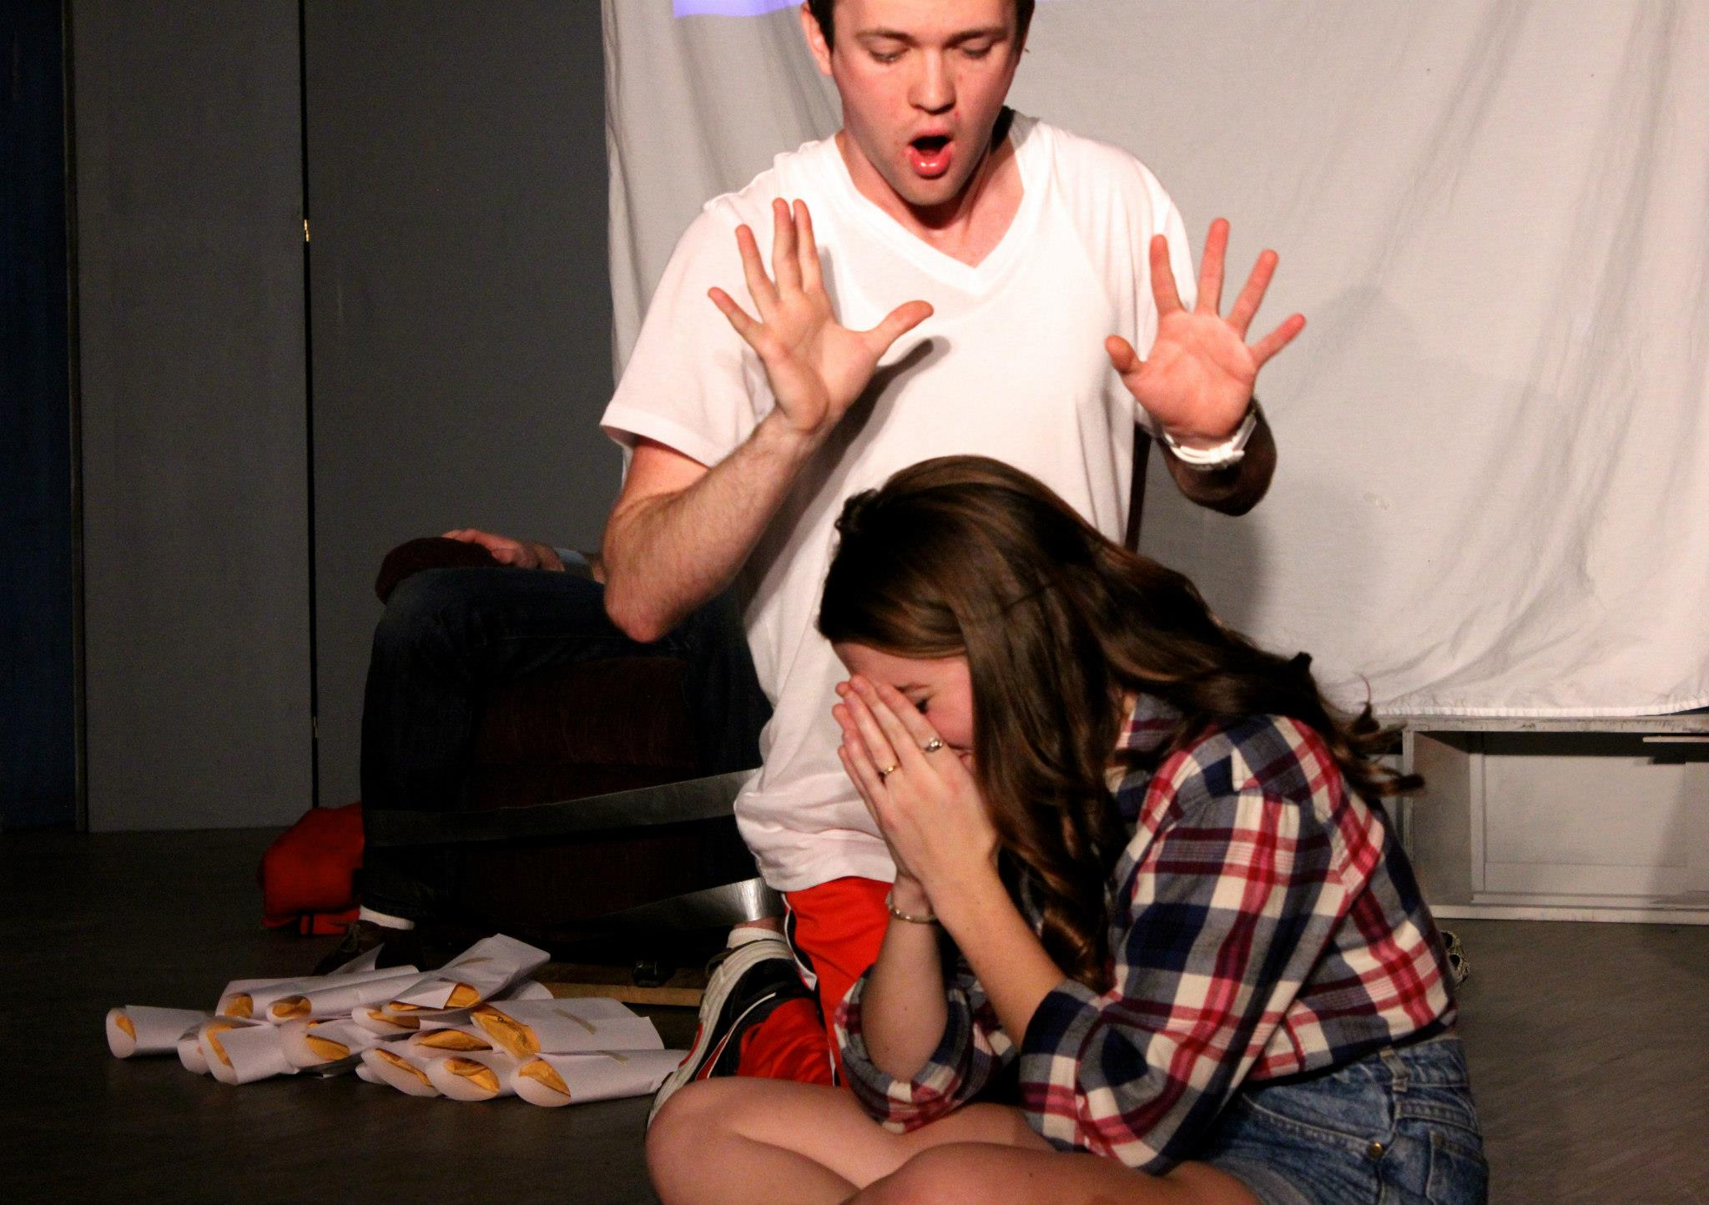

Slide 13
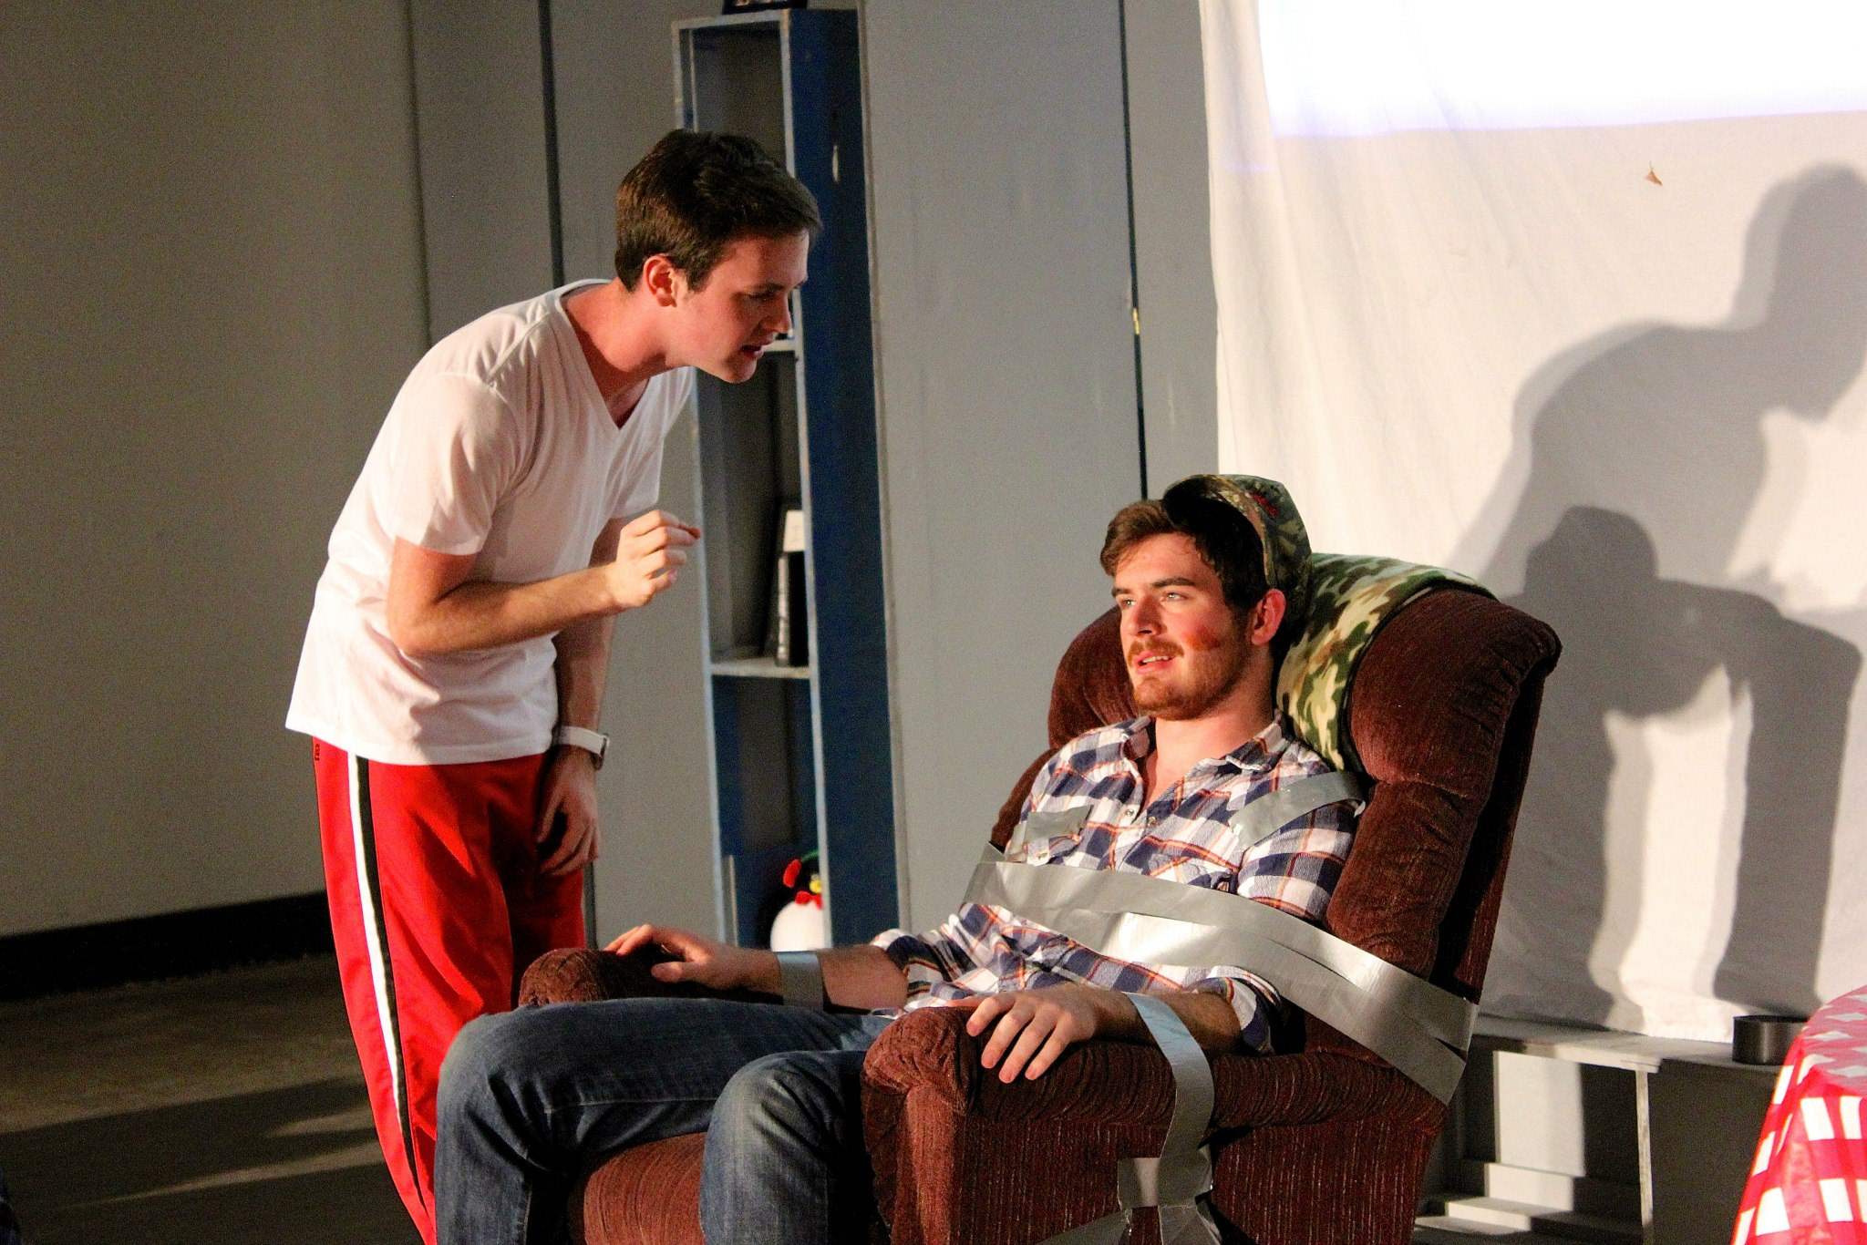

Slide 14
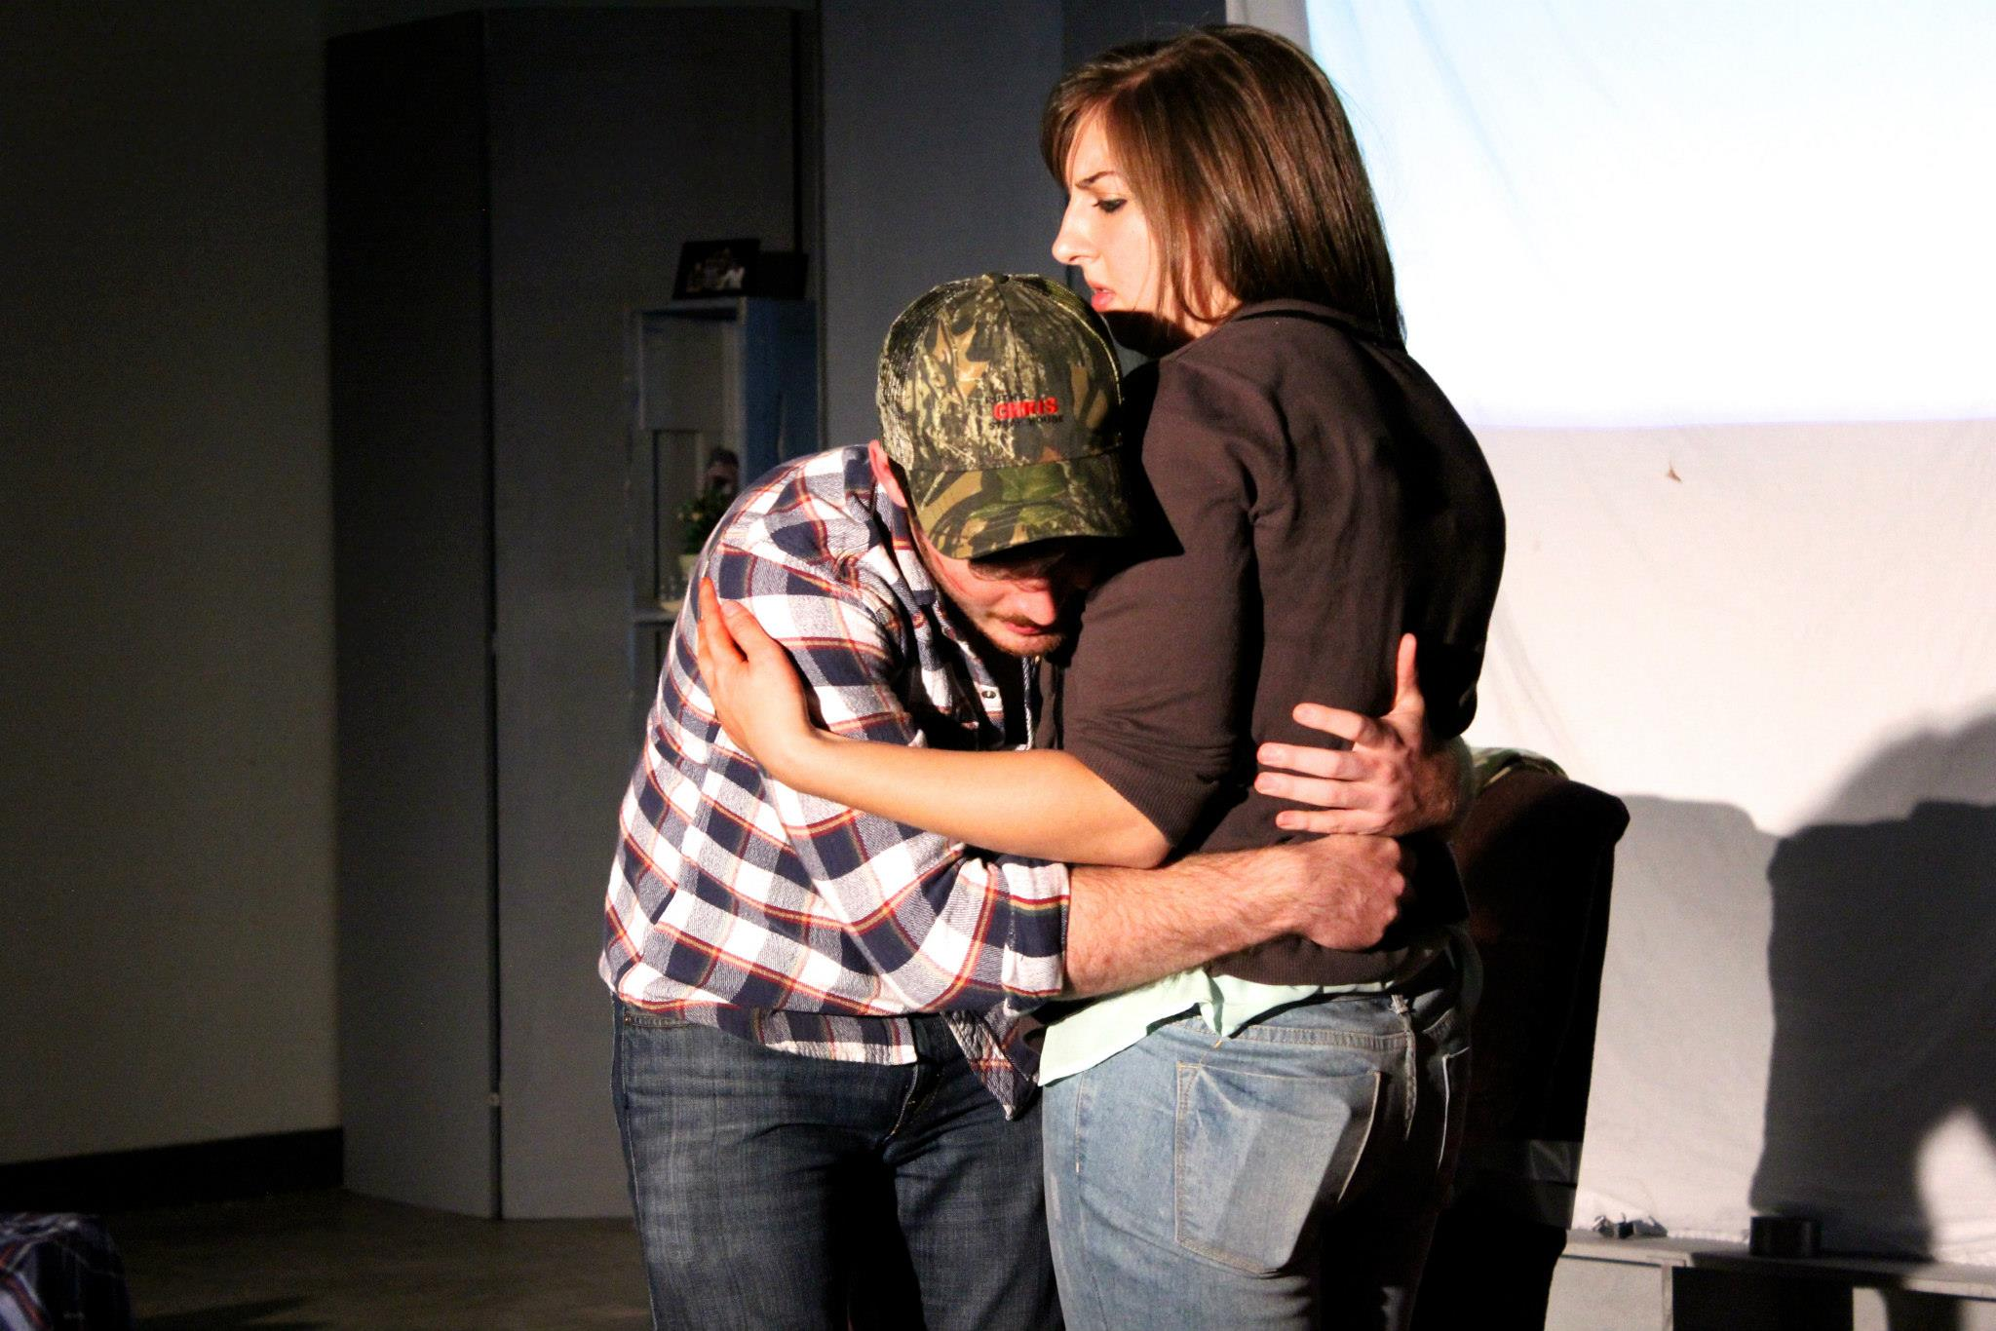

Slide 15
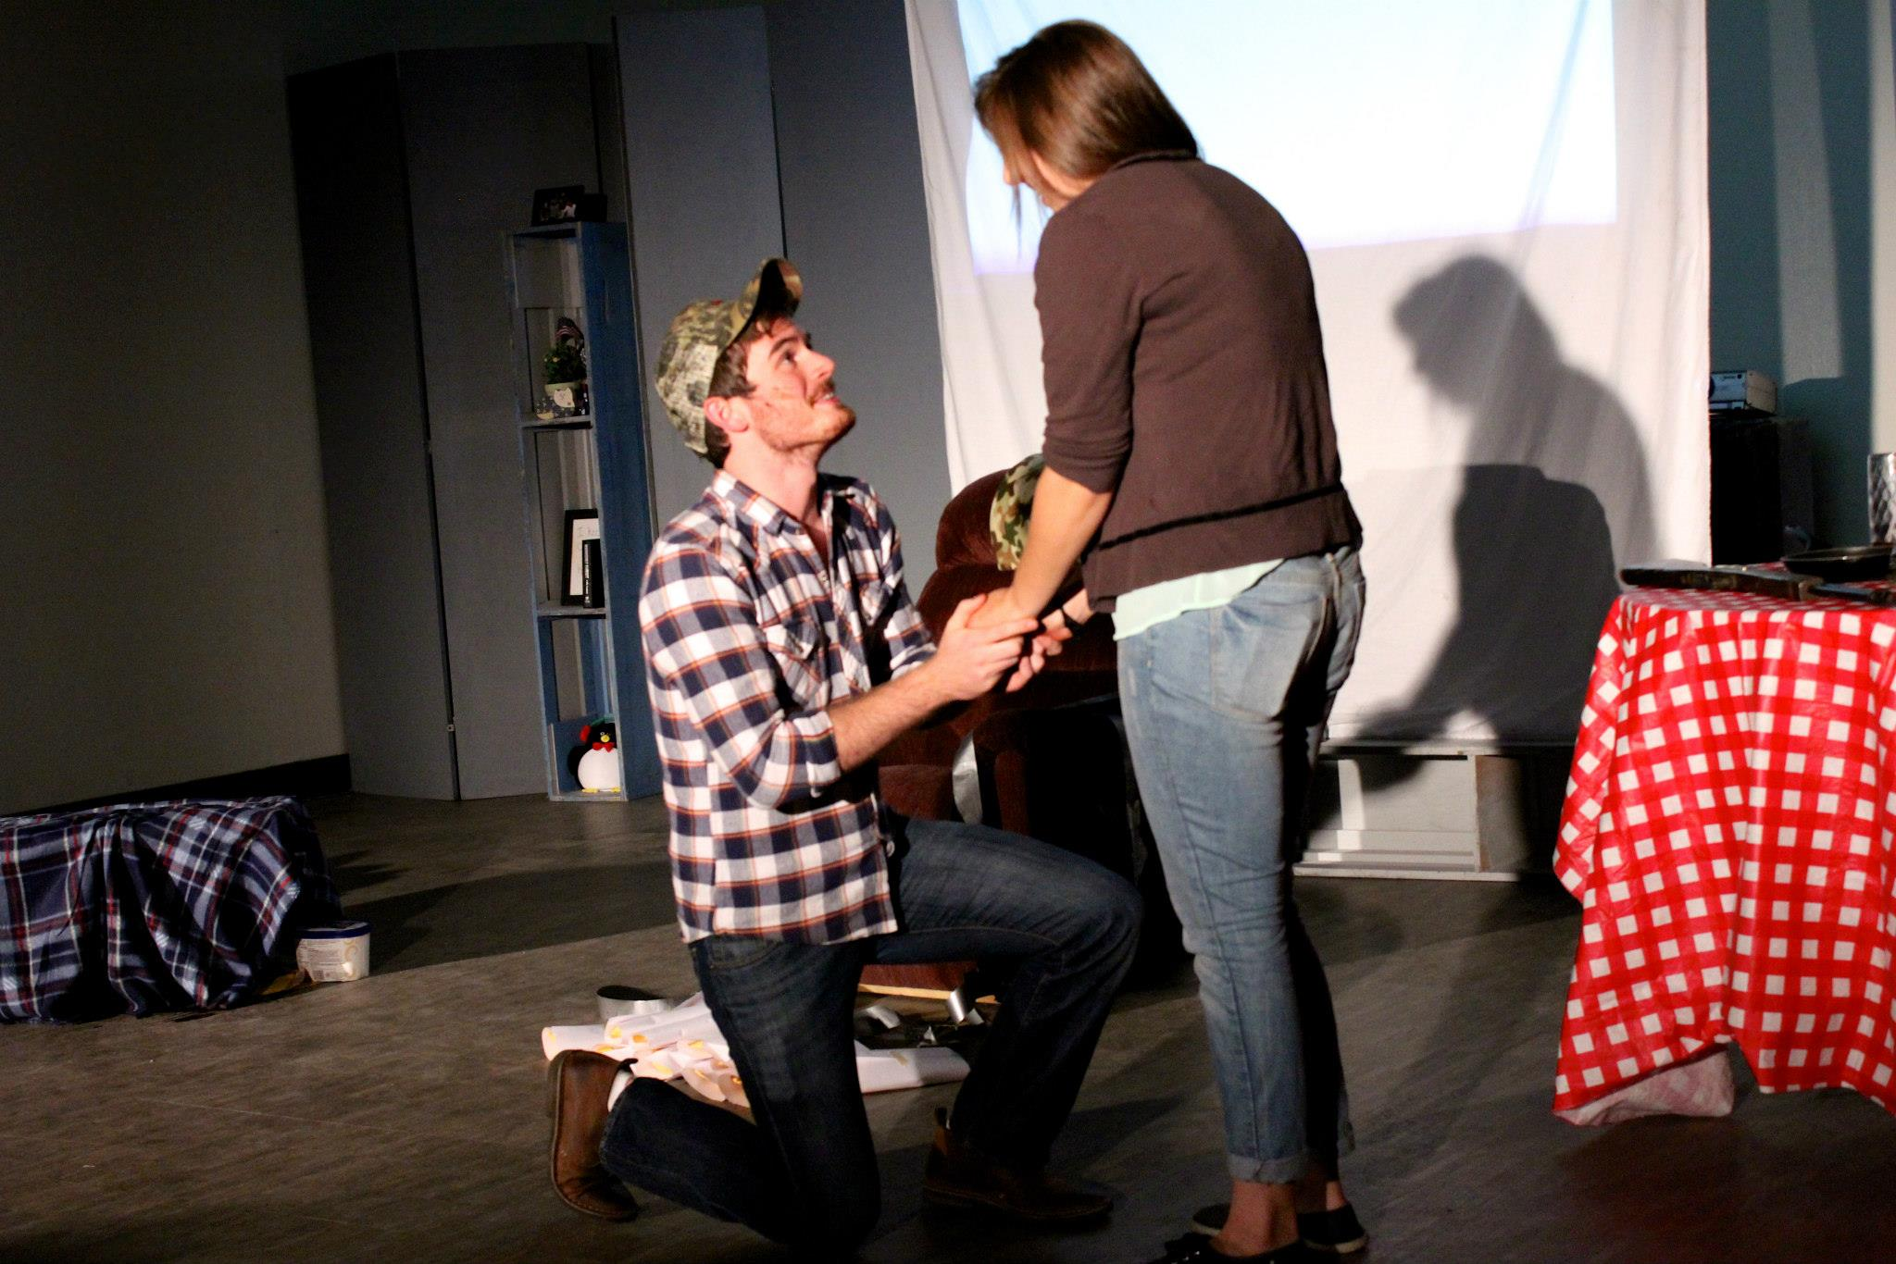

Slide 16
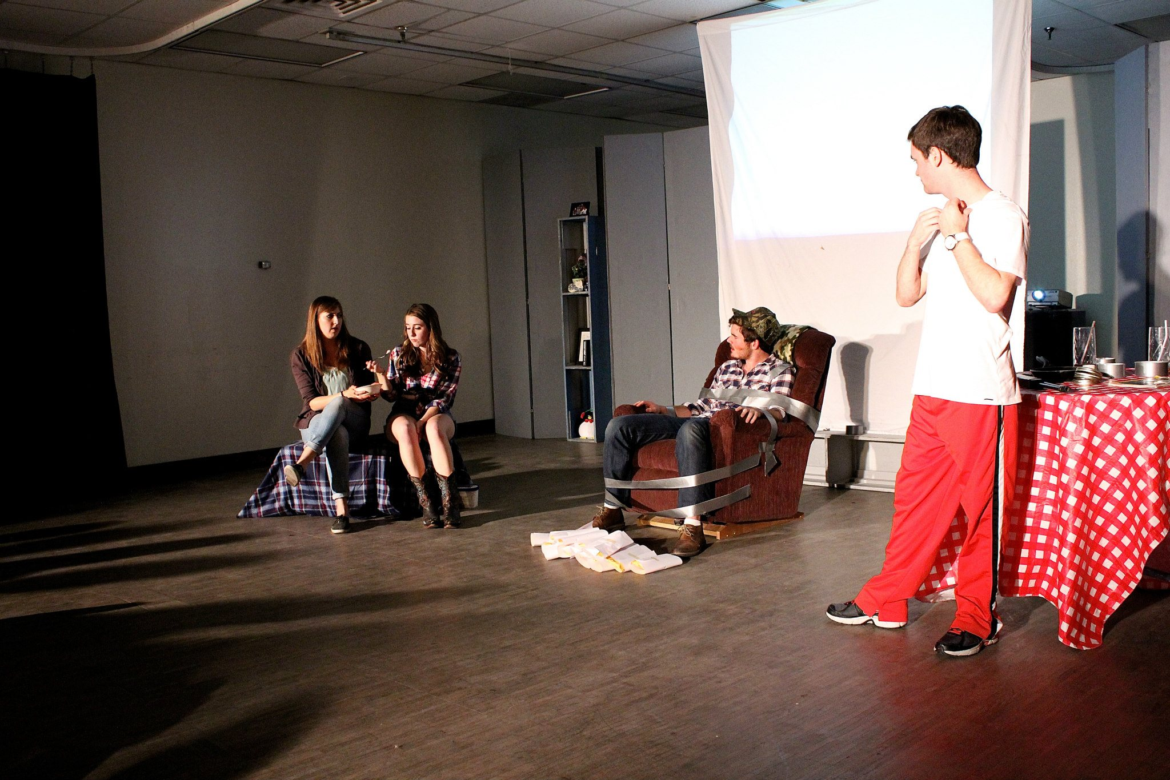

Slide 17
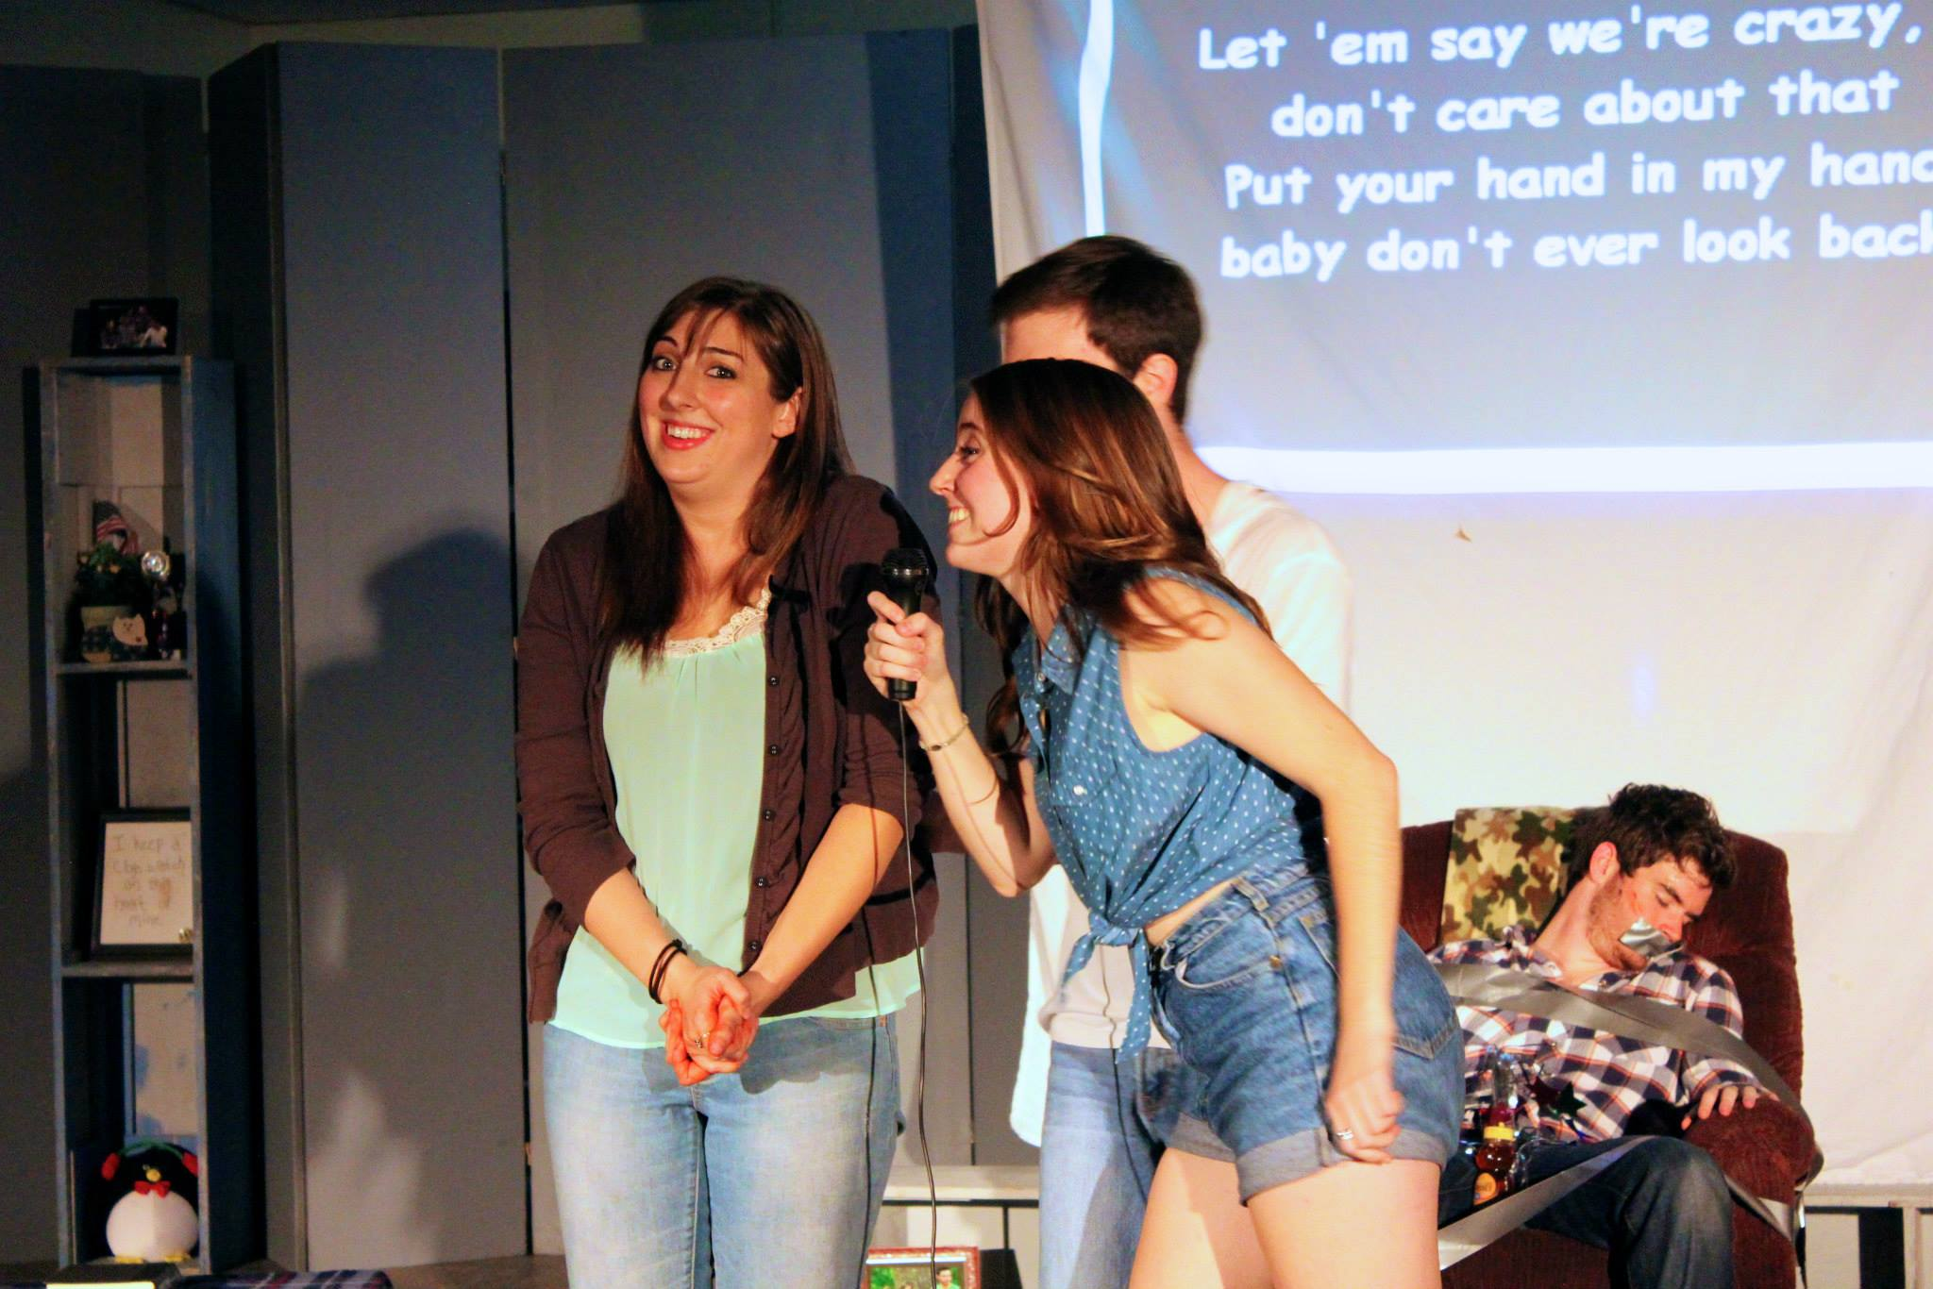

Slide 18
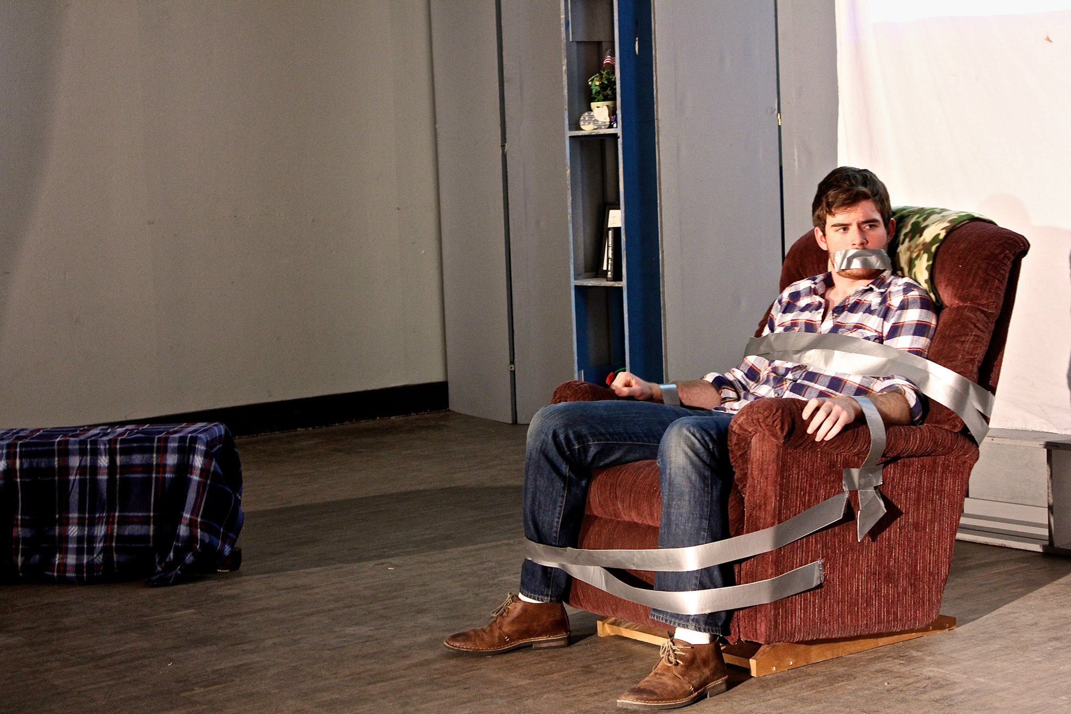

Slide 19
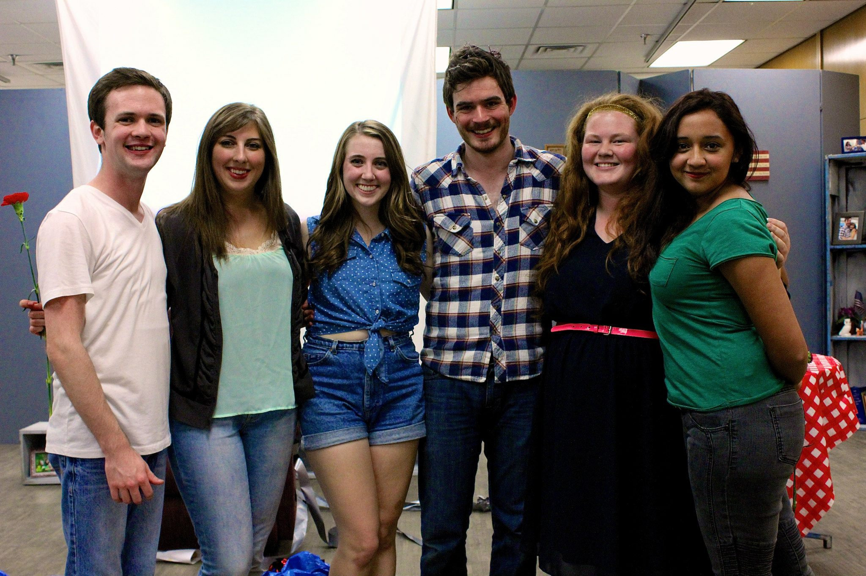
From right to left: Conner Palmore, Someone, Someone, Bishop Wash, Addie Arnold, Someone

Slide 20

Dog Sees God: Confessions of a Teenage Blockhead
By Bert V. Royal
Directed by Sean Tecson

Slide 21
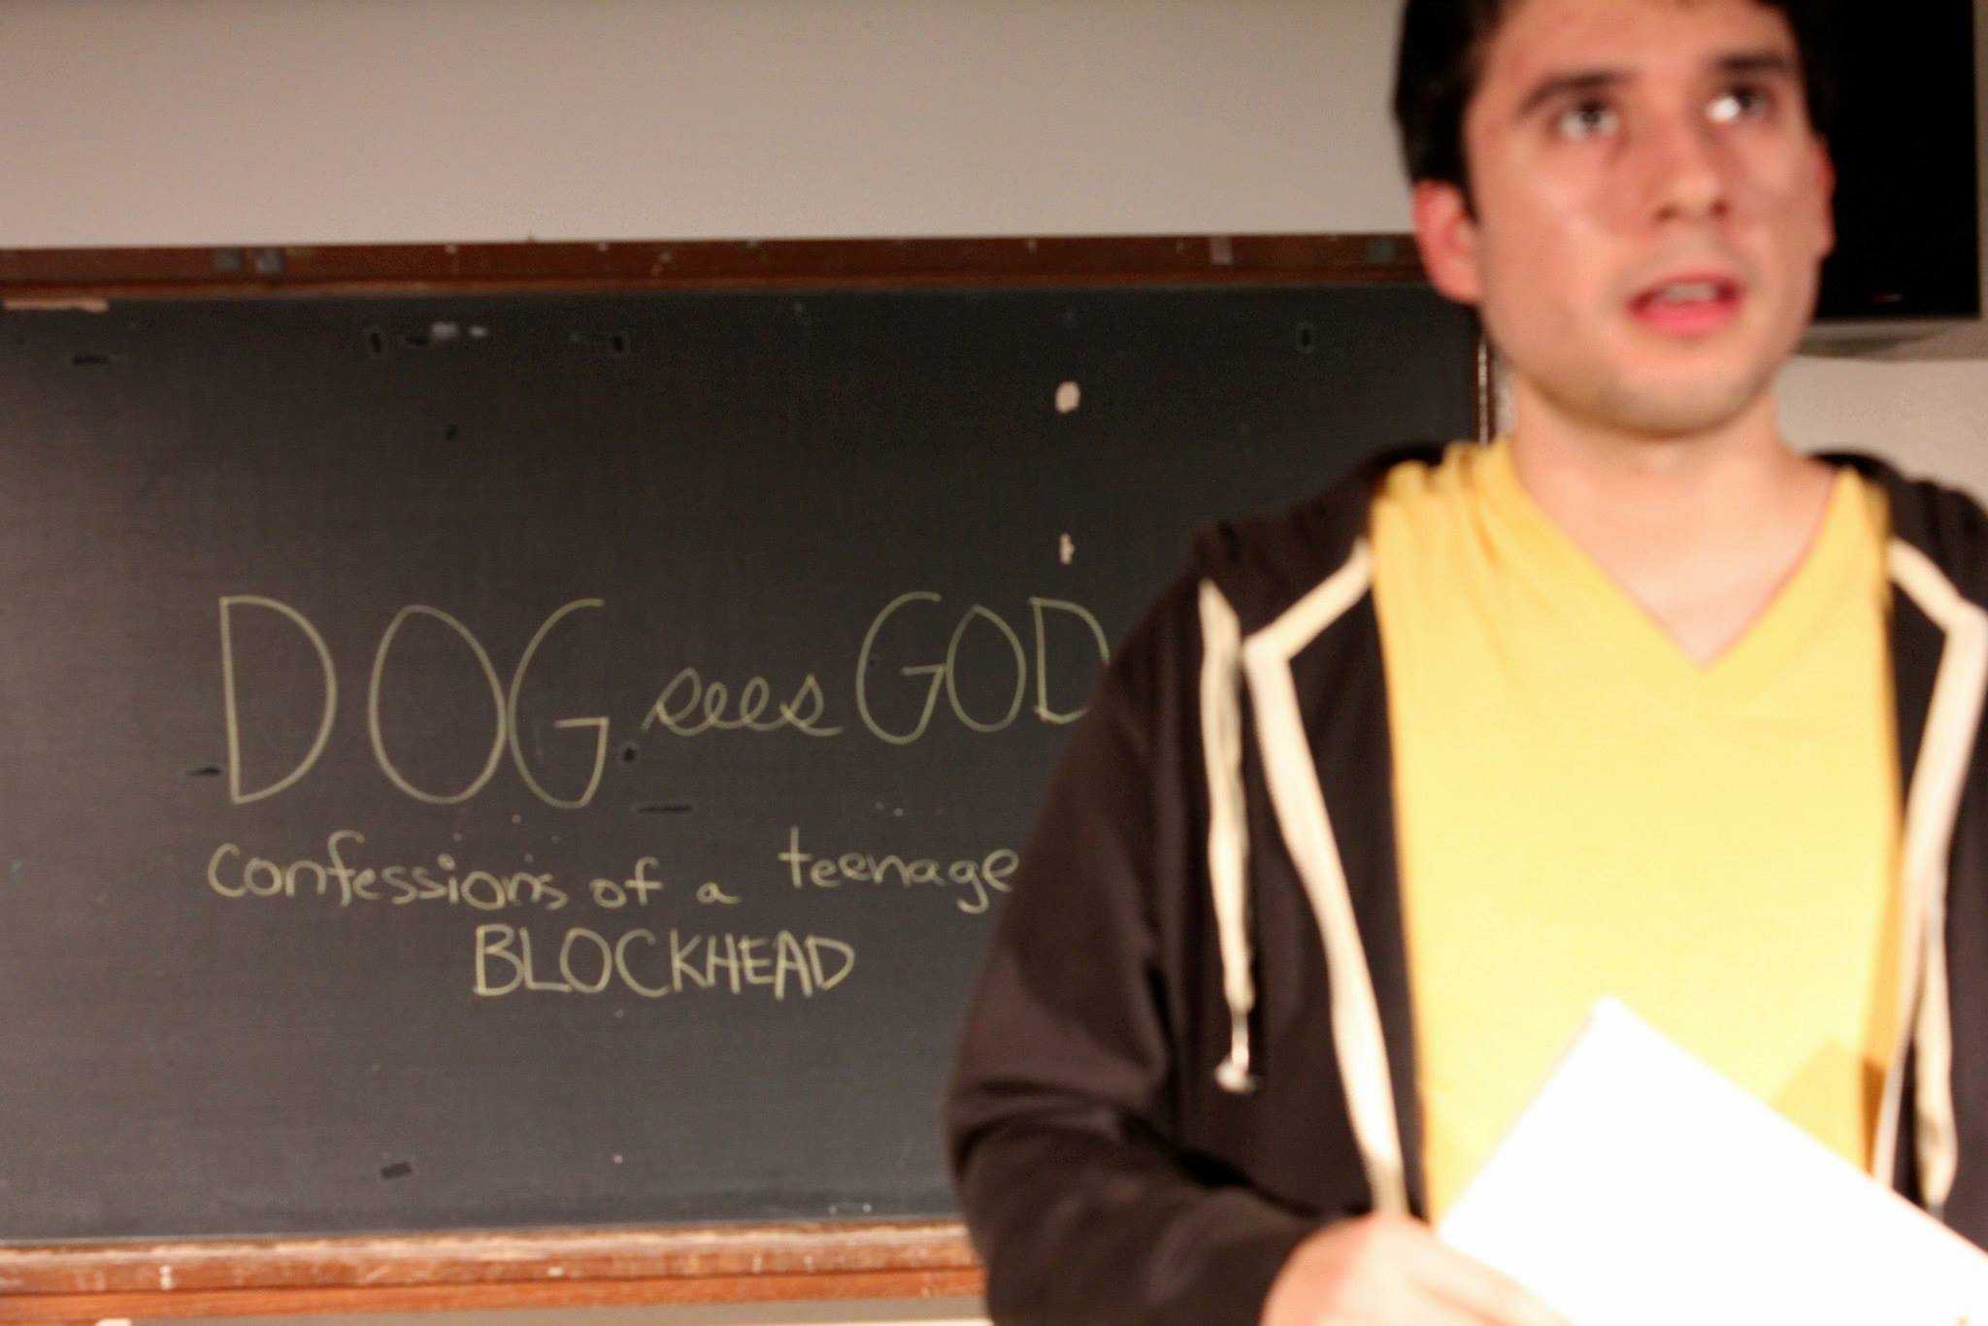

Slide 22
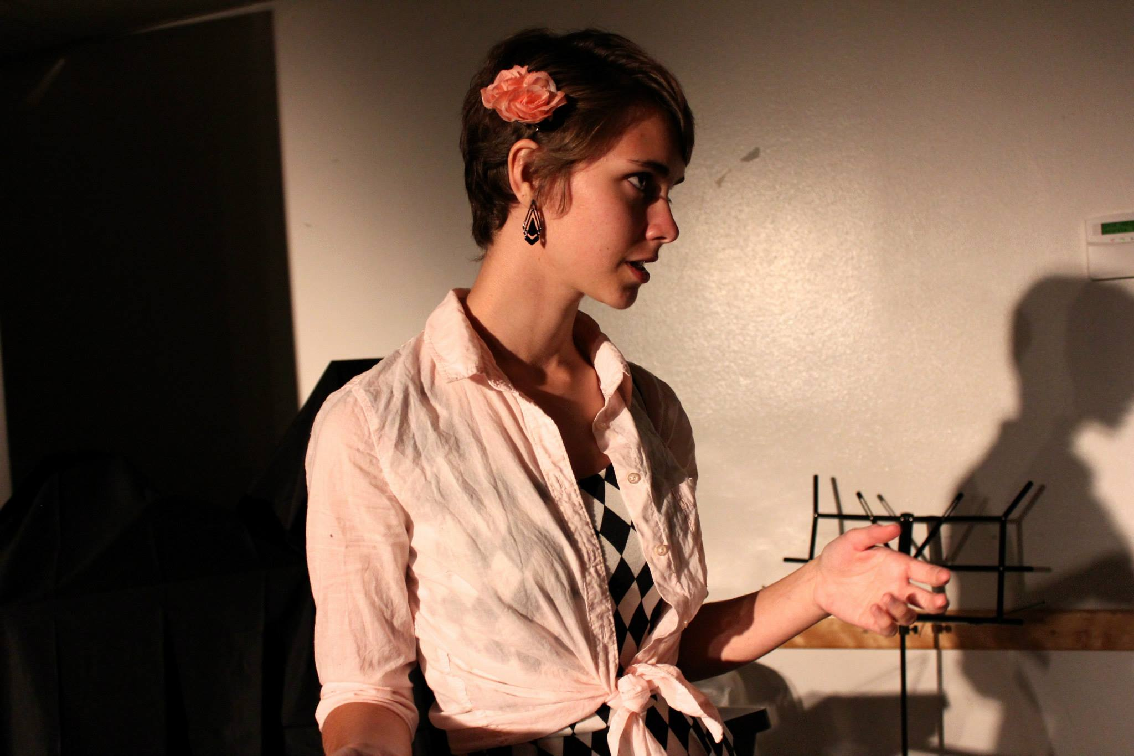

Slide 23
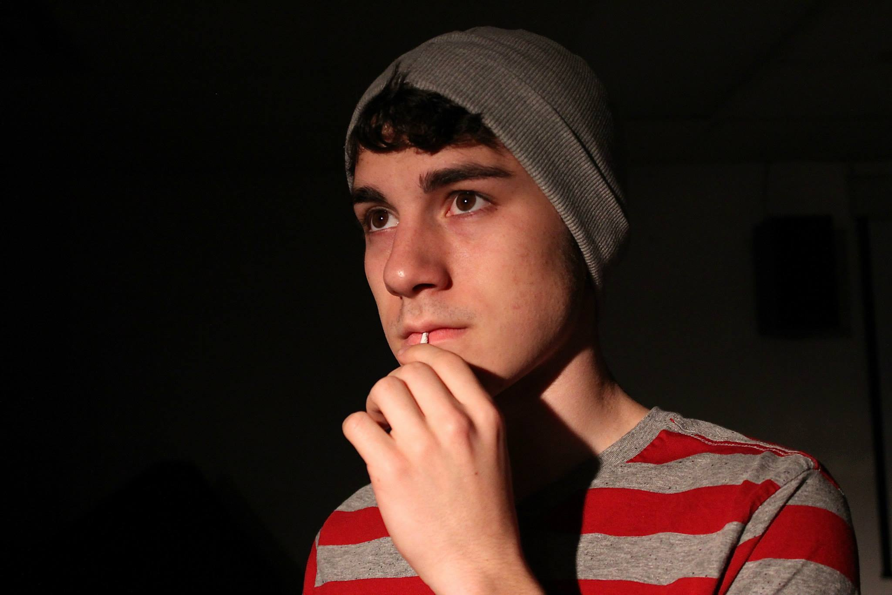

Slide 24
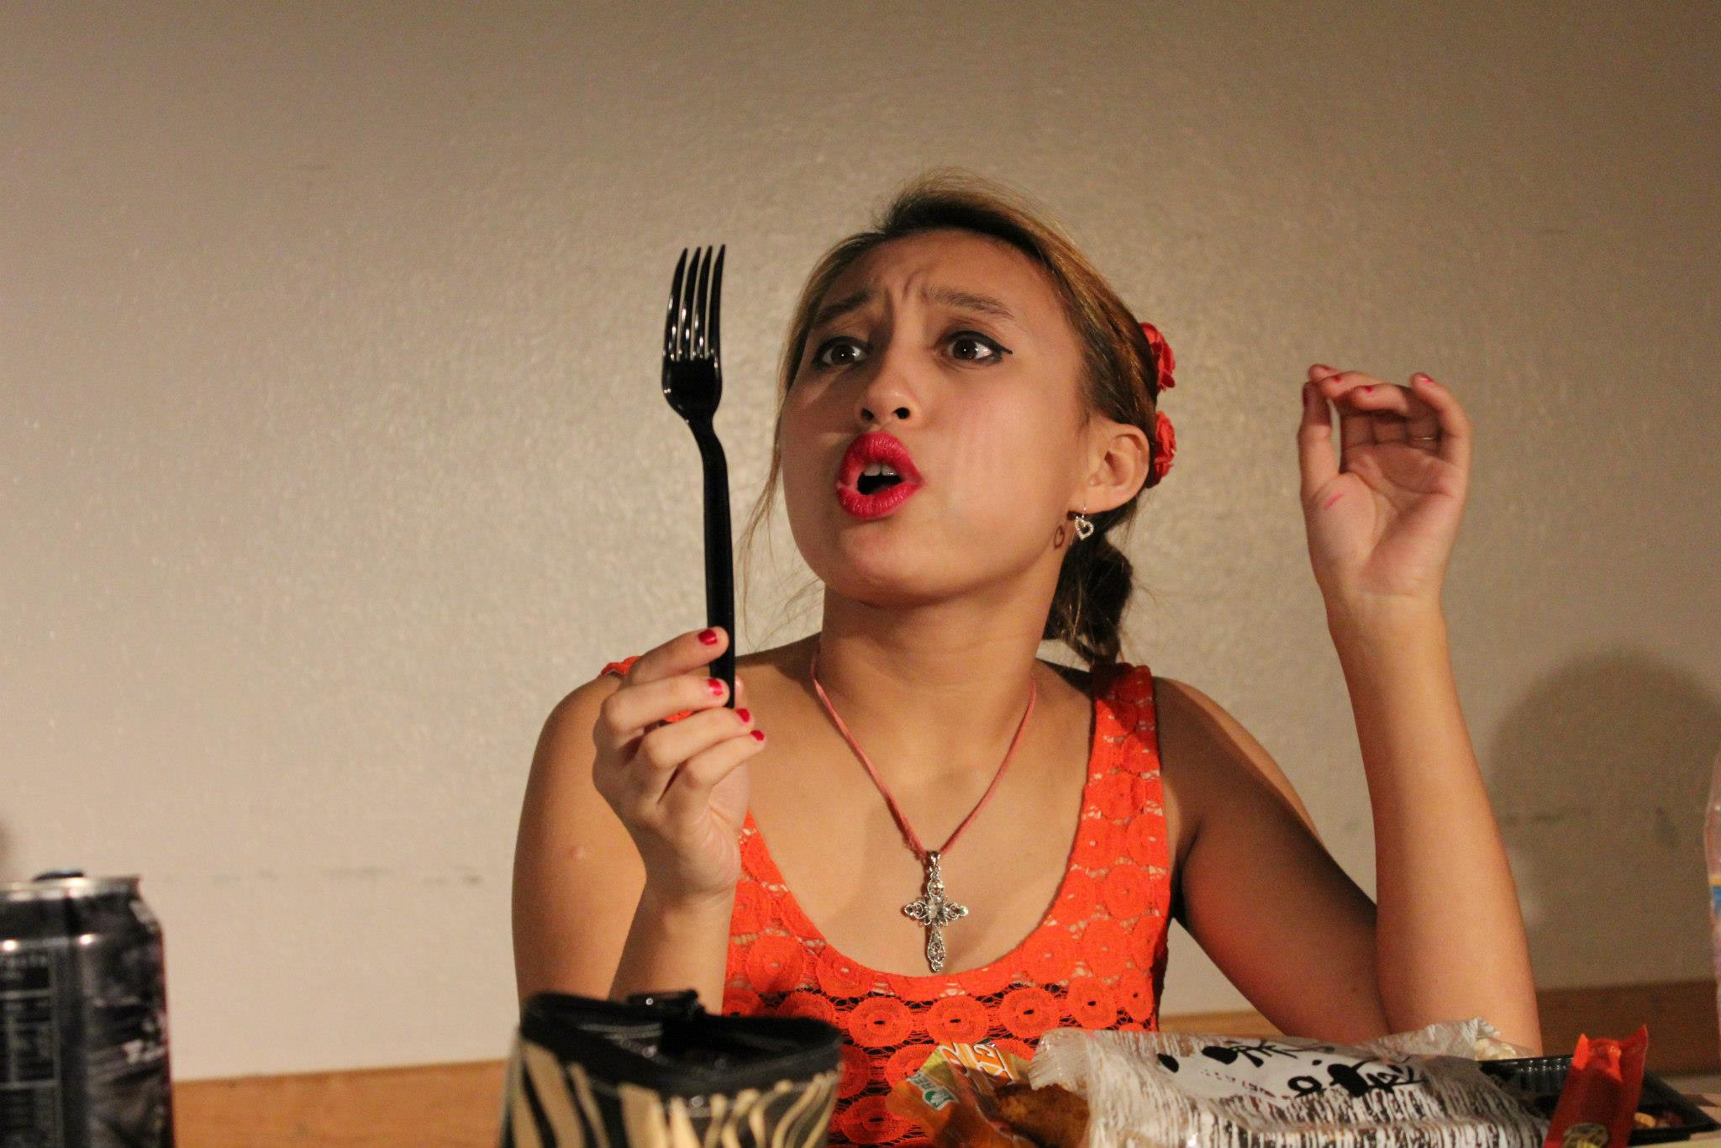

Slide 25
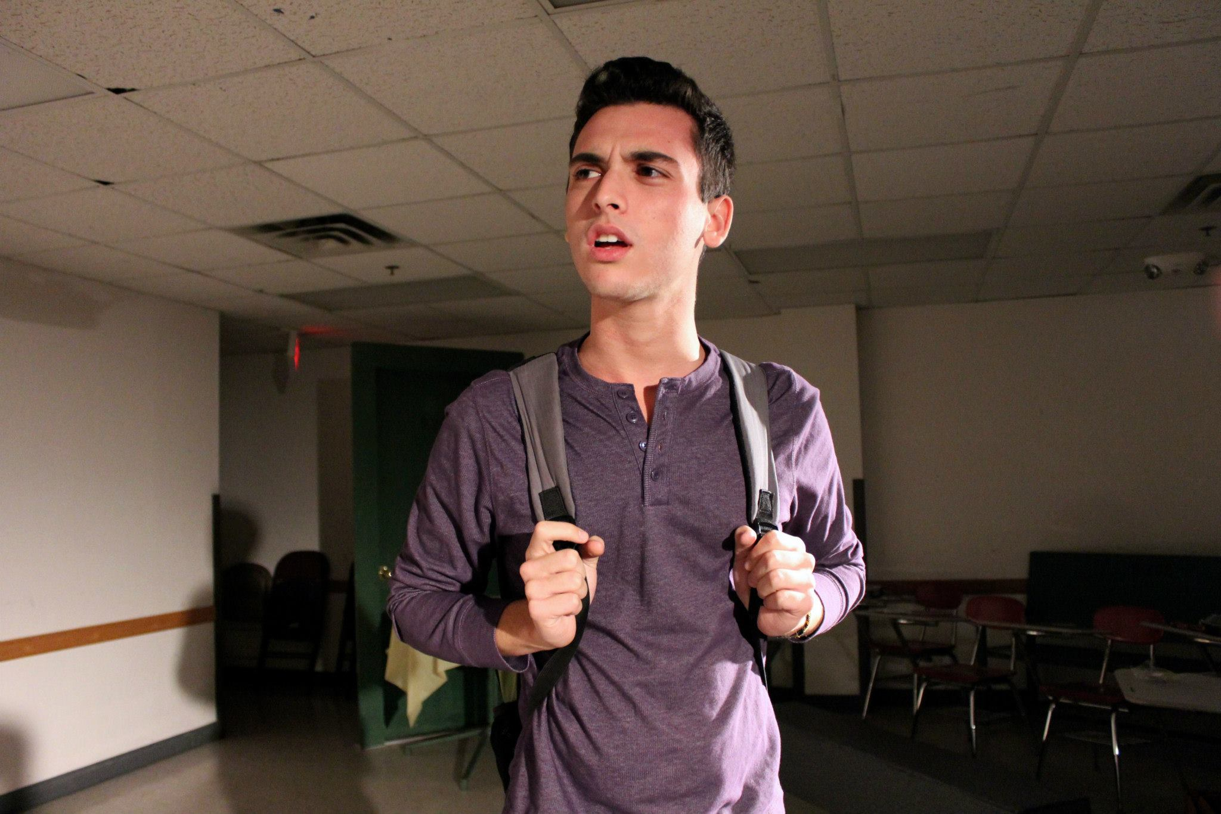

Slide 26
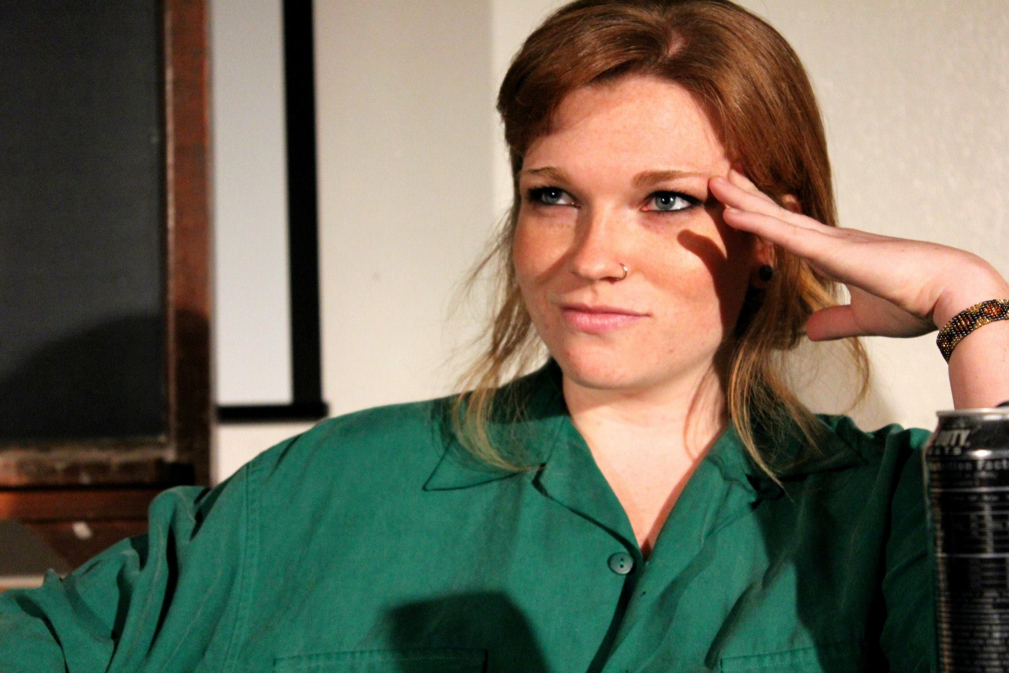

Slide 27
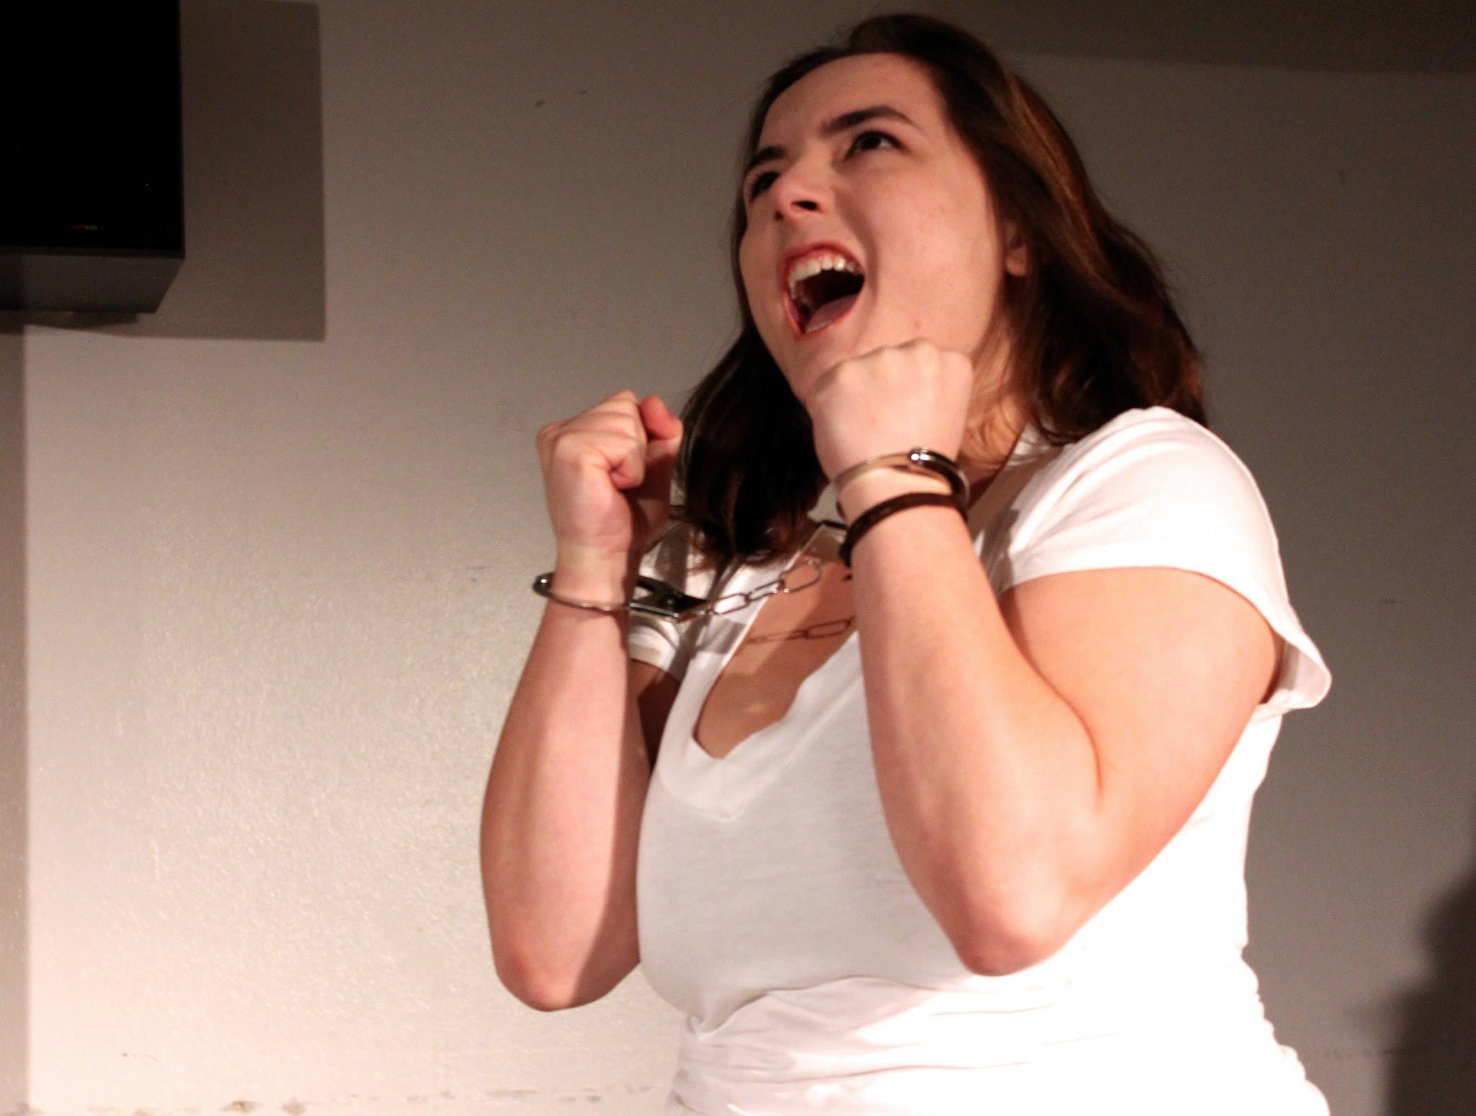

Slide 28
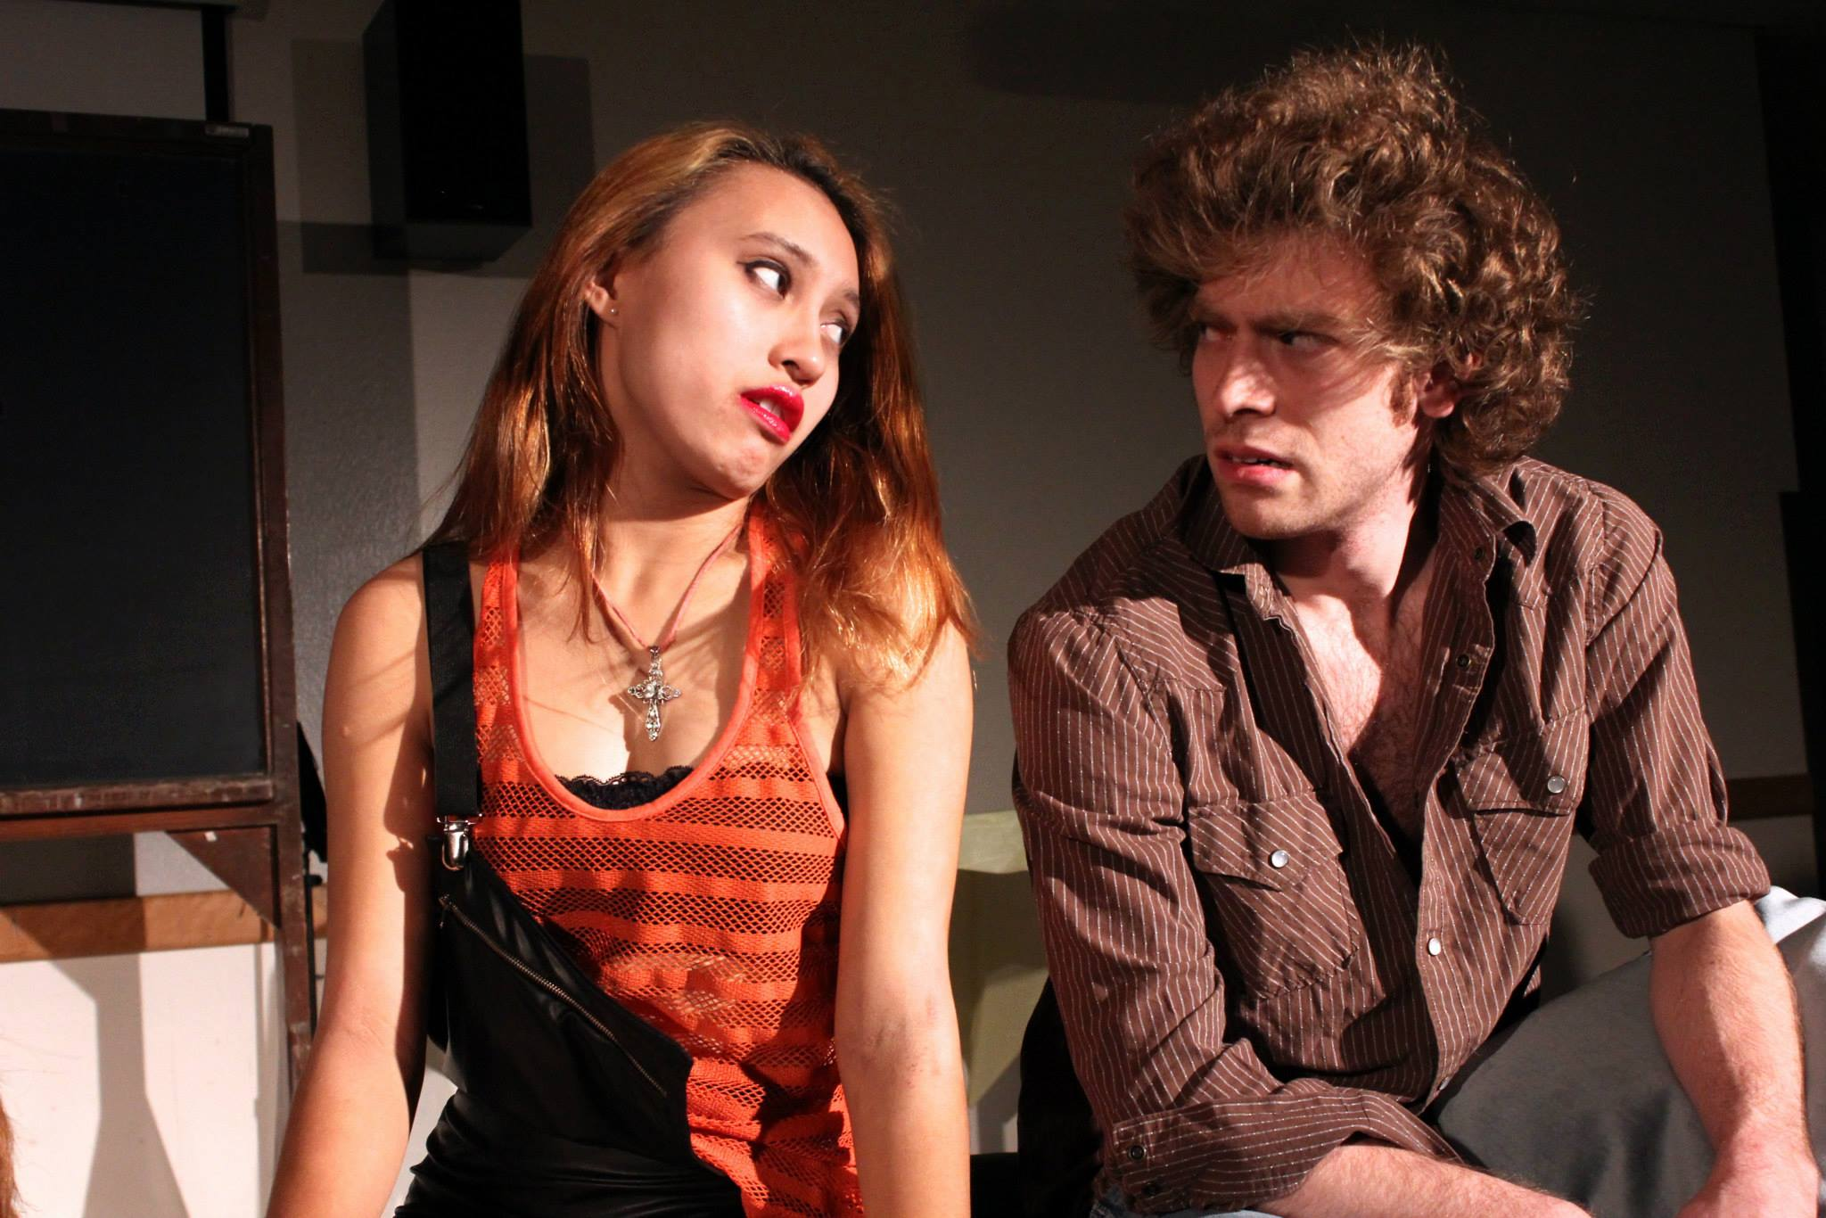

Slide 29
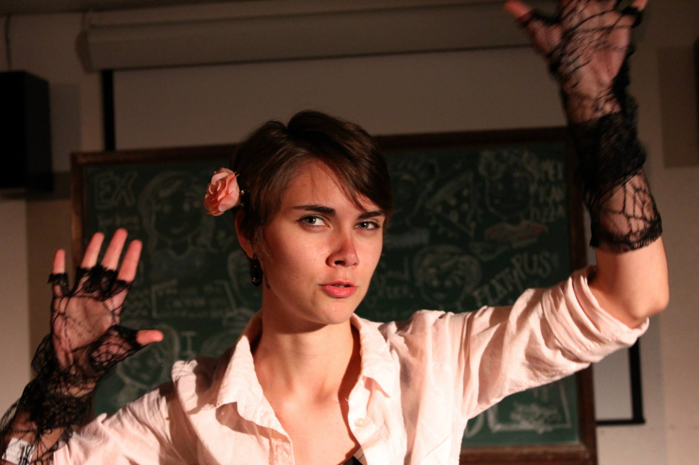

Slide 31
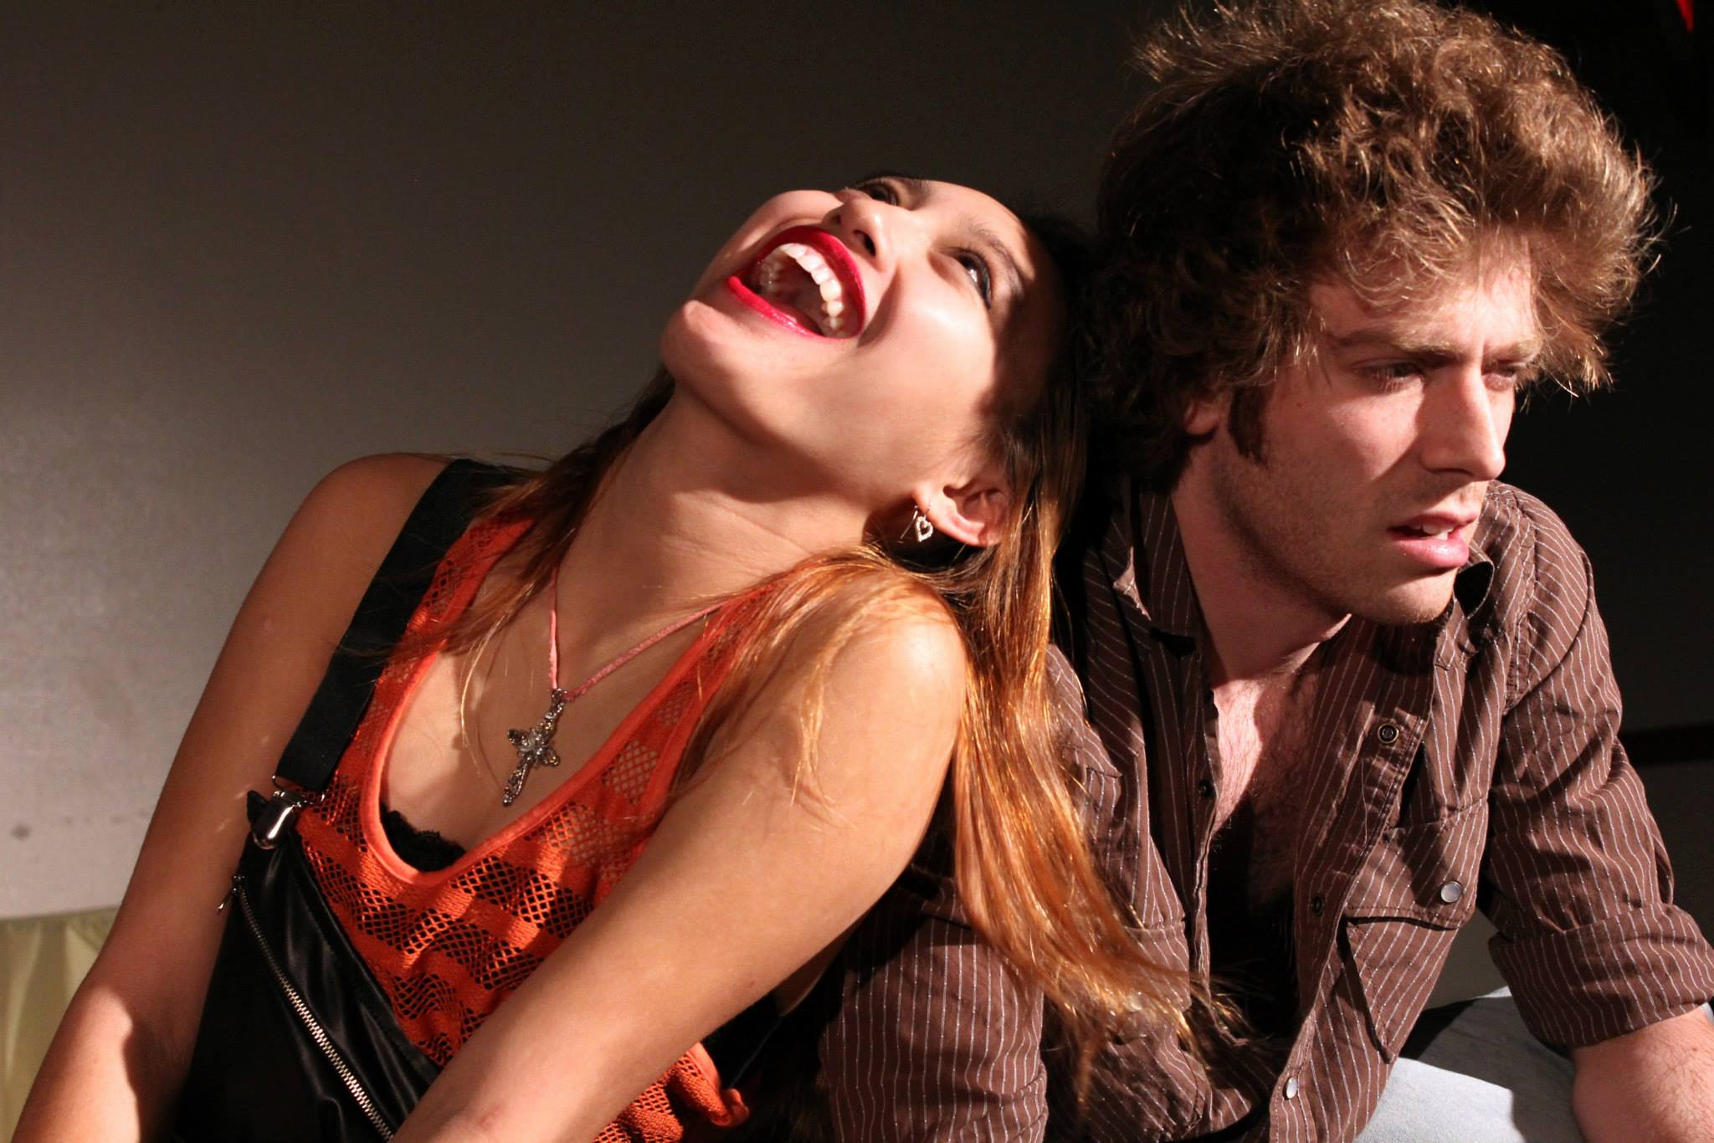

Slide 32
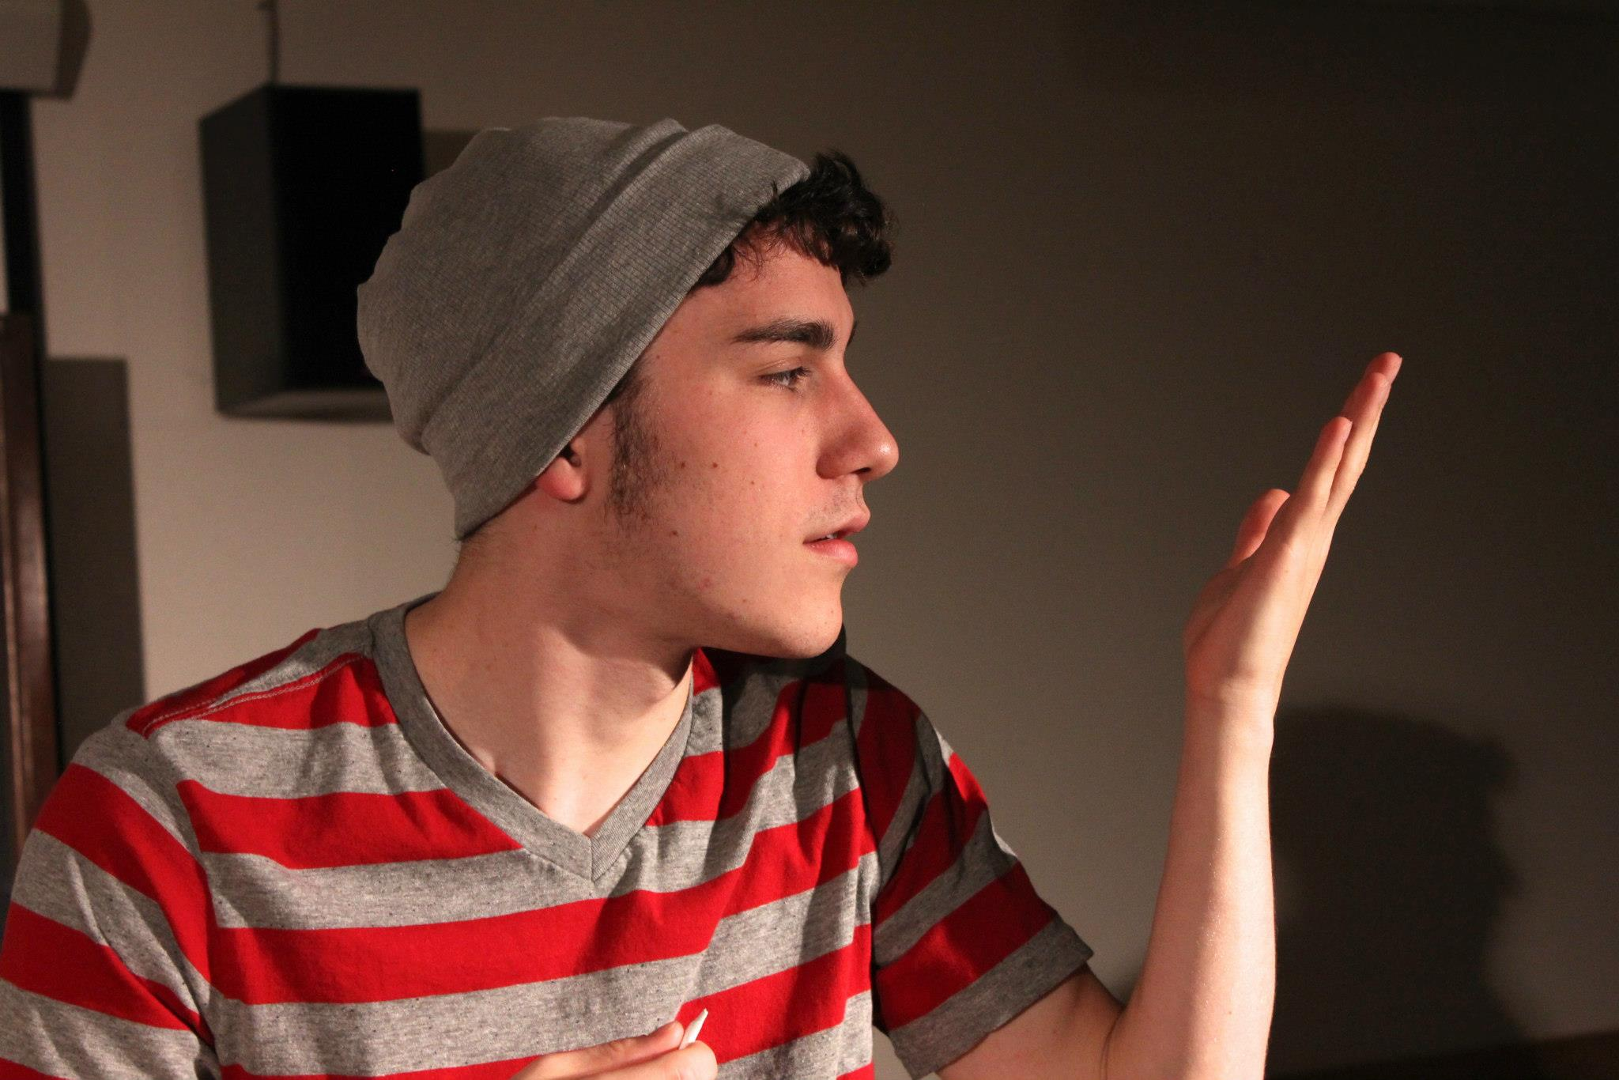

Slide 34
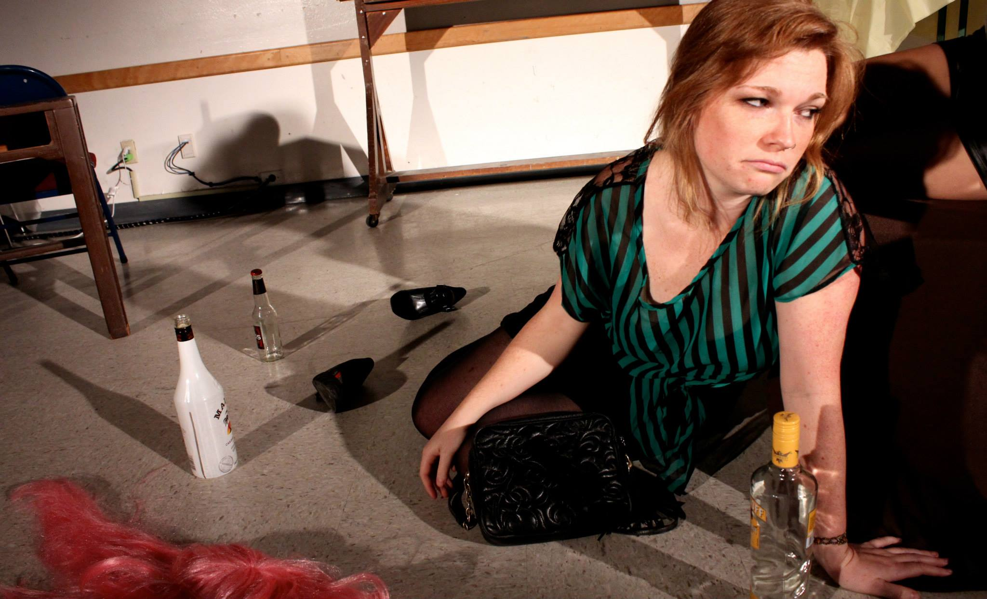

Slide 35
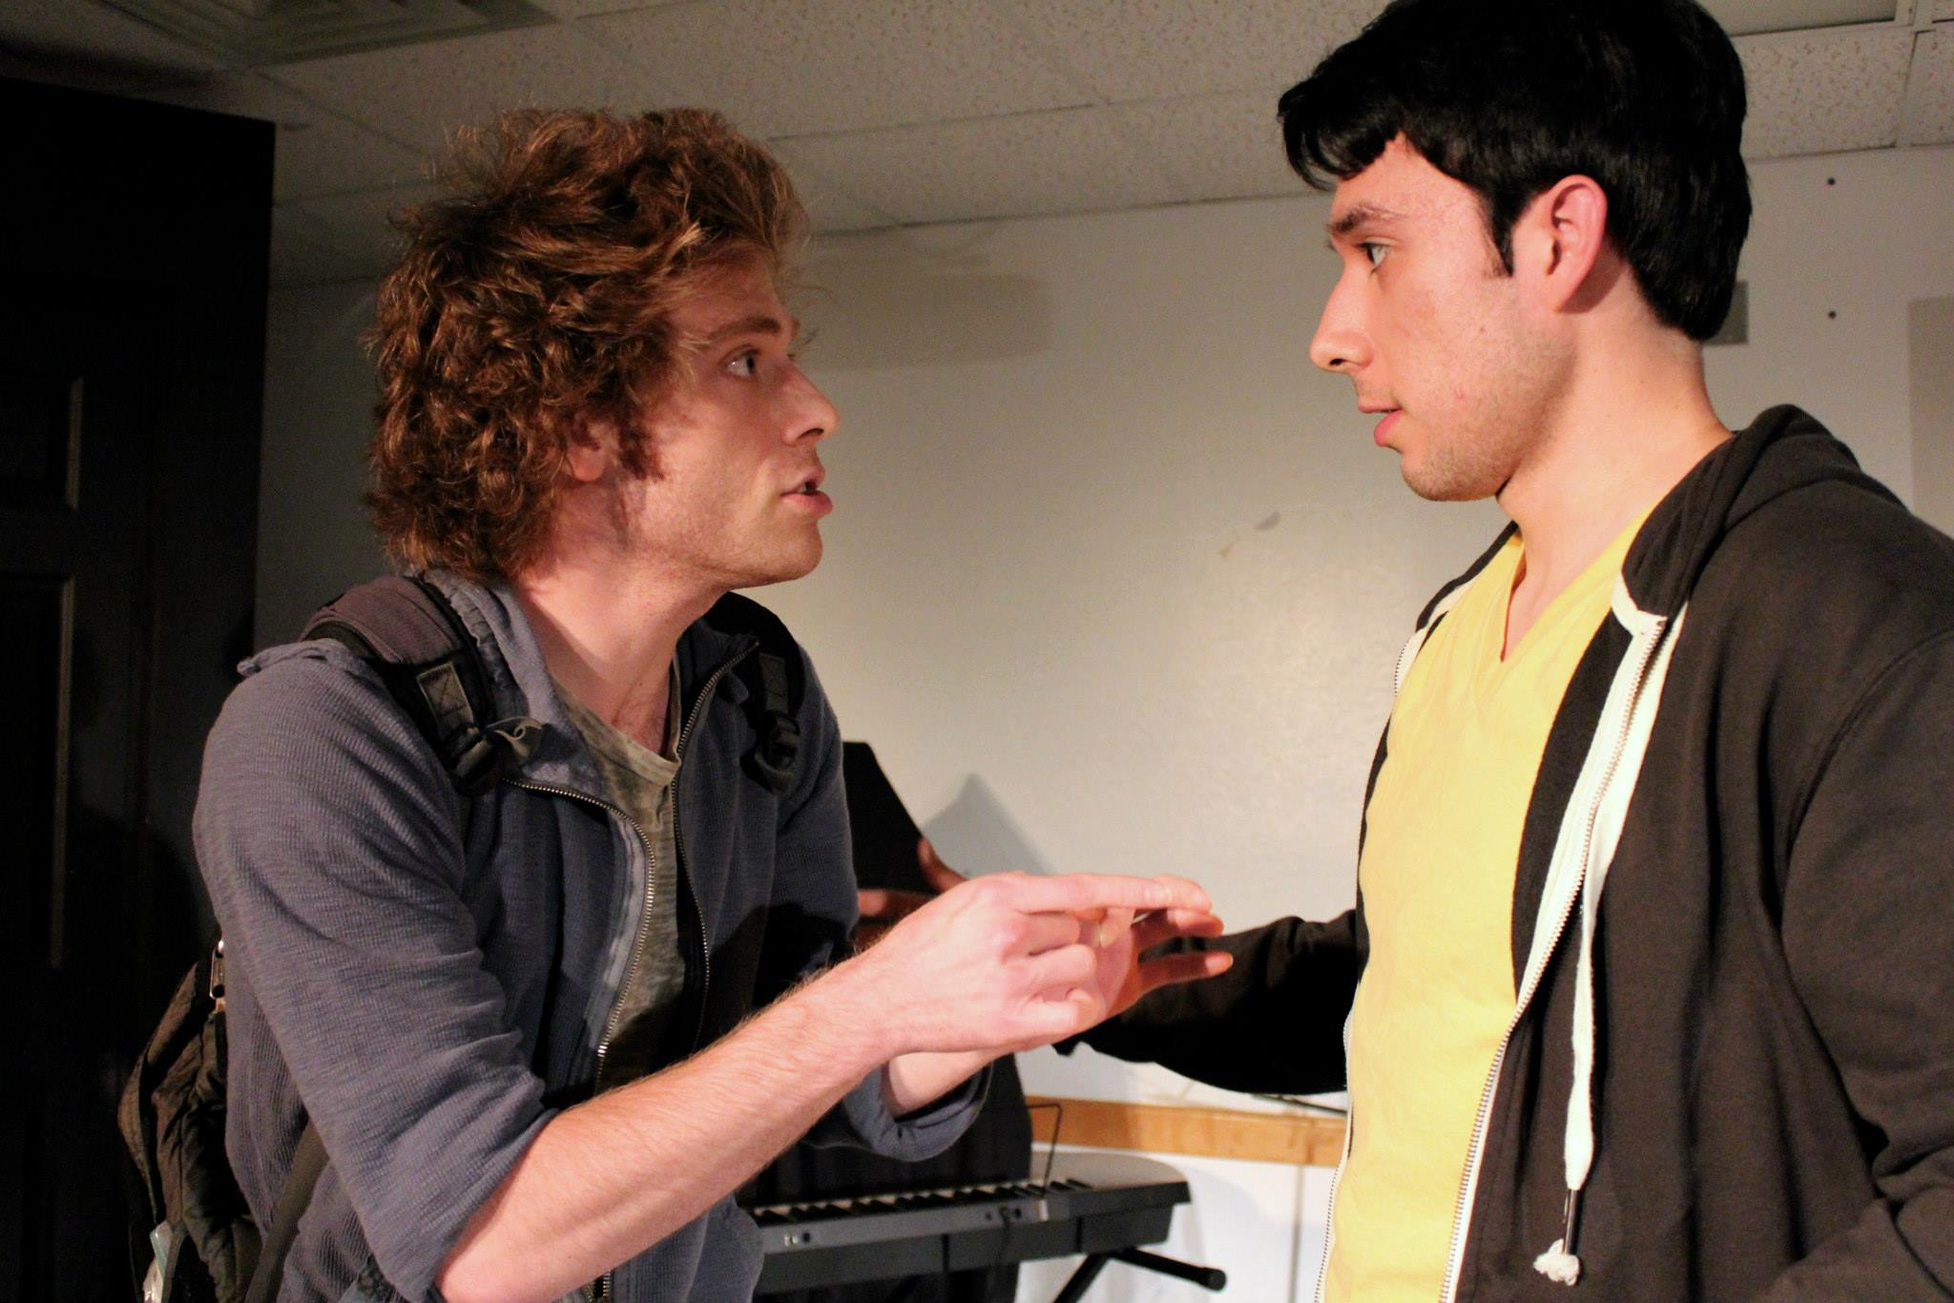

Slide 36
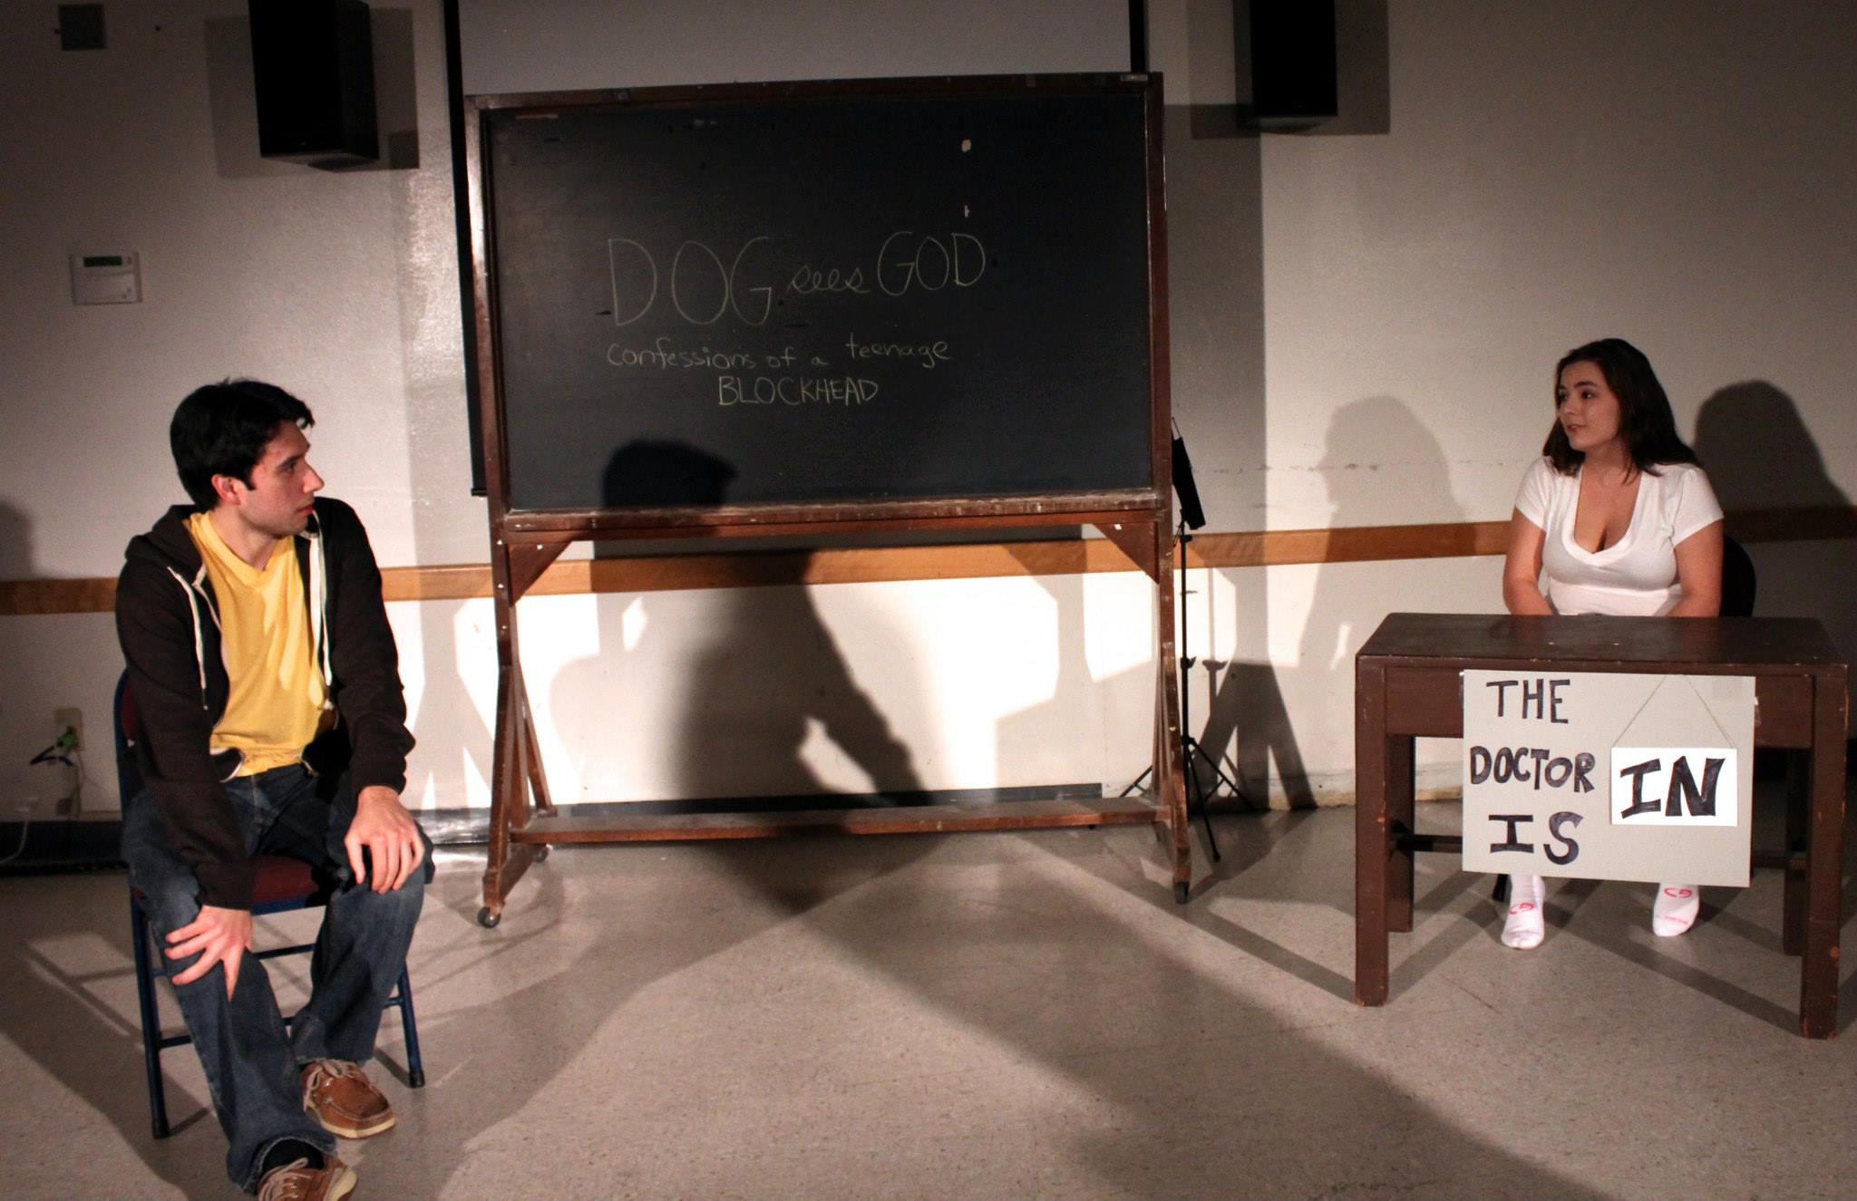

Slide 37
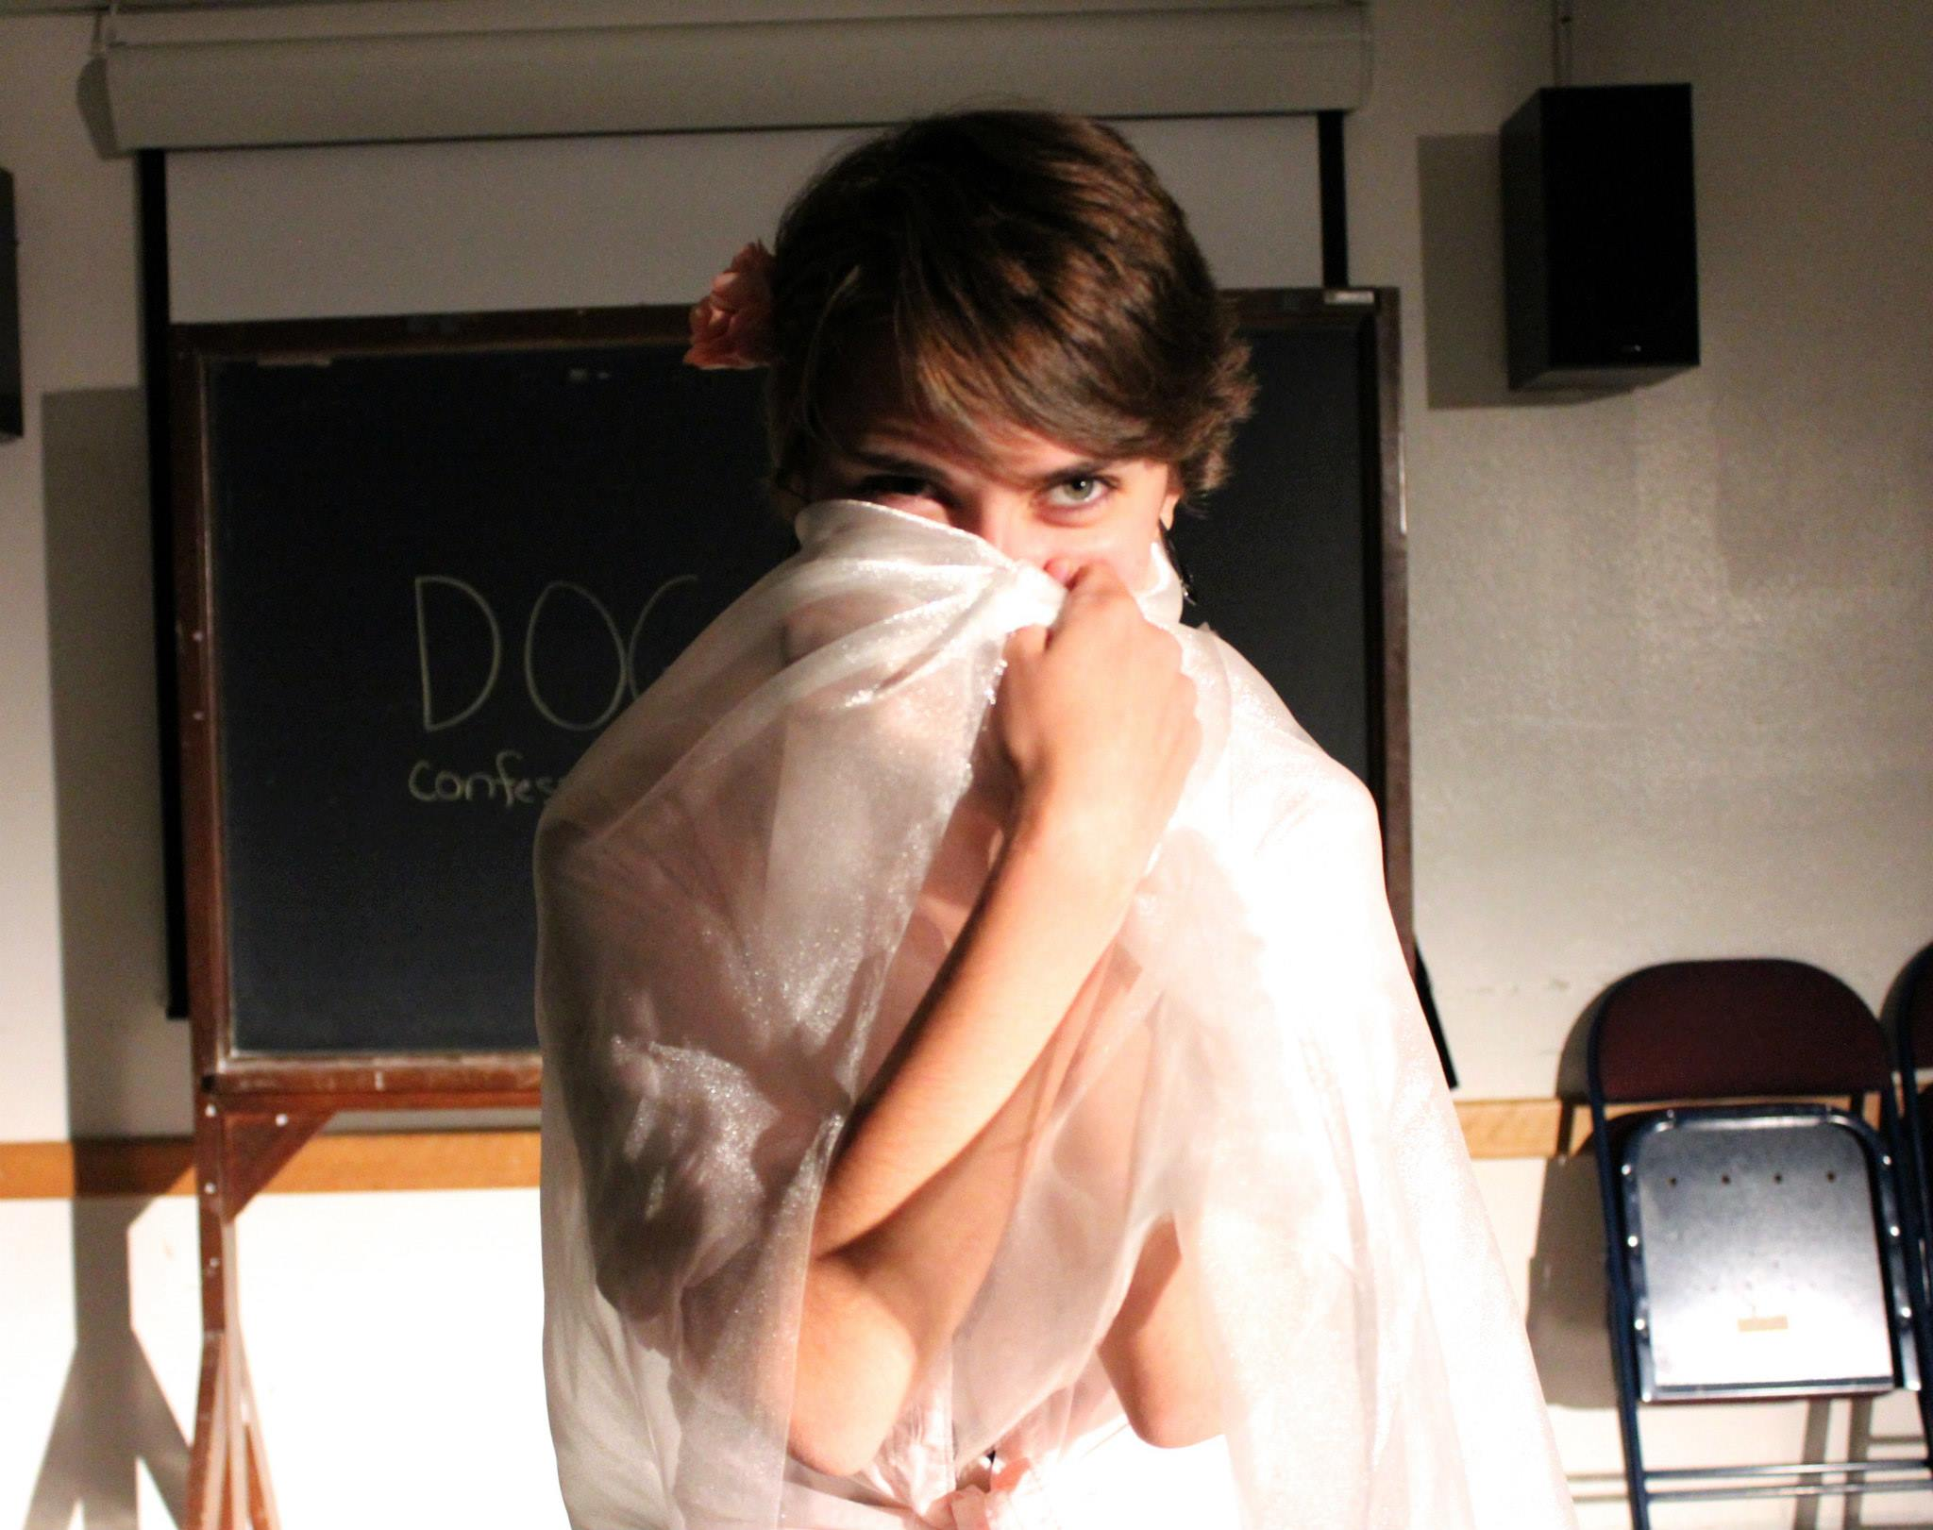

Slide 38
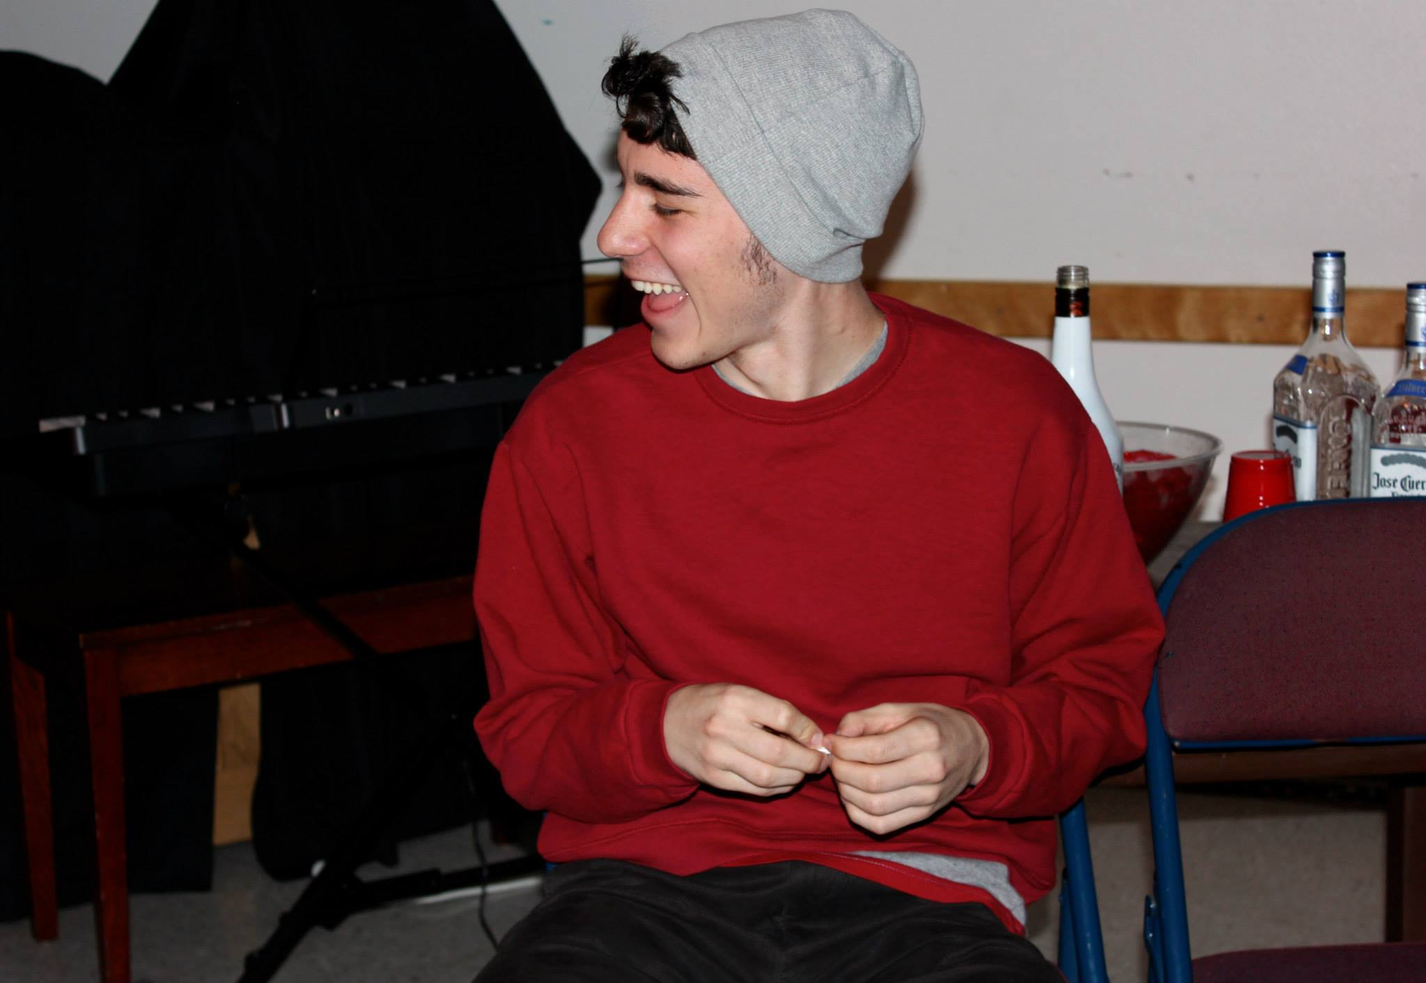

Slide 39
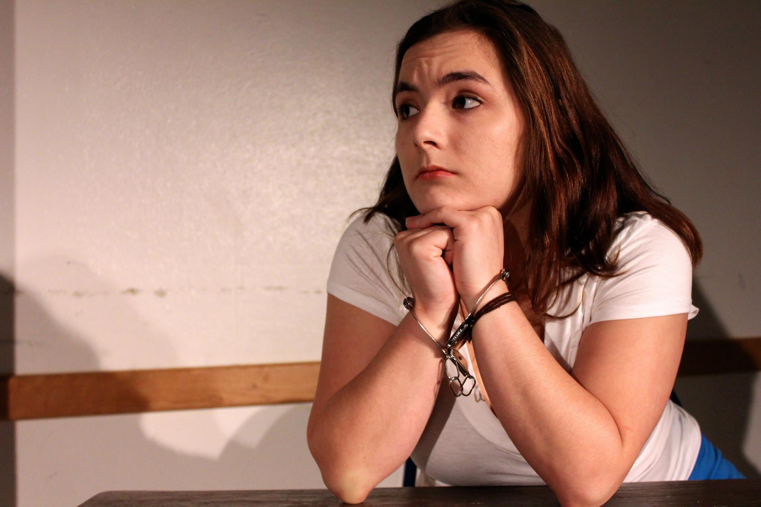

Slide 40
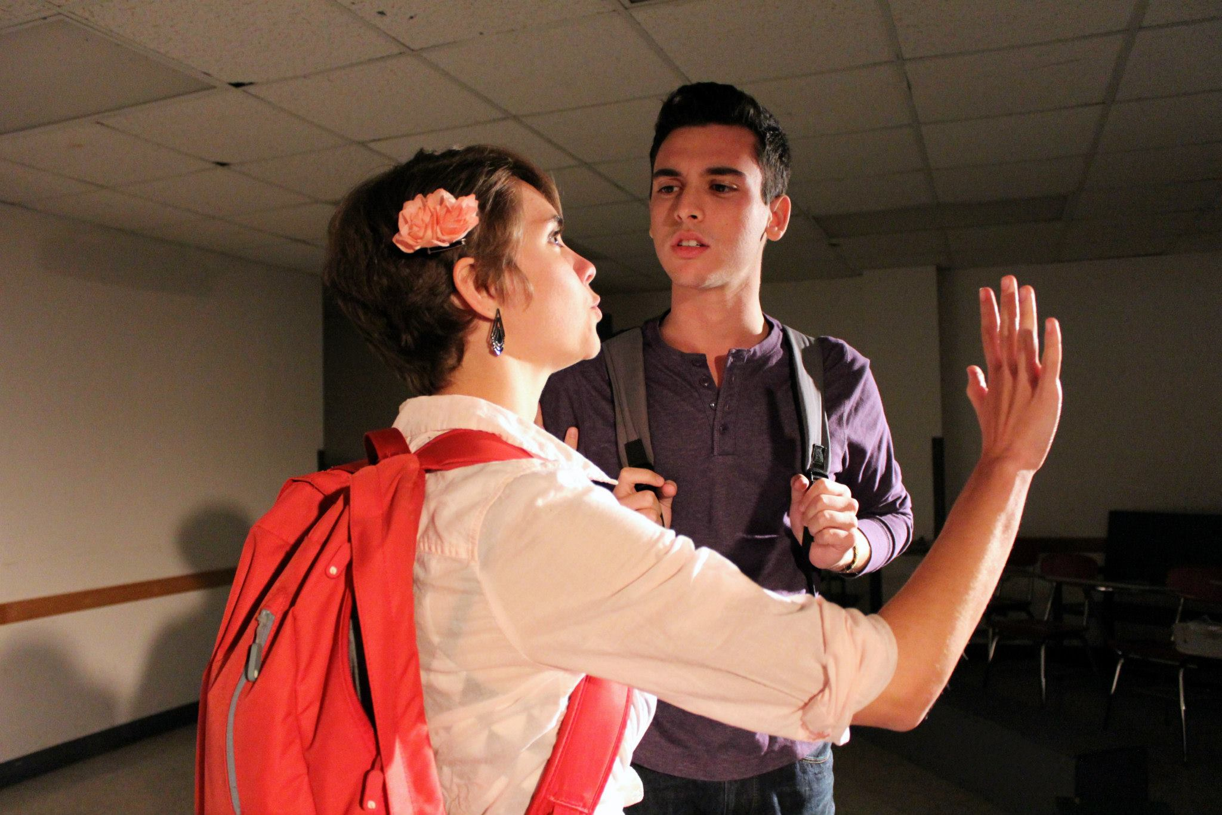

Slide 41
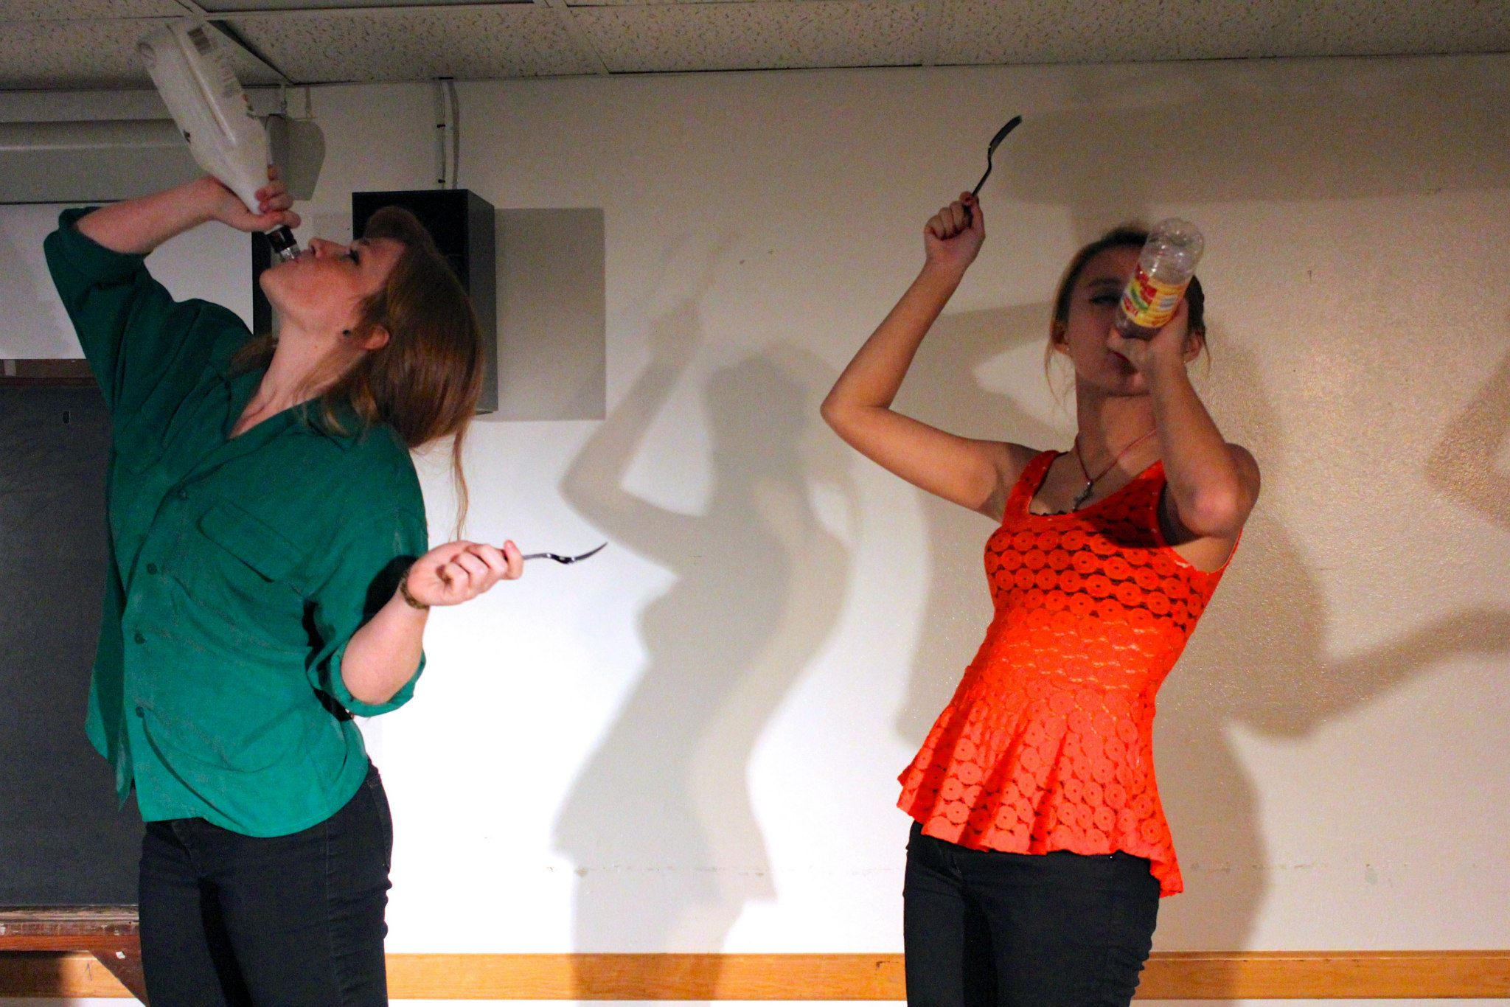

Slide 42
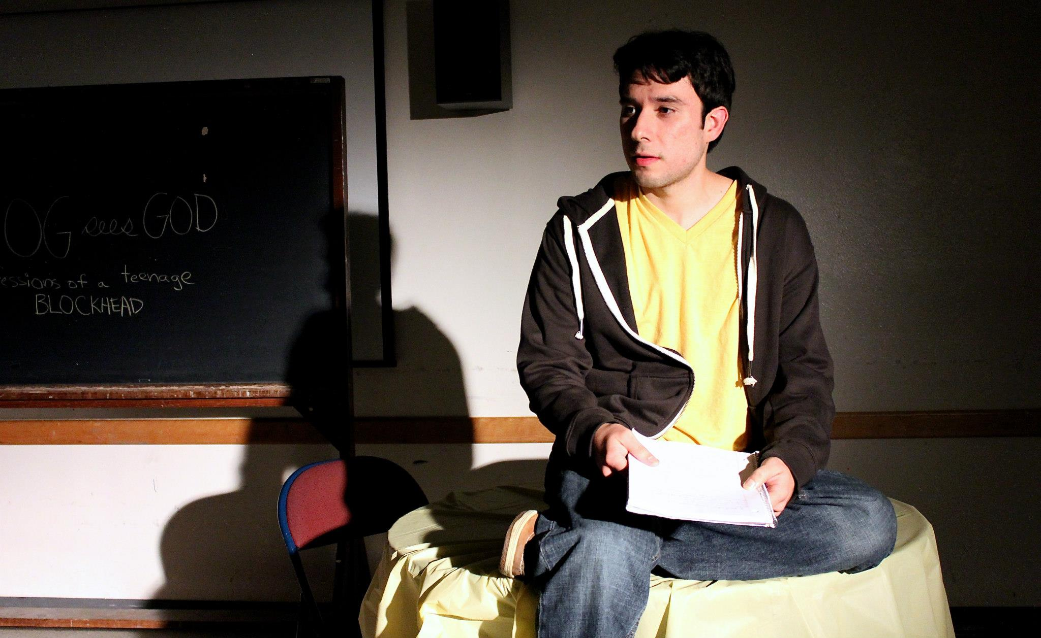

Slide 43
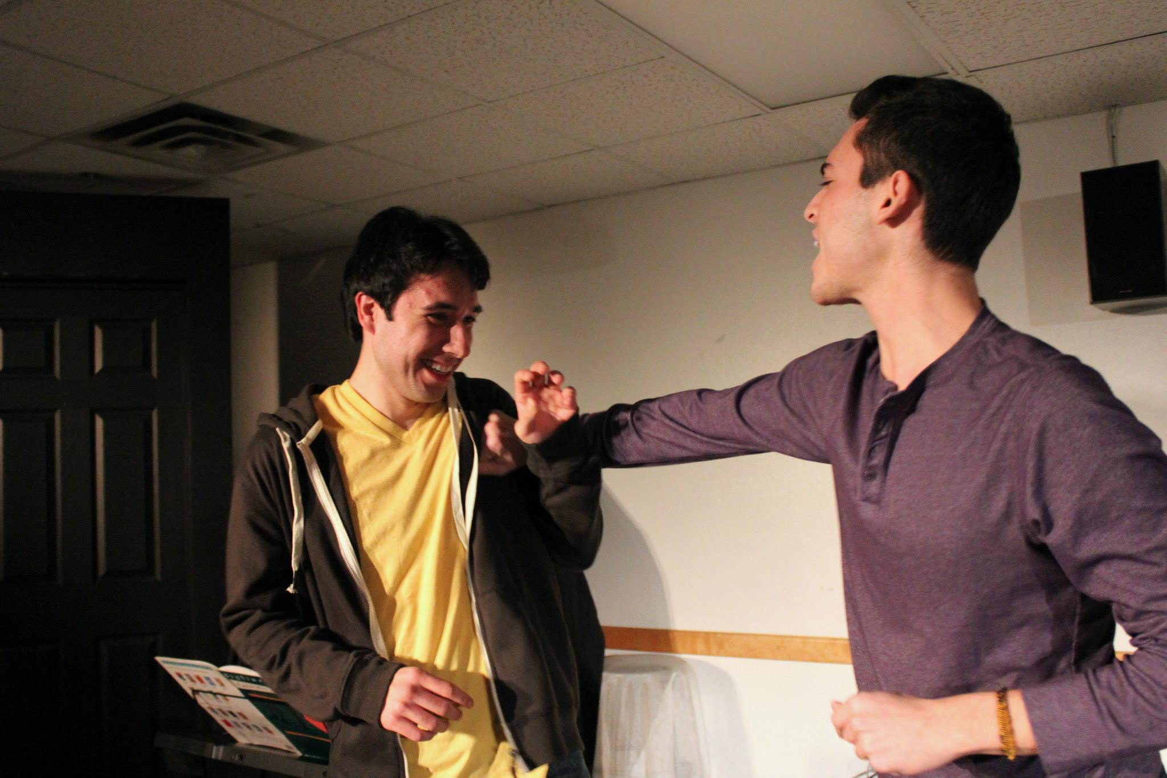

Slide 44
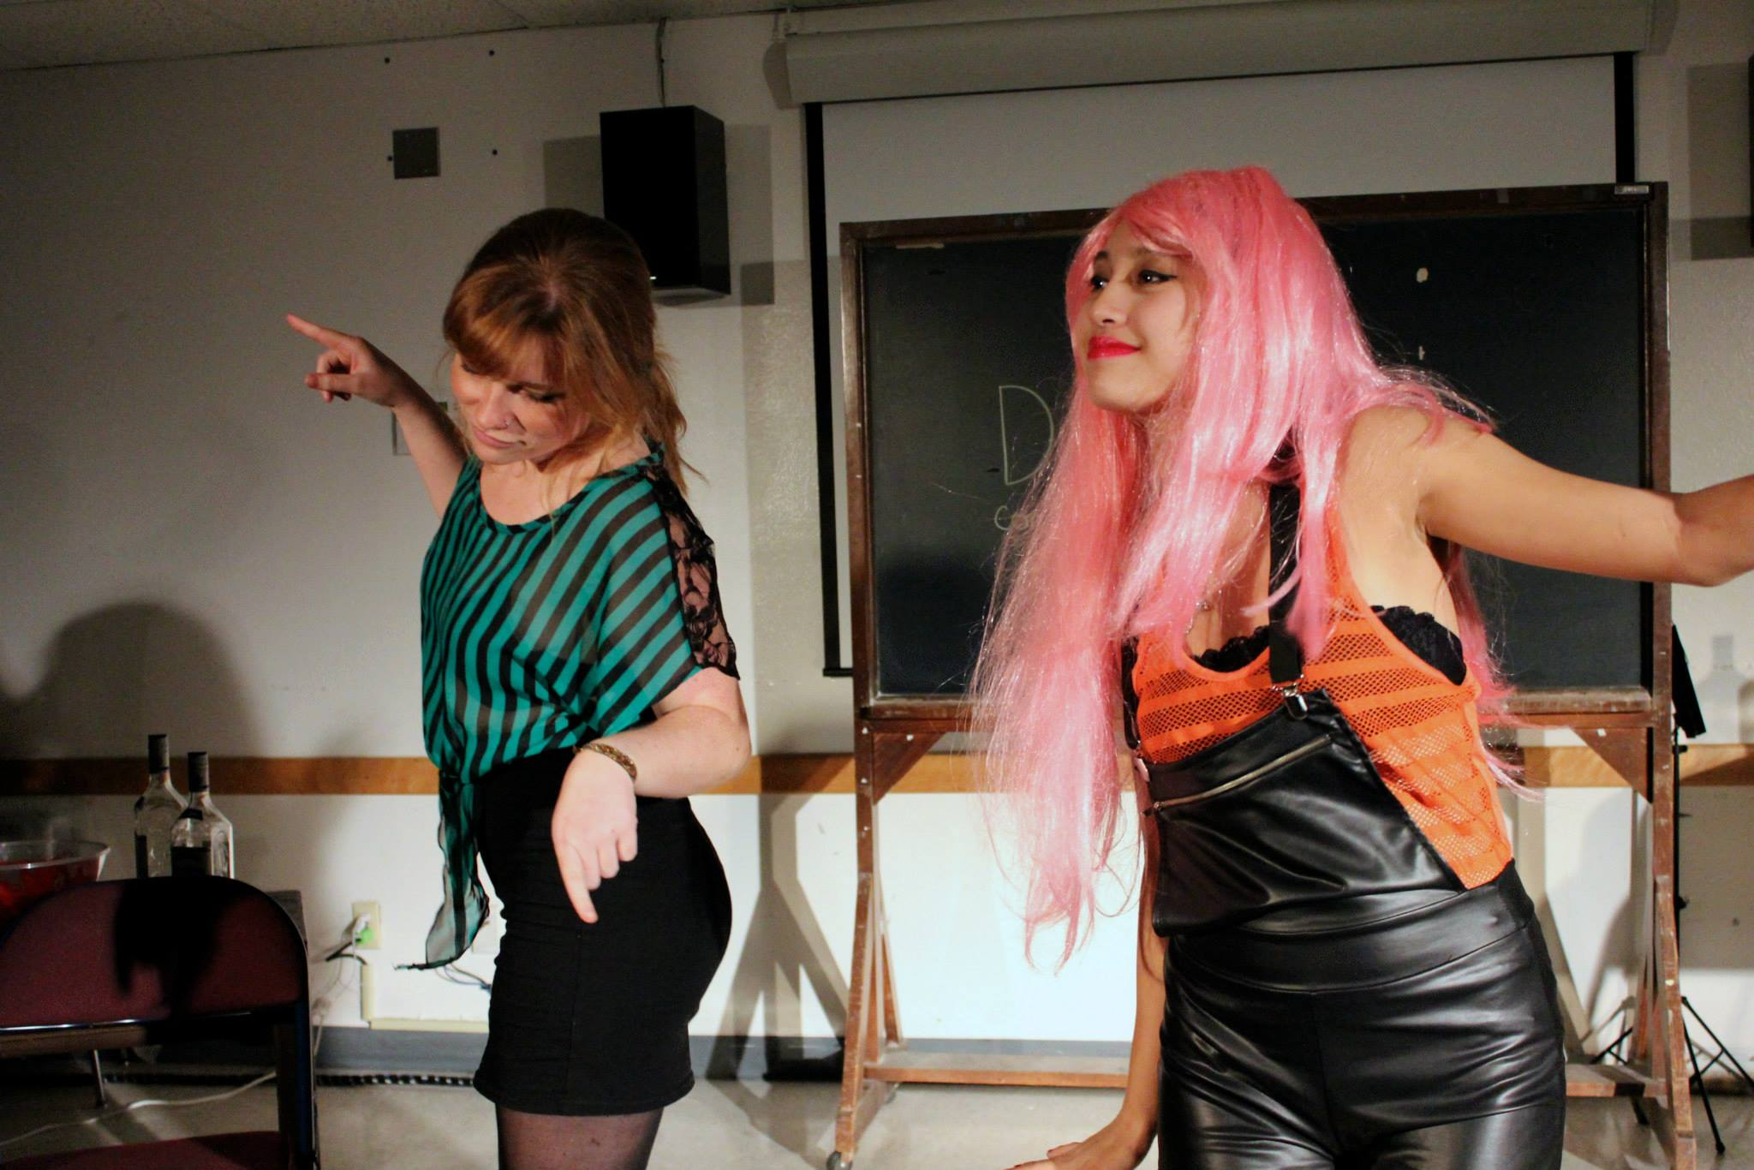

Slide 45
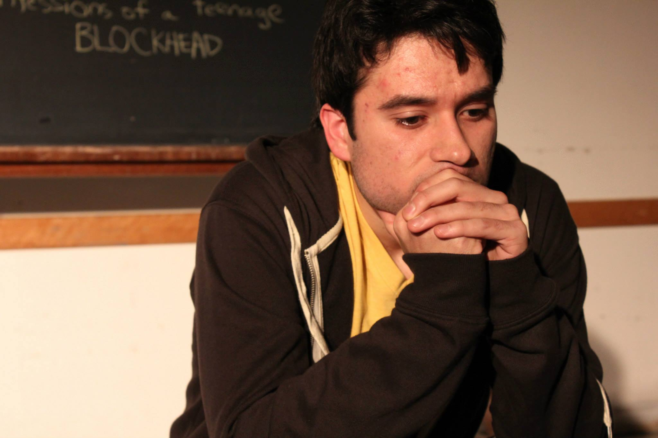

Slide 46
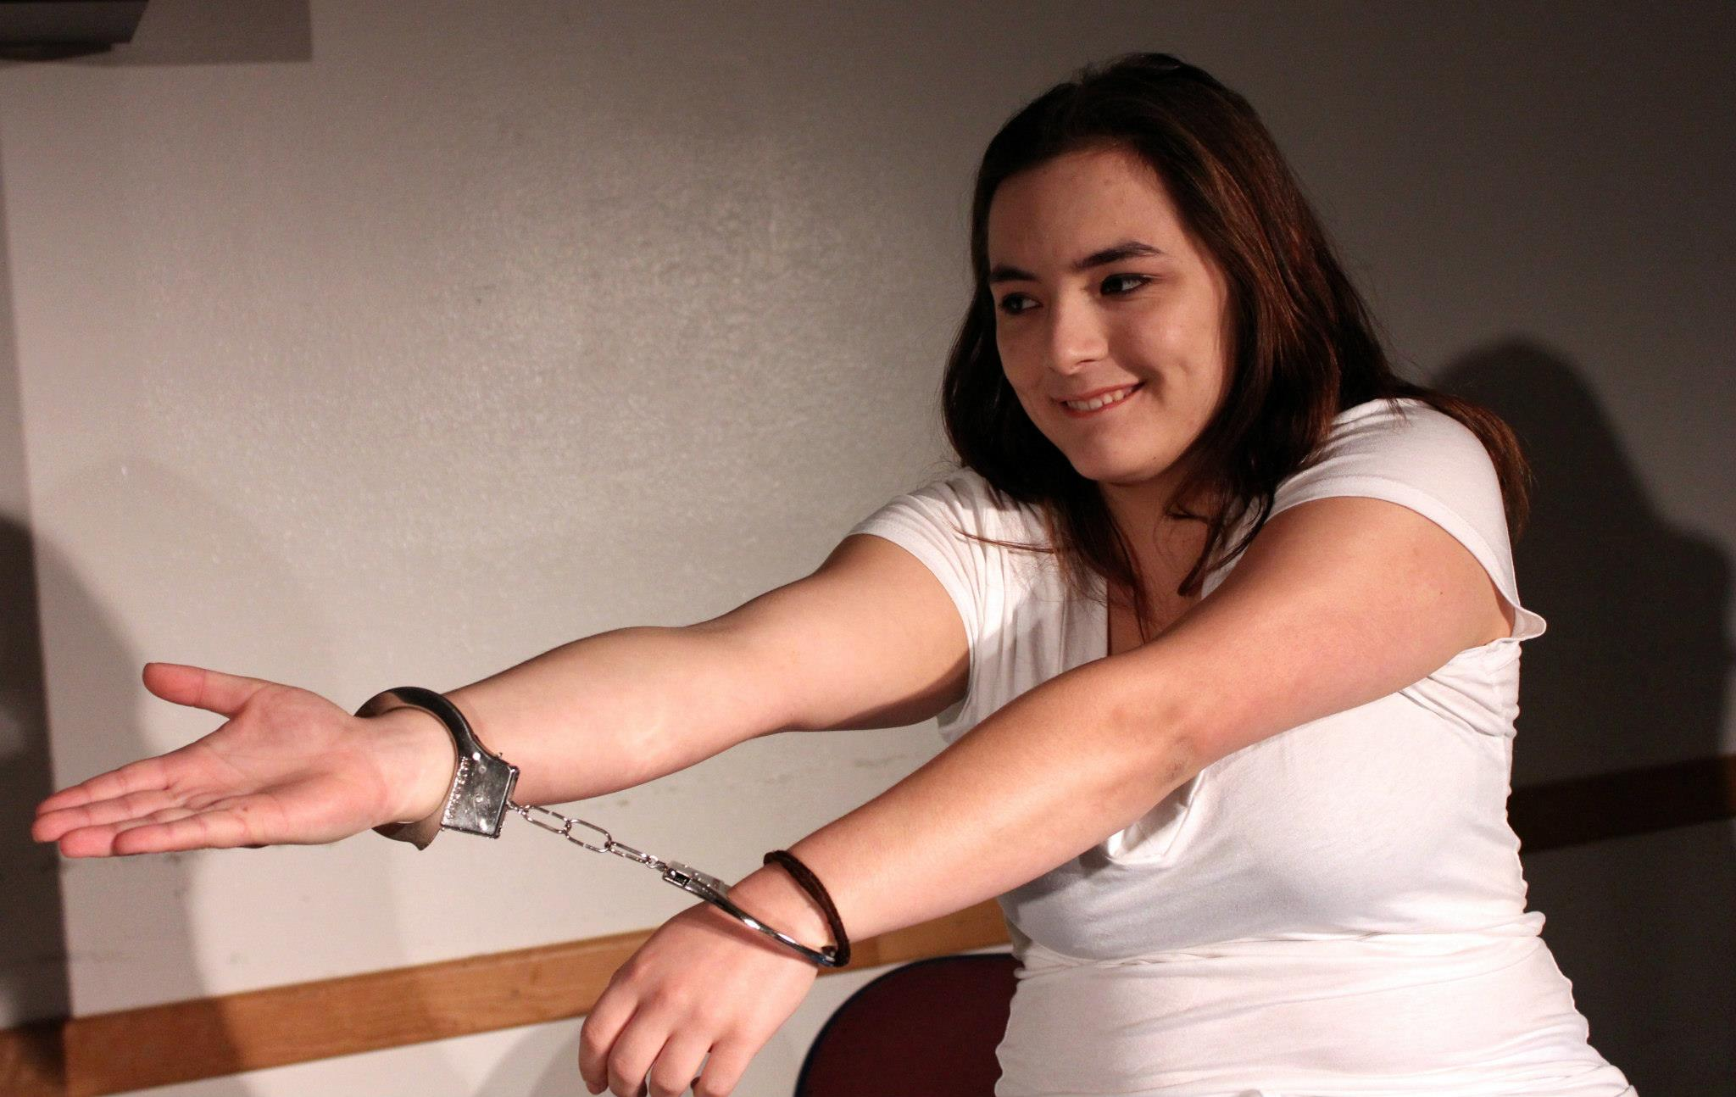

Slide 47
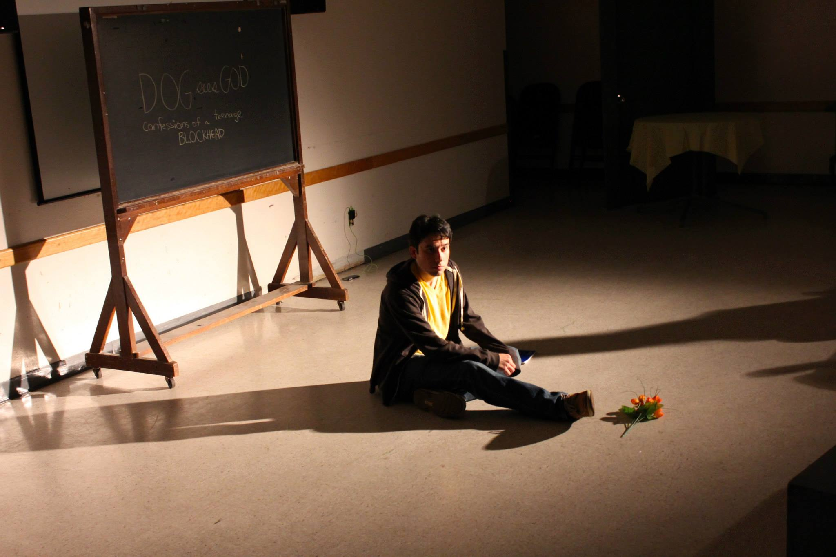

Slide 48
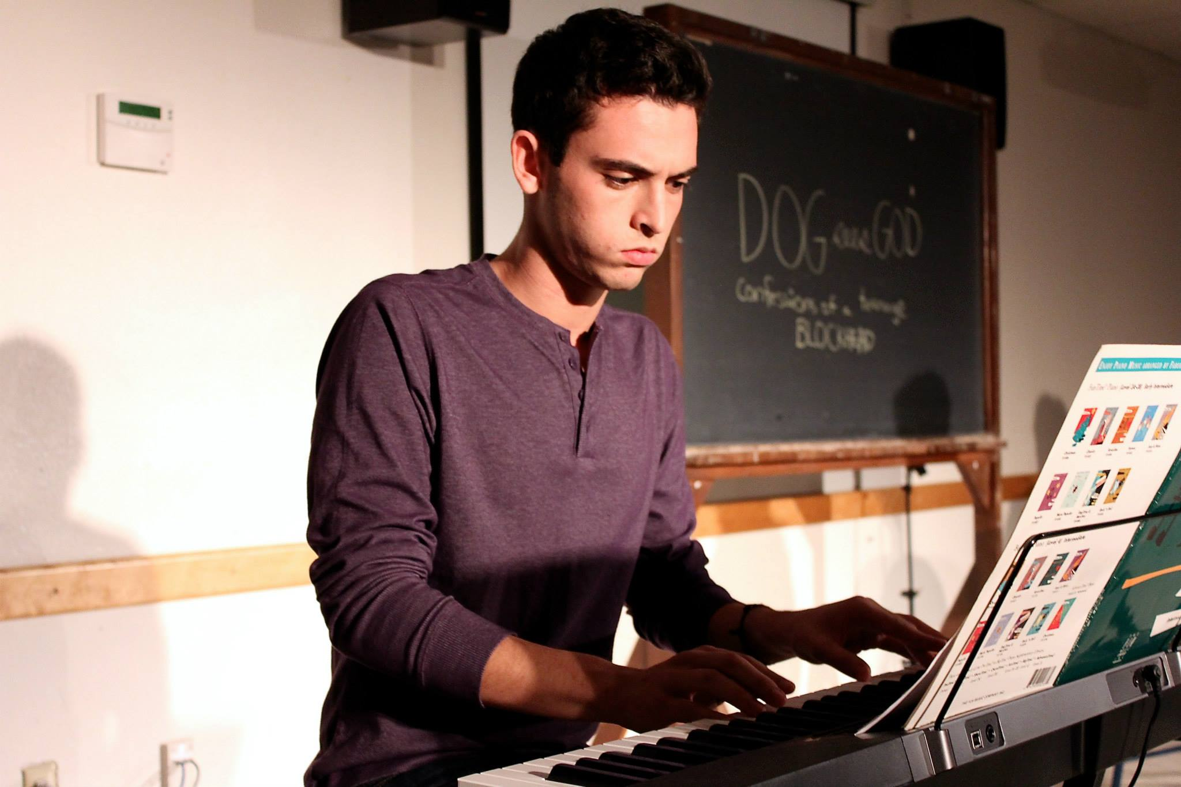

Slide 49
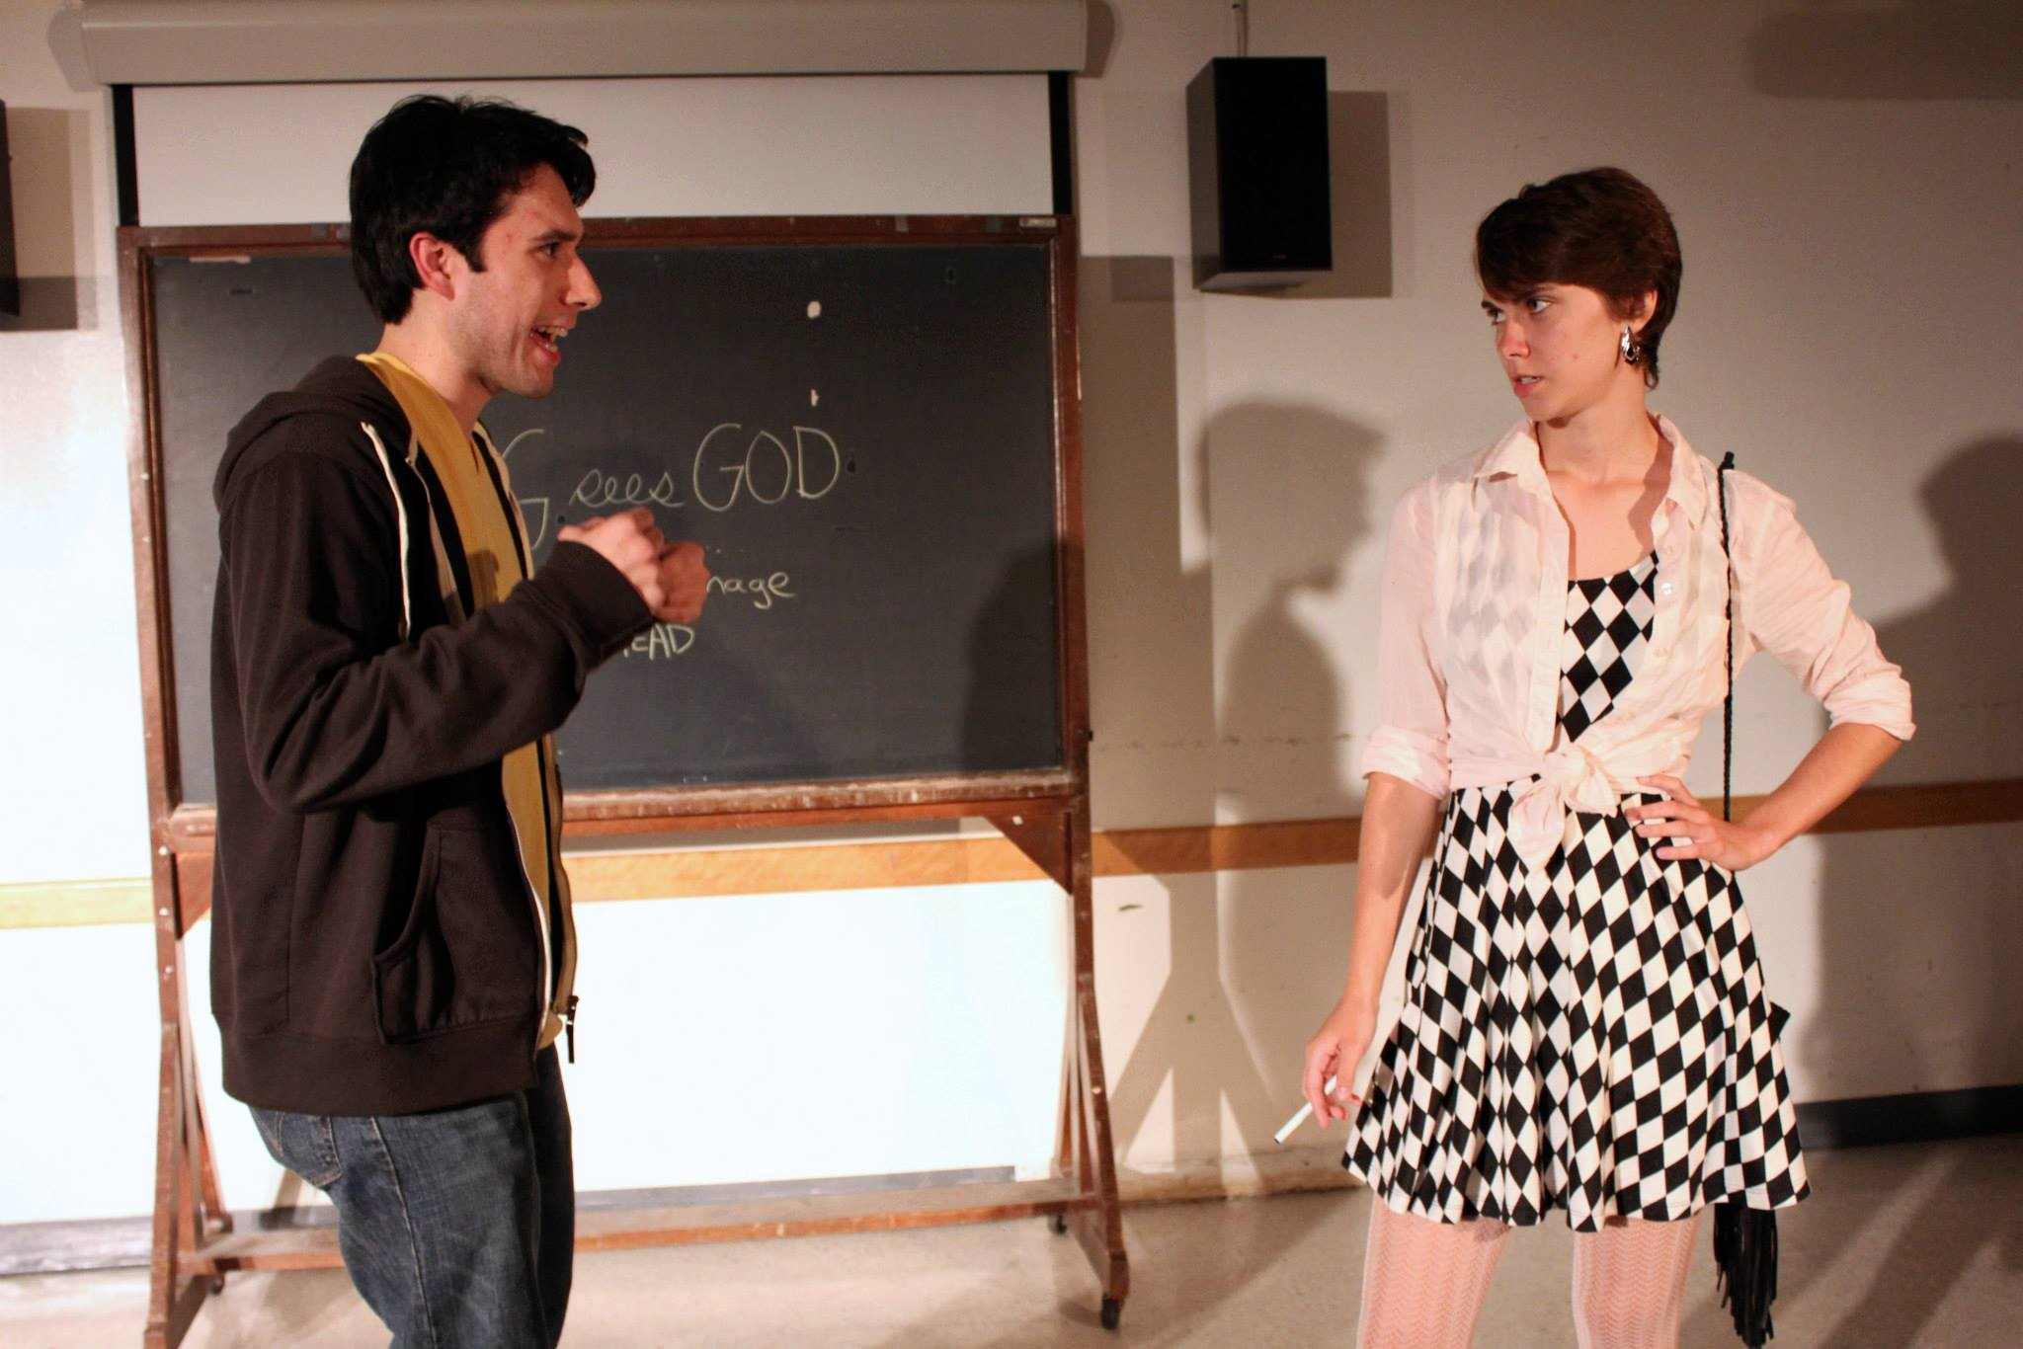

Slide 50
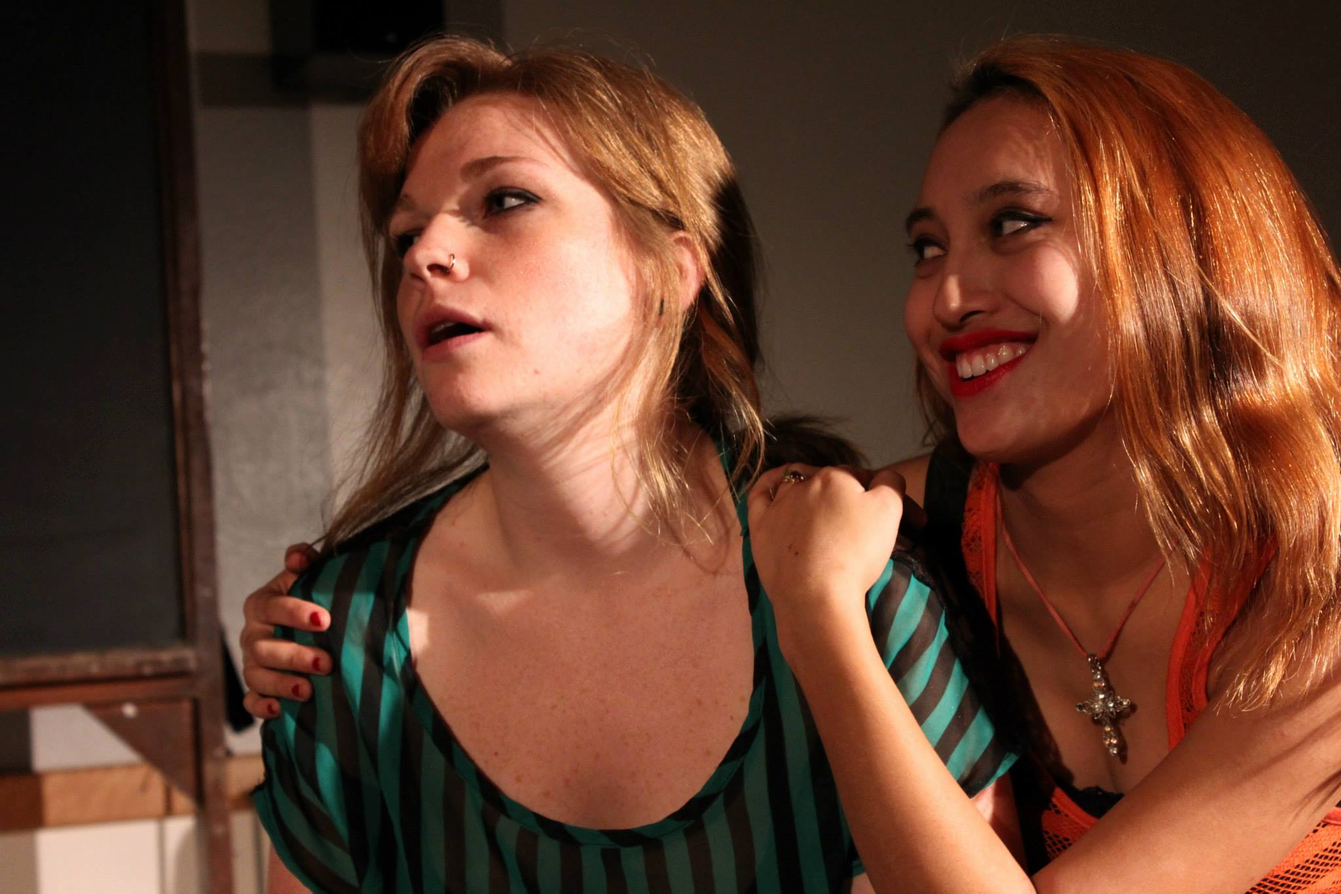

Slide 51
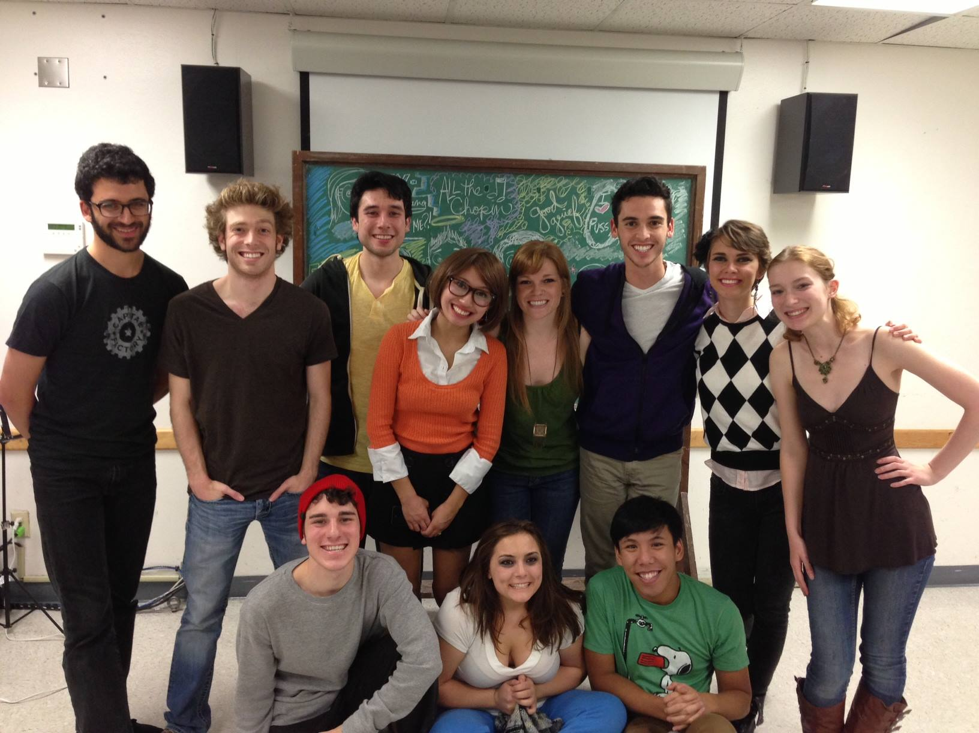
From left to right: Adam Chalmers, Sean Przano, Robert Di Donato, David Barrera, Kat Agudo, Callie Hacker, Julianne Plantes. Jerry Berger, Sean Tecson, Marian Kansas, Kathleen Brown

Slide 52

The Beauty Queen of Leenane
By Martin McDonagh
Directed by Robert Di Donato

Slide 53
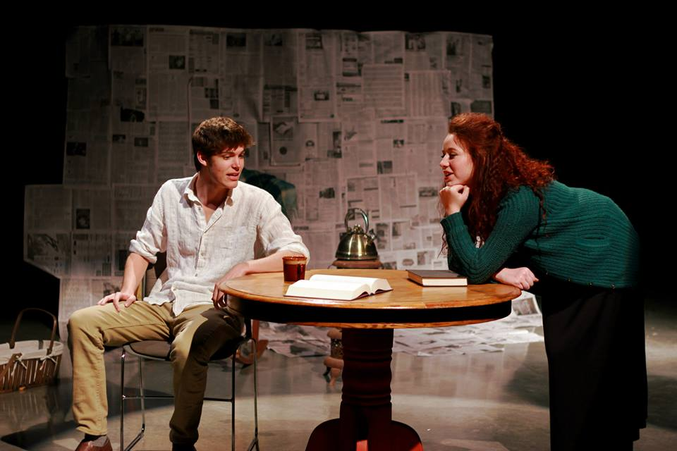

Slide 54
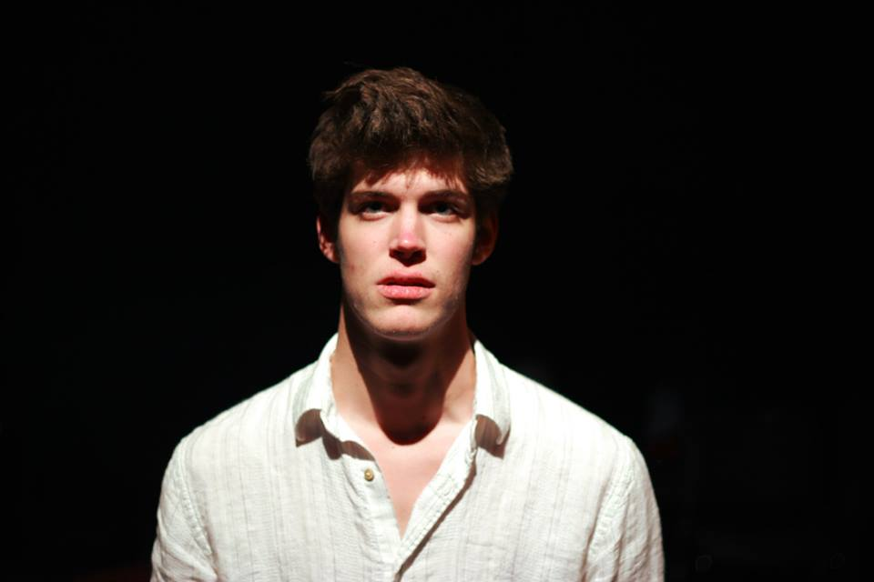
Brennan Patrick as Pato

Slide 55
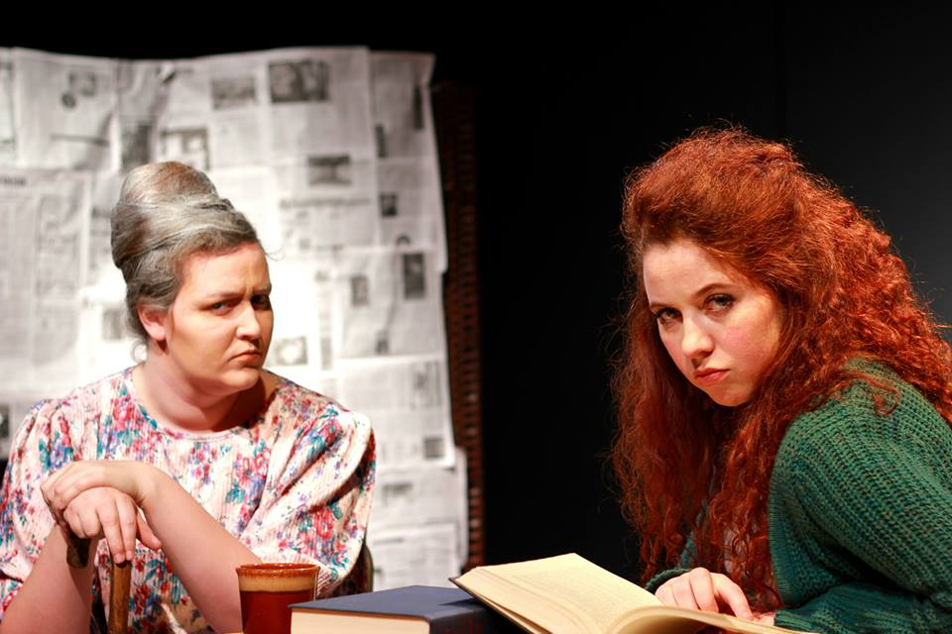
Katie Baskerville As Mag
Caitlyn Thibodeaux as Maureen

Slide 56
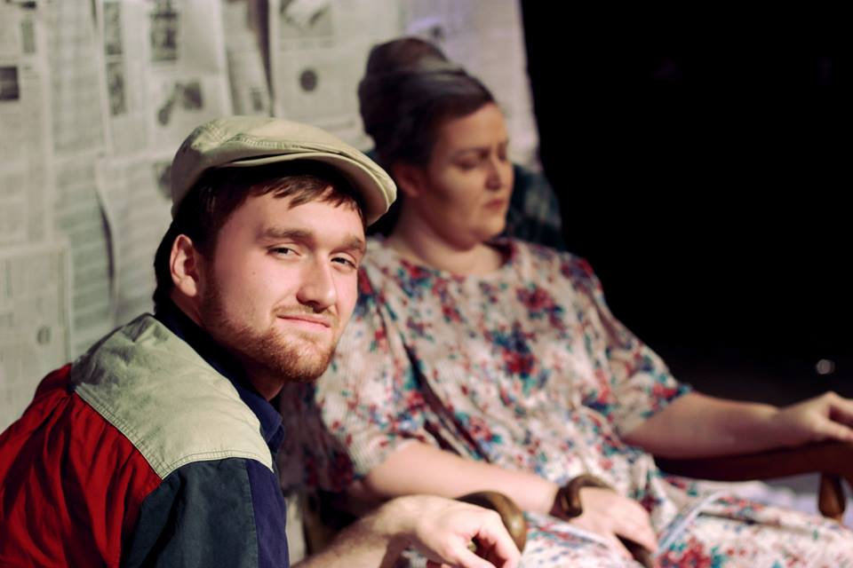
Liam Dolan-Henderson as Ray

Slide 57


Slide 58


Slide 59


Slide 60


Slide 61


Slide 62


Slide 63


Slide 64

Reasons to be Pretty
By Neil LaBute
Directed by Marian Kansas
Beauty Marks
Written and Directed by Anne Urban

Slide 65


Slide 66


Slide 67


Slide 68


Slide 69


Slide 70


Slide 71


Slide 72


Slide 73


Slide 74


Slide 75


Slide 76


Slide 77


Slide 78


Slide 79


Slide 80


Slide 81


Slide 82


Slide 83


Slide 84

From left to right: Sara Roach,
Austin Allie, Sylvia Hinojosa, Andrew
Valdez, Charlotte York,
Anne Urban, Izabella Arnold

Slide 85

From left to right: Kylie Zeko, Brennan Patrick, Julianne Plantes, Marian Kansas, Sean Przano

Slide 86
RAP’s Fall Season
Wildflower by Lila Rose Kaplan
Directed by Caleb Britton
September 26th, 27th, and 28th in the SAC Blackbox
Really Awesome Plays
Original play submission by students
October 3rd, 4th, and 5th in the SAC Blackbox
LOL V
Improv comedy by students
October 24th and October 26th in the SAC Auditorium
[start] by Abigail Vela
November 1st and 2nd in the SAC Auditorium
When the Rain Stops Falling by Andrew Bovell
Directed by Caitlyn Thibedoux
November 8th and 9th in the SAC Auditorium

