Slide 1

Miss Julie
August Strindberg
Got bored and made a poster

Slide 2

Me
Marian Kansas
4th Year
BA Theatre & Dance with a focus in Directing, BS Advertising

Slide 3
Synopsis
Miss Julie, the young daughter of a wealthy count, has recently shamed her family by breaking off her engagement. She becomes attracted to a servant in her household, Jean, who is engaged to Catherine, a cook. After Catherine goes to bed Jean and Miss Julie quickly realize their feelings for one another and consummate the relationship. The next morning Miss Julie is afraid of bringing more dishonor to her family. Jean and Julie consider eloping abroad, but instead Jean convinces Julie the only way to avoid further trouble is suicide. The play ends with Julie leaving with Jean’s shaving razor.

Slide 4
Characters
Miss Julie: a 25-ish year old blue blooded aristocrat, flirtatious, wary of subservient relationships with men
Jean: a 25-30 ish servant in the household of Miss Julie, very intimidated by Miss Julie’s father, manipulative, ambitious, smarter than his position
Catherine: 25 ish, fiancé (?) to Jean

Slide 5
Why This Play, Why Now
Why This Play
  Issues of feminism relevant to the concerns of our audience/student body: letting a woman’s worth be defined by her love interests, being taught to be strong like a man, issues with obedience and subservience in relationships with men
  Complex characters for actors close to our age
  An opportunity for me to work on my directing skills in depth with a naturalistic play
Why Now
  Economic issues that relate to recent financial crisis, loss of status and wealth becomes personal
  The time change I am planning would set this 1880’s play in a time and place familiar to our audience
  Raise questions of feminist issues in relation to this play, the 1920’s and now

Slide 6
1920’s Adaptation (My Vision)
1920s is more familiar in terms of dress and history than 1880’s Sweden, the original setting
1920s was famous for decadence and changing ideals of a younger generation (Miss Julie), like the original setting, and cynicism towards the “lost generation” (Jean)
Women’s roles began to change in the 1920s, and Miss Julie experiences some gender confusion during her childhood as she was growing up and was taught masculine skills (like horseback riding and hunting)
Impending doom for the play also includes the historical context as World War II and economic downfall in the future

Slide 7
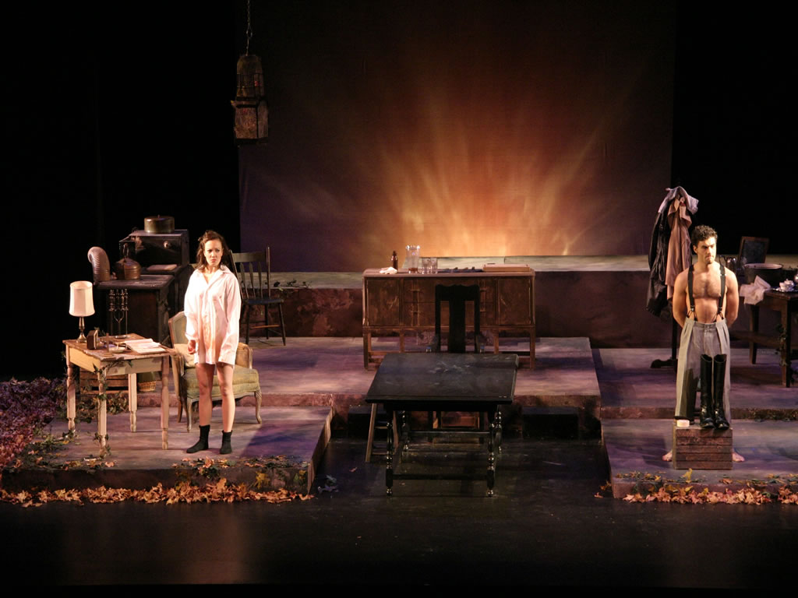
Set Inspiration/Vision

Slide 8
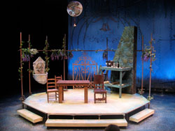
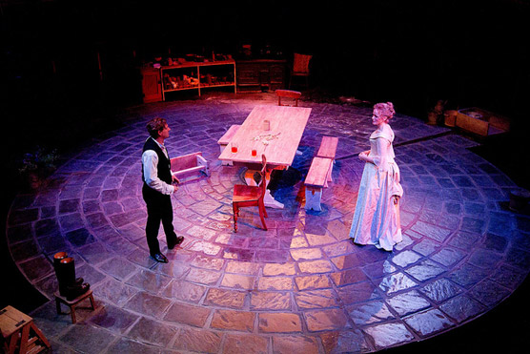

Slide 9
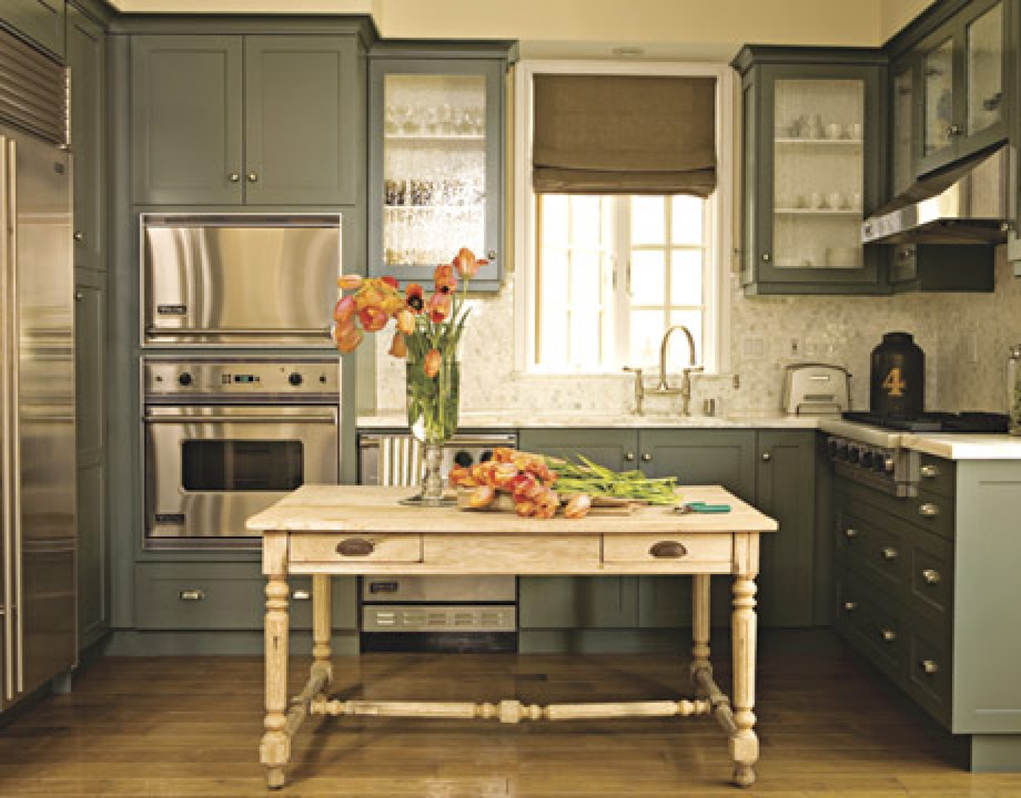
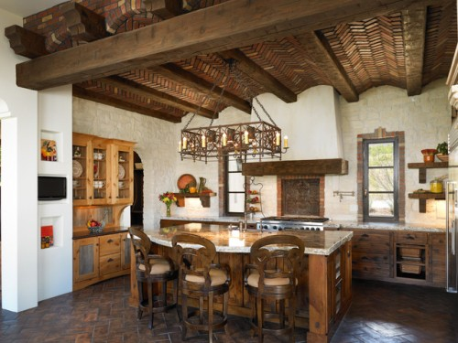
Colors: Off white, pale pinks and purples, cadet blue, mahogany
Textures: painted wood, varnished wood, brick, cast iron

Slide 10
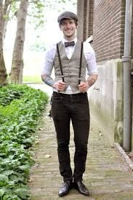
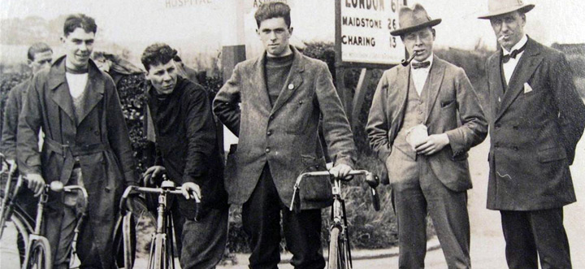
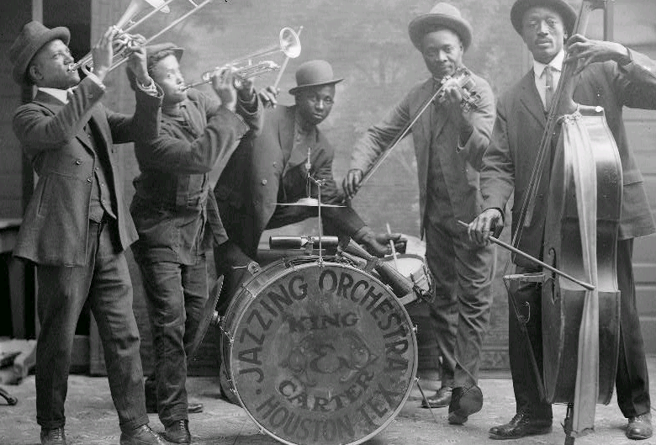
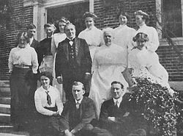
Costume Inspiration/Vision
Jean

Slide 11
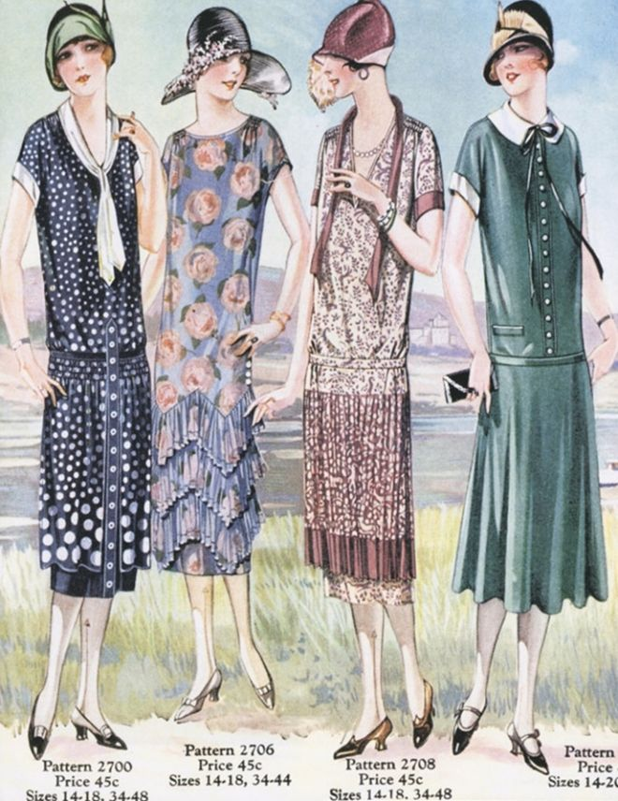
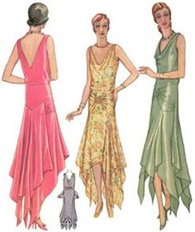
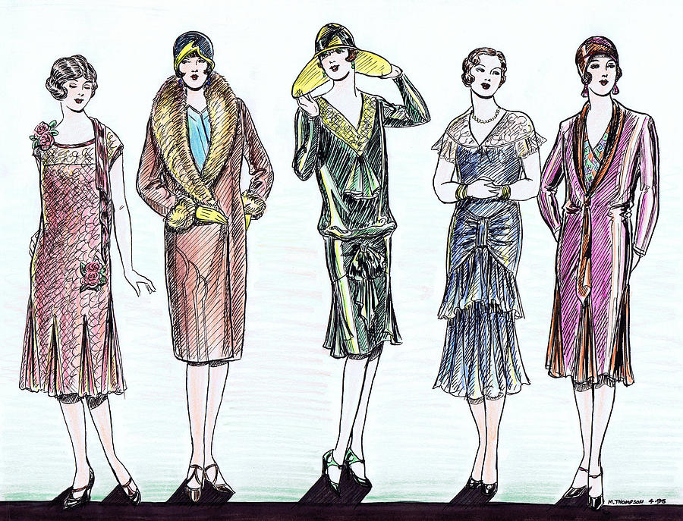
Julie

Slide 12
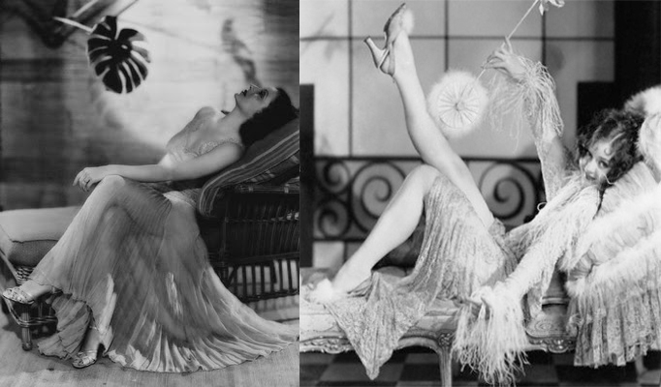
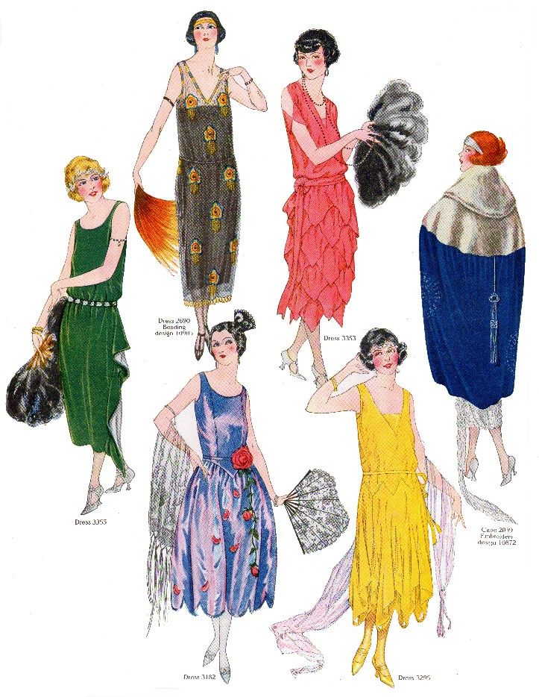
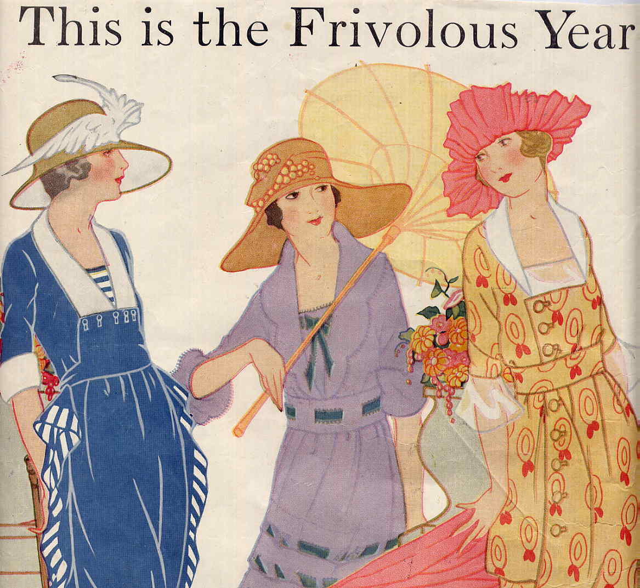
Julie

Slide 13
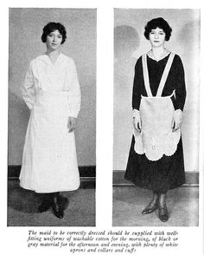
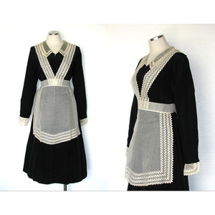
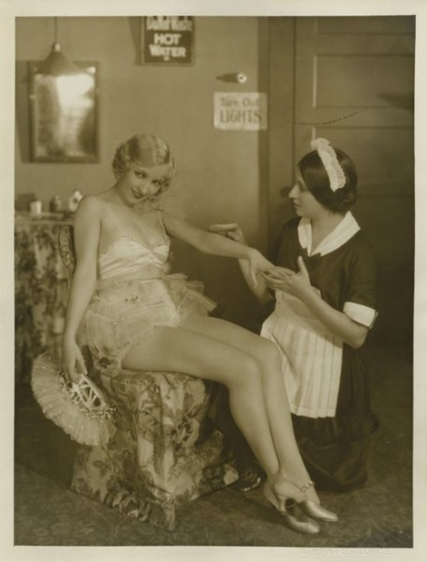
Catherine

Slide 14
Creative Challenges for Me
This play allows me to really delve into the three lives of these complex characters because it’s such a small cast. Naturalism takes into account all of the forces that act on a person and determine their behavior, and creating such a complete world will be difficult
The adaptation I’m proposing means I will need to be familiar with both the original time period and adaptation time period (lots of fun dramaturgical work).
This play will be my first attempt at working on a Naturalistic play, and trying to adhere to certain principles of Naturalism that advance the action or message of the play will be challenging.
I would like to set this play in the Auditorium in Rainey Hall, which is more of a lecture space than a performance space, so that will be challenging in terms of staging.

Slide 15
Creative Challenges for Actors
These are very complex characters. Actors will be challenged to make sense of these characters and portray them truthfully. (Strindberg in the introduction says “I have made my figures vacillating, out of joint, torn between the old and the new”).
This allows actors to work within a genre (Naturalism) that may not be familiar to them, and is not frequently produced.
This show will be physically exhausting, especially for Jean and Miss Julie. I will challenge my actors to maintain a connection and live truthfully throughout the entire production.

Slide 16
Creative Challenges for Technicians
The small budget for this production will force technicians to get creative when creating costumes, set pieces and lighting.
The 1920s is a culturally and historically significant time period in American history, which allows designers a lot of resources to work off of and creative freedom. Creating such a recognizable time period without playing the time period will be difficult.
I would like to perform this play in Rainey Hall, which is a lecture space, which could be difficult for technicians who are used to working in a Black Box theatre.

Slide 17
Message/Theme
I want people to leave this play thinking about the evolution of the modern woman, and what stands in her way to equality. The fight to be seen as equally capable has been going on since the late 1800s, the 1920s, and continues today. Miss Julie as a play and character allows an audience to view the struggles of social Darwinism, and how that affects the development of women’s roles in society.
“the problem of social ascendancy or decline, of higher or lower, of better or worse, of men or women, is, has been, and will be of lasting interest” - Strindberg
“Miss Julia is a modern character, not because the man-hating half-woman may not have existed in all ages, but because now, after her discovery, she has stepped to the front and begun to make a noise” - Strindberg

Slide 18
My Connection
I connect to this piece because as a female I need people to understand just how long the fight to have my abilities and wants considered equal has been. Miss Julie fights her desires and is taught to be like a man, but Jean still manipulates her and discredits her wants and needs. As a female director I have been seen as biased an incapable. This play is important to me because it’s an examination of the struggles of the “modern” woman, and just how long the “modern” woman has been trying to make her way. Miss Julie’s struggle to be herself, socially acceptable, and happy is what I most strongly connect to in this play.
http://shitpeoplesaytowomendirectors.tumblr.com/ (the fight continues!)

Slide 19
My Dedication
I would dedicate this show to my Mom. She is the strongest and most patient women I know. She balances both the traditional female role but being a stay at home Mom for a while, but also earned her teaching certificate in order to pursue a job she really wanted. My Mom’s dedication to both our family and her work is inspiring, and she is an example of what we as women can achieve. Miss Julie, although a tragedy, asks the important questions about what women want and deserve, and voiced feminist concerns since the 1880s that allowed my Mom to be where she is today.

Slide 20
Additional Production Members
Kailey Moore has agreed to be my Assistant Director if chosen.

Slide 21
NEEDS
A stage manager
A costume designer
The auditorium space in Rainey Hall (although if this is unavailable for whatever reason I can figure something out)

Slide 22
WANTS
A set designer
A sound designer

Slide 23
RAP Mission Statement
Miss Julie gives technicians and actors the opportunity to really delve into their work, either by creating full bodied and complex characters or set and costume pieces from a historically rich era. Miss Julie explores issues, like feminism and social mobility, are relevant to our student body and generation. Debates over feminism and how that relates to both the male and female social status are important as women seek equal opportunities in college majors and employment. The debate over meritocracy is also alive and well in our society, generation, and education system. Setting these important issues in the context of an intense personal relationship makes this play engaging, daring, and exhilarating.

